Slide 1

Processed Foods: Insights From Nutrition Science and Regulations
Katarina Smiljanec, PhD, Senior Scientist, Regulatory & Scientific Affairs

Slide 2
Outline
What does
NUTRITION SCIENCE
say?
What are
CLINICAL RESEARCHERS
doing?
How are
REGULATORS & GOVERNMENTS
responding?
Notes:
Nutrition science: WHAT WE KNOW. Inconsistency between established dietary advice and food categorization according to processing
Clinical research: WHAT RESEARCHERS ARE DOING TO ADDRESS GAPS IN THE KNOWLEDGE. Brief overview of ongoing clinical trials that will move the topic forward (what are they doing?)
Regulatory: HOW IT’S TRANSLATED TO DIETARY ADVICE & POLICIES. Overview of processing and UPFs being embedded (or not) in dietary guidelines and labeling around the world (mention that this has downstream implications to policy like school meals and SNAP)

Slide 3
Outline
What does
NUTRITION SCIENCE
say?
What are
CLINICAL RESEARCHERS
doing?
How are
REGULATORS & GOVERNMENTS
responding?
Notes:
Nutrition science: Inconsistency between established dietary advice and food categorization according to processing
Regulatory: Overview of processing and UPFs being embedded (or not) in dietary guidelines and labeling around the world (mention that this has downstream implications to policy like school meals and SNAP)
Clinical research: Brief overview of ongoing clinical trials that will move the topic forward (what are they doing?)

Slide 4
UPF definitions become longer and include more elements
2009
Original NOVA criteria released
3 categories
“The most important factor now, when considering food, nutrition and public health, is not nutrients, and is not foods, so much as what is done to foodstuffs and the nutrients originally contained in them, before they are purchased and consumed. That is to say, the issue is food processing – or, to be more precise, the nature, extent and purpose of processing, and what happens to food and to us as a result of processing.
(Monteiro C 2009; World Nutr)
Today
Current Nova Criteria
4 categories
SAMPLE EXPANDED DEFINITION
Industrial formulations typically with 5 or more and usually many ingredients. Besides salt, sugar, oils, and fats, ingredients of ultra-processed foods include food substances not commonly used in culinary preparations, such as hydrolyzed protein, modified starches, and hydrogenated or inter-esterified oils, and additives whose purpose is to imitate sensorial qualities of unprocessed or minimally processed foods and their culinary preparations or to disguise undesirable qualities of the final product, such as colorants, flavorings, nonsugar sweeteners, emulsifiers, humectants, sequestrants, and firming, bulking, de-foaming, anticaking, and glazing agents.
New elements added:
*Nutrient element – emphasizing salt, sugar, oils, and fats
*Numerical limit on ingredients (clean label)
*Non-availability of ingredients from retail outlets such as super-markets
*Food fortification elements
ORIGINAL DEFINITION
These are made up from group 2 substances (Group 2 is of substances extracted from whole foods) to which either no or relatively small amounts of minimally processed foods (Group 1) are added, plus salt, and other preservatives, and often also cosmetic additives.
*Convenience elements
*Element of “food synthesized in the laboratory”
Definition of UPF
*Numerical limit on food additives
*Accessibility elements
*Palatability elements
(Monteiro C 2009; World Nutr)
Gibney 2019; Curr Dev Nutr
(Moubarac et al. 2017; Appetite)
Notes:
Definition modifications were made over the years, including notable evolutions in 2010, 2012, 2014, 2015, 2016, 2017, took a year off in 2018 and came back strong in 2019, and maybe more? It’s a TRUE moving target.
Examples of elements included:
I put sample in the expanded definition because it’s always a lengthy explanation of what a UPF is. How useful of a grouping category is ‘processing’ if you need 30 caveats and addendums to make the grouping category capture what you want it to capture? It’s either a failure of language or a failure of grouping.

Slide 5
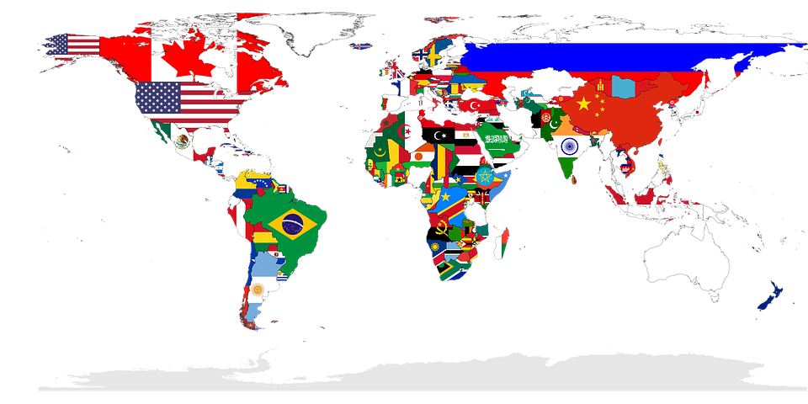
Global (ultra) processed food consumption
Canada
45% kcal
France
36% kcal
16 European Countries
10-46% purchased dietary energy
The UK
53% kcal
Italy
17% kcal
USA
58% kcal
Chile
29% kcal
Brazil
30% kcal
Adams and White, Int J Behav Nutr Phys Act 2015
Cediel et al. Public Health Nutr 2018
Julia et al. Public Health Nutr 2018
Louzada et al. Prev Med 2015
Machado et al. BMJ Open 2019
Martinez Steele et al. BMJ Open 2016
Monteiro et al. Public Health Nutr 2017
Nardocci et al. Can J Public Health 2019
Ruggiero et al. Public Health Nutr 2021
Australia
42% kcal
Notes:
Main sources of UPFs in the US: breads; cakes, cookies, pies, salty snacks, frozen and shelf-stable plate meals, soft drinks (carbonated), pizza (ready-to-eat/heat), fruit drinks, others <3% EI (Martinez Steele, 2016)

Slide 6
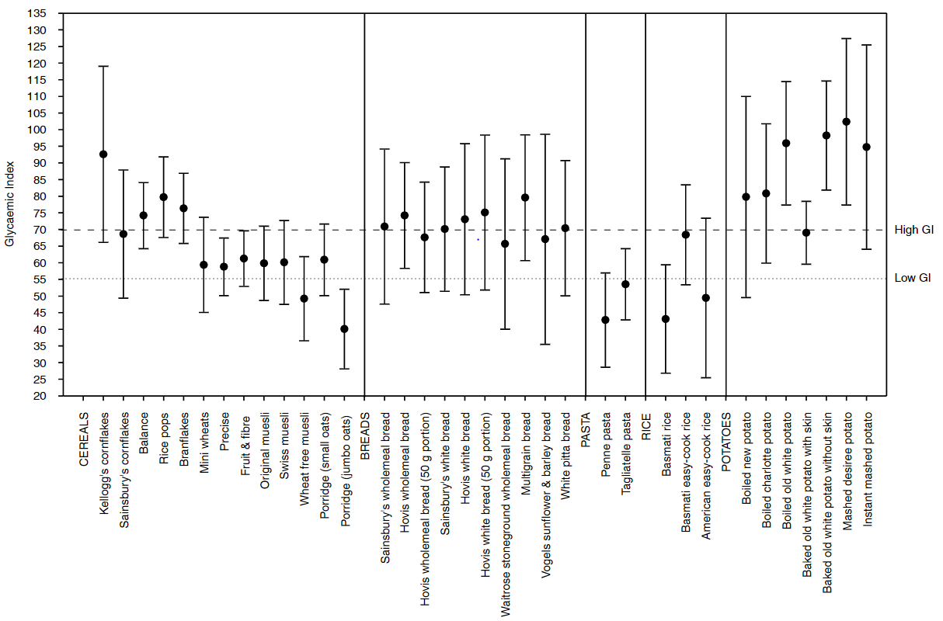
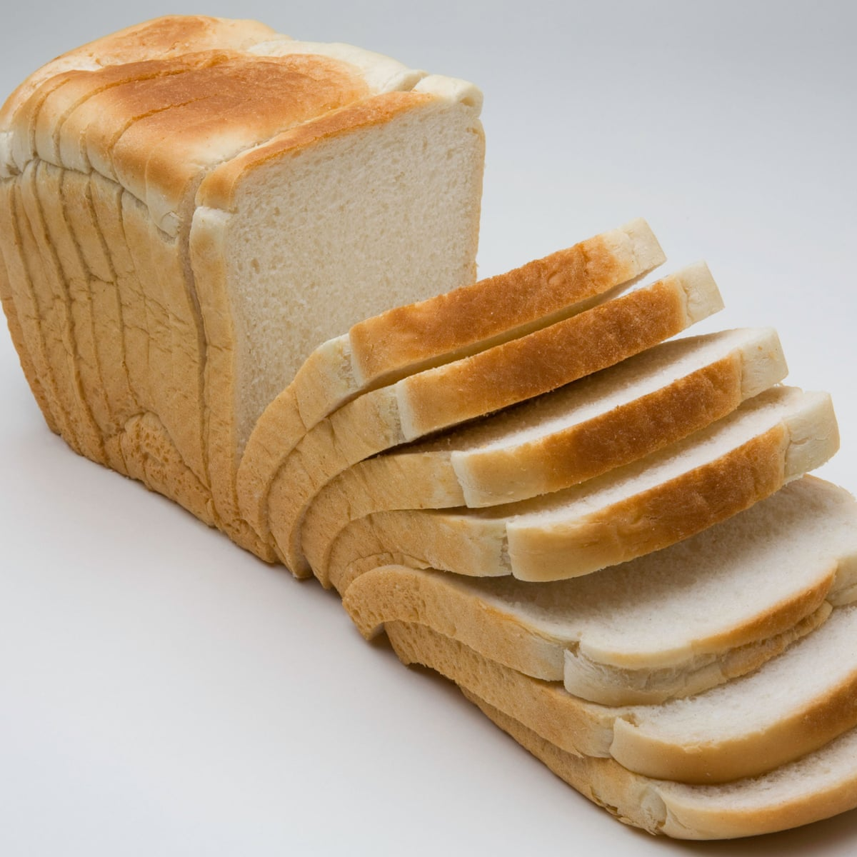
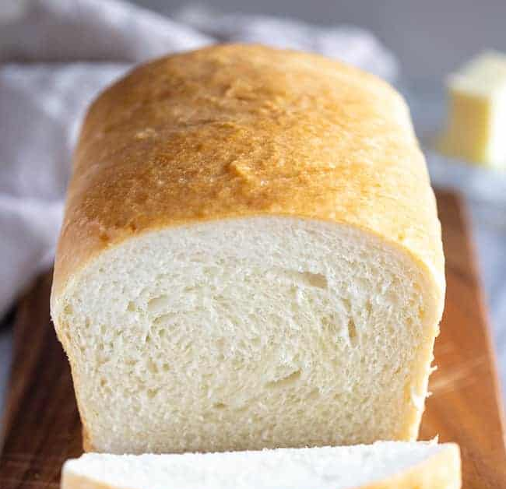
Avoid this…
No difference in GI
...but consume this?
‘Commercial’ pre-sliced white bread
Because this product is ‘mass-produced’ and contains ‘cosmetic additives,’ Nova classifies this as an ultra-processed food and recommends avoidance.
‘Home-made’ white bread
Nova would encourage intake of homemade white bread, despite postprandial glycemia and satiety not differing between the varieties of bread.
Aston et al, 2008; Eur J Clin Nutr

Slide 7
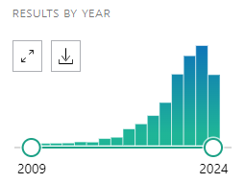
Do we know now more than we did 15 years ago?
In ~1 year:
147
Articles
12
Editorials & commentaries
0
Randomized controlled trials
PubMed: “ultraprocessed food” (8/14/24)
Hess, J. IAFNS Annual Symposium, June 2024.
Since introduction of Nova: 1* randomized controlled trial
Notes:
Primarily observational studies (cross-sectional, secondary analyses, prospective cohort)

Slide 8
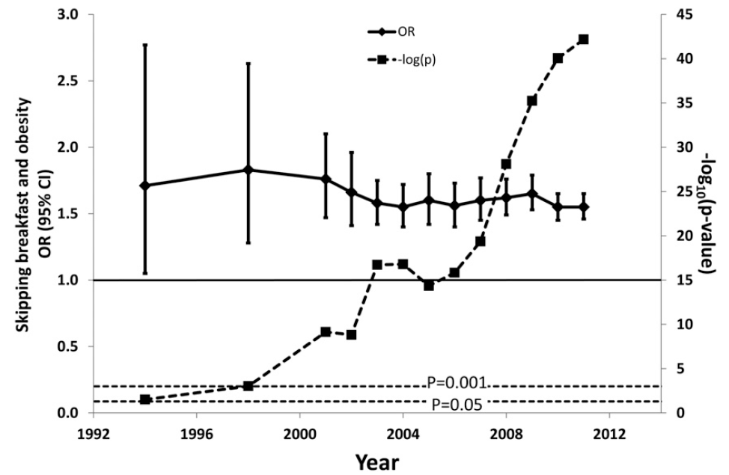
Repeated observational studies do not progress the field
Is skipping breakfast associated with obesity?
92 studies
“…at some point, additional similar observational analyses
will only trivially add to our knowledge.”
Brown, et al. (2013) Am J Clin Nutr. 98:1298-308.
Slide adapted from LE O’Connor; 2023
Notes:
Meta-analysis about the relationship between skipping breakfast and obesity risk, and you can see that the cumulative evidence in the late 90s had already established that association between the exposure and outcome, and that the subsequent obs studies did not really add much more to the knowledge base. Arguing that the time and resources spent on those obs studies could have been dedicated to more causal research approaches to test this hypothesis
Our goal: Identify areas where more causal or experimental research can further our understanding of this working hypothesis, introducing nuance and mechanistic perspectives.
With increasing number of publications, certainty of the strength of the belief increases while strength of evidence remains constant.

Slide 9
What does
NUTRITION SCIENCE
say?
What are
CLINICAL RESEARCHERS
doing?
How are
REGULATORS & GOVERNMENTS
responding?

Slide 10
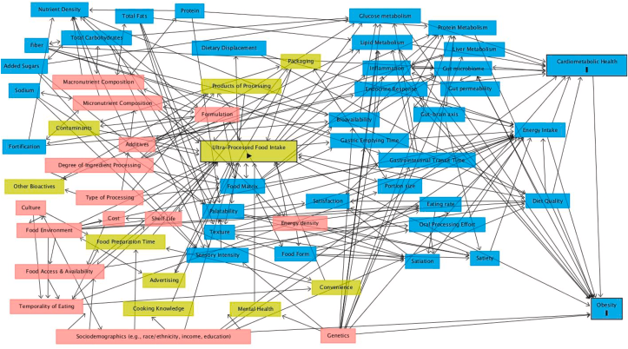
…detangling this!
O’Connor, et al. (2023) Adv Nutr. 14(6):1255-69.
Notes:
UPF associated with NCD → certain UPFs (animal based UPFs, SSBs, artificially sweetened beverages; but not breads, cereals, desserts) → UPF characteristics rather than entire UPF category

Slide 11
Ongoing interventional studies
Study title | (Primary) Outcomes | Principal investigator | Location
Impact of the Eating Rate of Ultra-processed Foods on Dietary Intake Behavior and Metabolic Responses | Energy intake | Ciaran Forde, PhD | Wageningen University
Effect of Ultra-processed Versus Unprocessed Diets on Energy Metabolism | Energy metabolism, eating rate | Kevin Hall, PhD | NIH
Ultra-processed Food Consumption, Gut Microbiota, and Glucose Homeostasis | Insulin sensitivity | Brenda Davy, PhD, RD | Virginia Tech
The Effect of Processing on Food Reward | Glucose response, insulin response, energy expenditure | Alexandra G DiFeliceantonio, PhD | Virginia Tech
Highly Processed Foods and Vascular Health | Vascular function | Kevin Davy, PhD | Virginia Tech
Young Adult Eating Habits | Brain reward processing, executive function | Alexandra G DiFeliceantonio, PhD | Virginia Tech
Ultra Crave: An Investigation of Ultra-Processed Food | Withdrawal symptoms, motivational salience | Ashley Gearhardt, PhD | University of Michigan
Ultra-Processed Foods and Executive Function | Executive function, hunger and satiety hormones | Sam Emerson, PhD | Oklahoma State University
Biobehavioral Reward Responses Associated With Consumption of Nutritionally Diverse Ultra-Processed Foods | Subjective reward responses, energy intake | Erica M. LaFata, PhD | Drexel University
Impact of Ultra-Processed Food Intake on Gingival Tissue Health | Gingival tissue health | Nicola Discepoli, DDS MSc PhD | University of Siena
Energy intake, glycemia, vasculature
Central nervous system
Oral health
Source: Clinicaltrials.gov. Filters: interventional studies + recruiting. Accessed Aug 7, 2024.

Slide 12
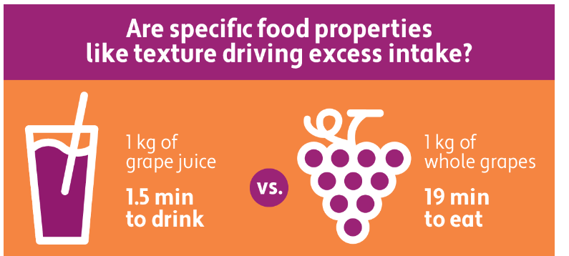
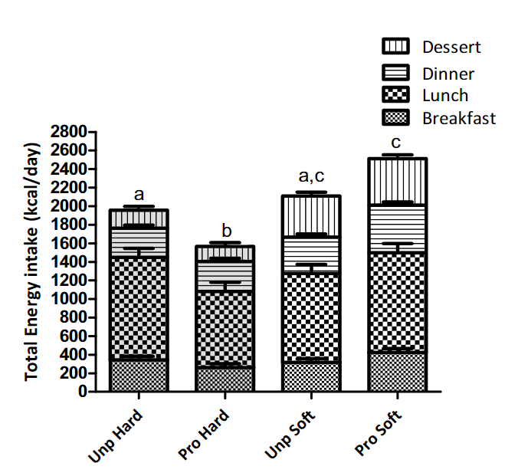
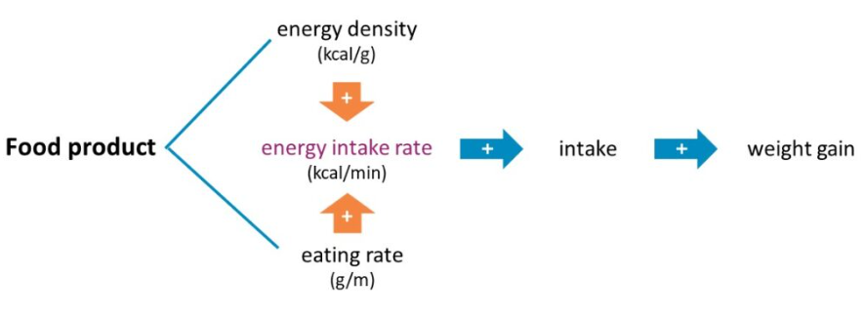

Differences in food texture affect energy intake
Modifying food textures reduces daily calorie intake (33%) and food intake (14%)
~950 kcal difference
Lasschuijt, M; et al. (2023) Eu J Nutr. 62: 2949-2962.
Notes:
Restructure -

Slide 13
What does
NUTRITION SCIENCE
say?
What are
CLINICAL RESEARCHERS
doing?
How are
REGULATORS & GOVERNMENTS
responding?
Notes:
Nutrition science: Inconsistency between established dietary advice and food categorization according to processing
Regulatory: Overview of processing and UPFs being embedded (or not) in dietary guidelines and labeling around the world (mention that this has downstream implications to policy like school meals and SNAP)
Clinical research: Brief overview of ongoing clinical trials that will move the topic forward (what are they doing?)

Slide 14
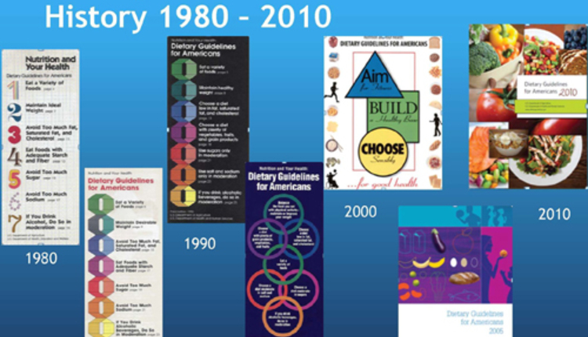
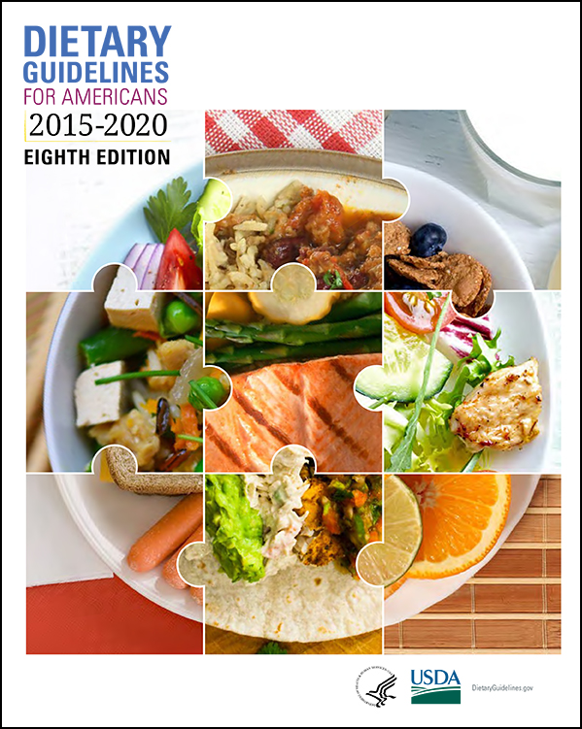

Will processing be included in the US dietary guidelines?
Focus of US Dietary Guidelines
1980
2000
2015
2025
Single Nutrients
Food-based
Dietary Patterns
Processing Level
What is the relationship between consumption of dietary patterns with varying amounts of ultra-processed foods and growth, size, body composition, risk of overweight and obesity, and weight loss and maintenance?
LIMITED EVIDENCE
Notes:
Limited evidence in children, adolescents, adults, and older adults
No conclusion drawn for infants, young children, pregnancy/postpartum
Many Unknowns: Limited direct evidence, No scientific consensus, Implications for nutrition programs, federal policy

Slide 15




Differing opinions globally on including ultra-processing in dietary guidance: FOR
Avoid ultra-processed foods. [They] are nutritionally unbalanced…Their means of production, distribution, marketing, and consumption damage culture, social life, and the environment. (2014)
Base your diet on natural foods and avoid the consumption of ultra-processed products. (2016)
Uruguay
Homemade meals with fresh or natural foods are preferred. They are healthier and cheaper. Avoid consumption of ultra-processed foods… (2020)
Avoid ultra-processed products with ‘HIGH IN’ labelling. (2022)

Slide 16




Differing opinions globally on including ultra-processing in dietary guidance: AGAINST
It is unclear to what extent observed associations between (ultra-) processed foods and adverse health outcomes are explained by established nutritional relationships between nutritional factors and health outcomes…(2023)
…not to associate the term ultra-processed with foods of poor nutritional quality as this does not depend solely on the intensity or complexity of processing but the final composition of the food itself. (2020)
…categorization of foods as ultra-processed foods does not add to the already existing food classifications and recommendations...(2023)
Notes:
UK - Scientific Advisory Committee on Nutrition (SACN) Scientific Advisory Committee on Nutrition (SACN)
SPAIN - Report of the Scientific Committee of the Spanish Agency for Food Safety and Nutrition (AESAN) on the Impact of Consumption of Ultra-processed Foods on the Health of Consumers

Slide 17

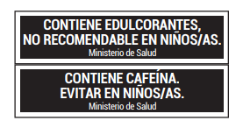


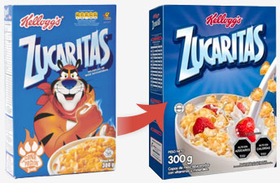
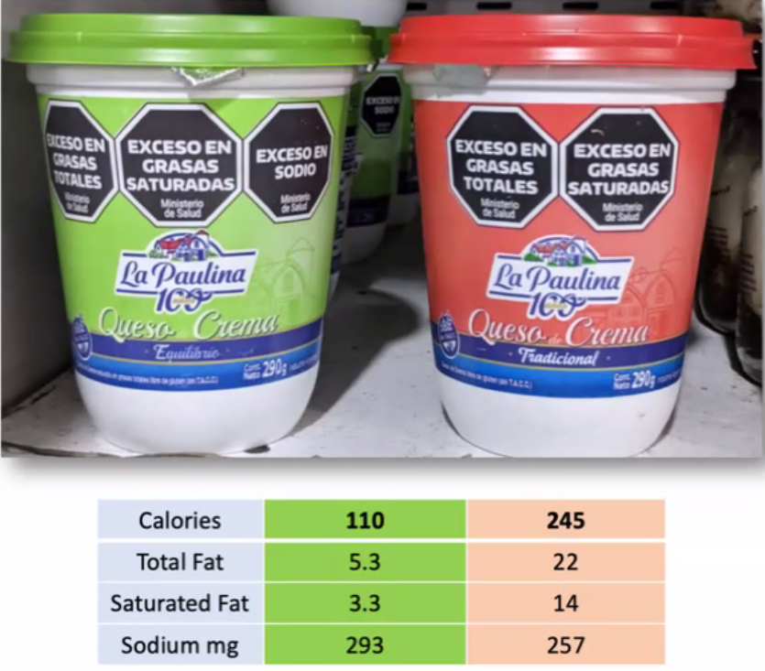
Labeling, advertisements, and fiscal policies
Adapted from S. Socolowsky
Notes:
REFORMULATION IS HINDERED. Studies show purchases are reduced, however no evidence of better health outcomes, only modeling. Of course, these will need long term monitoring.
Studies show that even professionals (nutritionists, food scientists, dietitians, health professionals) misclassify UPF even when highly certain they are correct!
Main sources of UPFs in the US: breads; cakes, cookies, pies, salty snacks, frozen and shelf-stable plate meals, soft drinks (carbonated), pizza (ready-to-eat/heat), fruit drinks, others <3% EI (Martinez Steele, 2016)

Slide 18
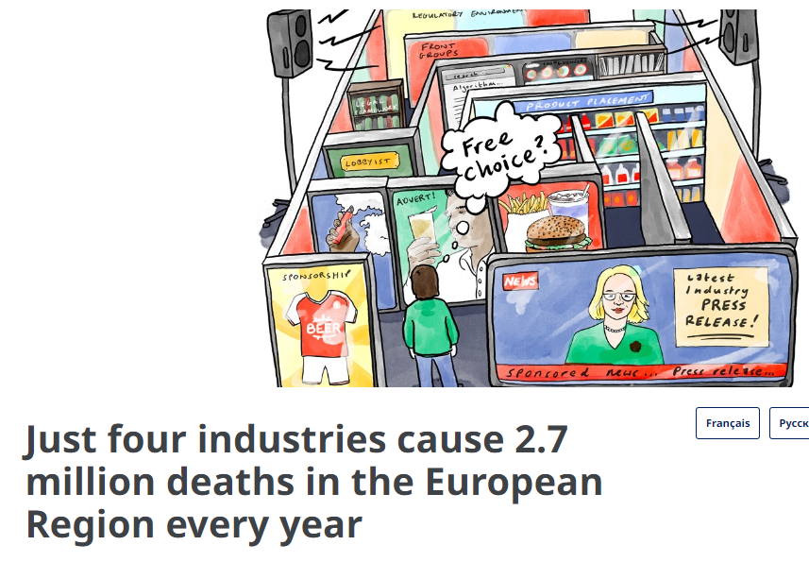


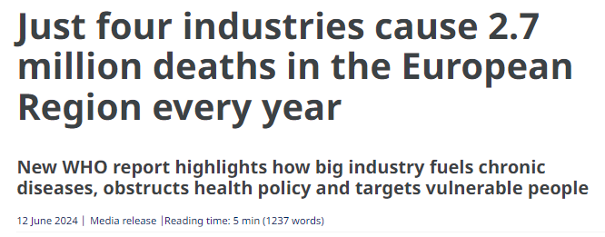
WHO & IARC increase global attention to processed foods
UPF consumption 2025-2029 HIGH PRIORITY evaluation
Night shift work
Glyphosate
Drinking hot beverages
Pickled vegetables
Ginkgo biloba extract
Aspartame
HAZARD
RISK
vs.
Notes:
tobacco, ultra-processed foods, fossil fuels and alcohol – cause 19 million deaths per year globally, or 34% of all deaths
IARC carcinogenicity evaluations; detailed report expected in Q3 2024
WHO/FAO Joint statement on principles of a healthy diet – Sept 2024; “healthy diets are moderate in (or avoid) non-essential nutrients (e.g. free sugars) and foods associated with negative health outcomes (e.g. UPFs)

Slide 19


To summarize:
Definition of “ultra-processed” foods conflicts with nutrition science and food science.
Scientists are researching which “ultra-processed” foods features may cause negative health effects.
Scientists, regulators, and governments are including “ultra-processing” in the dietary guidelines, labeling, and policies.

