Slide 1




Ultra-Processed Foods:
What are we missing by focusing on the term "Ultra" in processing?
Mario Ferruzzi, Ph.D.
Arkansas Children’s Nutrition Center
University of Arkansas for Medical Sciences

Slide 2
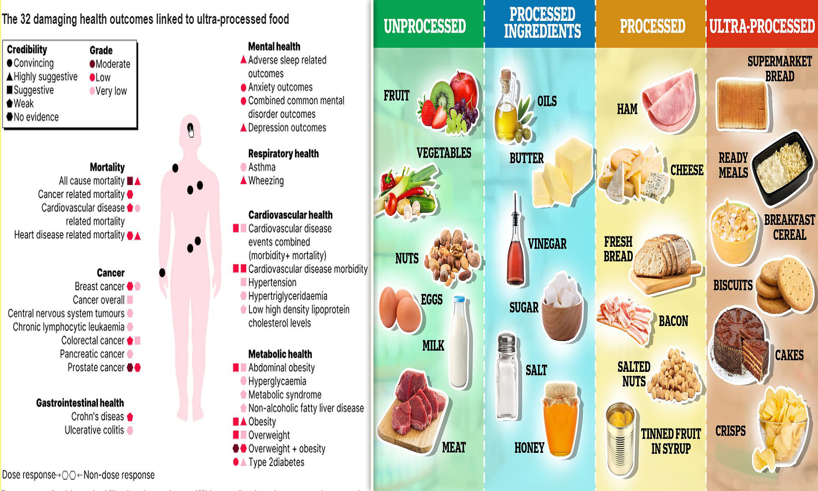

Risk of “ultra-processed” foods is perceived as proven science in the media despite direct evidence for this categorization of food
https://www.dailymail.co.uk/health/article-13135781/processed-foods-cigarettes-expert-cancer-heart-lung-disease.html

Slide 3


Why else are we talking more about this this year?
What is the relationship between consumption of dietary patterns with varying amounts of ultra-processed foods and growth, size, body composition, risk of overweight and obesity, and weight loss and maintenance?

Slide 4
Definitions that are being lost between scientist and consumers…
Food Processing can be defined as the use of methods and techniques involving equipment, energy, and tools to transform agricultural products such as grains, meats, vegetables, fruits, and milk into food ingredients or processed food products
The combination of food ingredients (food formulation) and use of processing step(s) to design a food product with particularly desired attributes (formulated food) is termed as Processed Food
Taken from the “All About Food Processing” at IFT.org

Slide 5

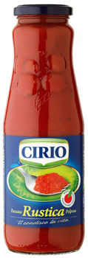
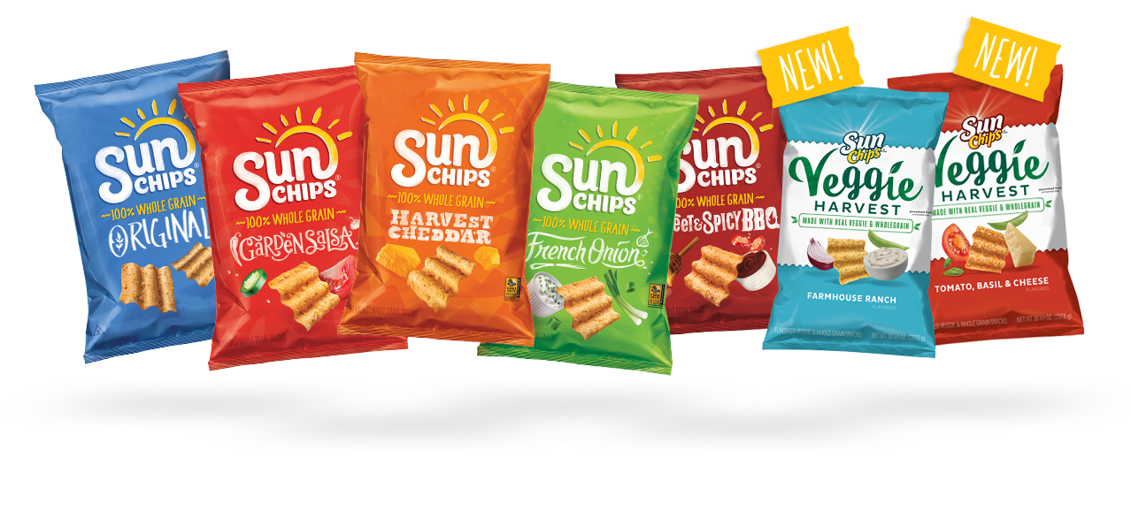
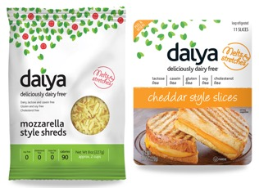
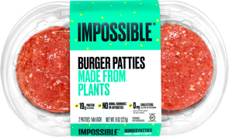

Why do we process foods?
For preservation, safety and quality
Food is inherently perishable
  Contain ingredients from living systems, and living systems deteriorate
  Modes of deterioration can influence safety and quality
Processing offers possibilities to
  Increase product shelf-life
  Improve sensory quality
  Inactivate pathogenic microorganisms
  Add convenience
  Develop new products with new functionalities for new value

Slide 6
Food classification systems:
A brief and complicated history….
2007
NIPH
Mexico
2009
IACR
Europe
2009
NOVA
Brazil
2011
IFPRI
Guatemala
2012
IFIC
USA
2015
Updated
NOVA
Brazil
2015
UNC
USA
2018
Food Standards
New Zealand
2024?
General characteristics for Highly/Ultra-processed foods:
Type and extent of food processing
High degree of formulation and use of ingredients that are deemed to be “synthetic”
General “Industrialization” of the process
Loss of identity from the original food
de Araújo et al. Food Processing: Comparison of Different Food Classification Systems. Nutrients. 2022 Feb; 14(4): 729.

Slide 7




Four classification systems at the center of the conversation for Highly/ Ultra-Processed Foods
Foods that have been industrially prepared, including those from bakeries and catering outlets, and which require no or minimal domestic preparation apart from heating and cooking
Formulations of industrial ingredients and substances derived from foods or else created in laboratories, and typically contain little or even no whole foods.
Foods that have undergone secondary processing into readily edible form, likely to contain high levels of added sugars, fats, or salt
Foods and beverages are multi-ingredient industrially formulated mixtures processed to the extent that they are no longer recognizable as their original plant or animal source.

Slide 8
Generalized summary of how food processing categorizations capture both formulation and processes and aligns with growing consumer perception
Unprocessed Foods
Raw Agricultural
Commodities
Food
Prep/Processing
Minimally
Processed Foods
Processed
Ingredients
Food
Processing
Processed
Foods
Synthetic
Ingredients
Food
Processing
Ultraprocessed
Foods
Food
Identity
Perceived
Nutritional
Quality
O’Connor et al. Perspective: A Research Roadmap about Ultra-Processed Foods and Human Health for the United States Food System: Proceedings from an Interdisciplinary, Multi-Stakeholder Workshop. Advances in Nutrition 14 (2023) 1255–1269

Slide 9

Food formulation is an integral part of food processing that relies on food ingredients and additives
Ingredients have specific roles in food
Food ingredients and additives are regulated by the FDA
Have integral roles in final product including in product quality, safety and nutrition (fortification)
Determination of ingredient use, and level of use, is dependent on many factors
Understanding & predicting ingredient functionality increases in complexity with the number of ingredients used
Example of Key Ingredient Categories
Macronutrient sources (Protein, Lipids, Carbs)
Sweeteners
Texturizers
Thickening/Gelling Agents
Stabilizers/Emulsifiers
Preservatives
Coloring Agents
Flavoring Agents
Fortification Agents

Slide 10
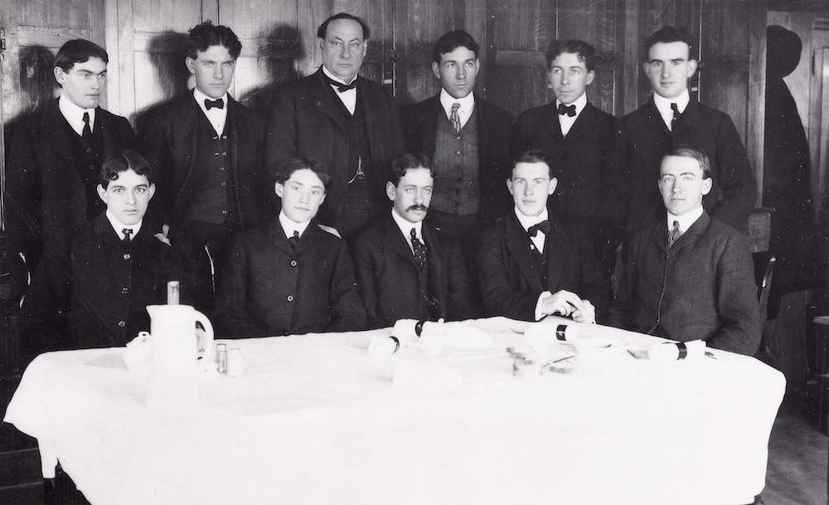
Safety of food ingredients and additives is not a new concept!
Wiley was appropriated $5,000 in 1902 to study the effects of a diet consisting in part of the various preservatives on human volunteers.
Key ingredients of study in early 1900’s:
  saccharin
  bleached flour
  caffeine
  benzoate of soda
Dr. Harvey Wiely M.D. and The Poison Squad
www.fda.gov

Slide 11
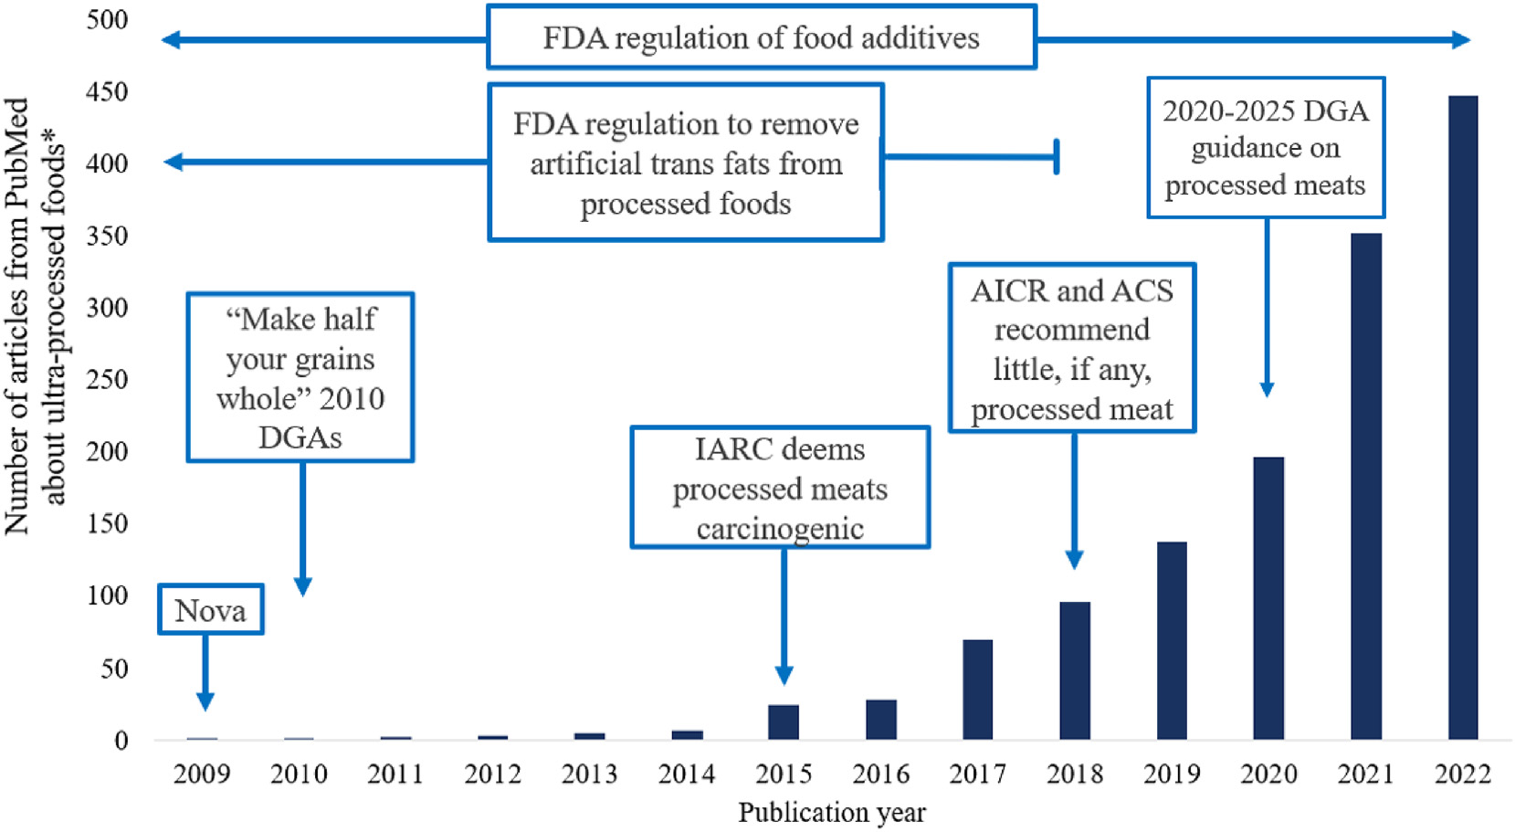
Timeline of select policies related to processed foods mapped onto the influx of research related to ultra-processed foods, as defined by Nova
O’Connor et al. Perspective: A Research Roadmap about Ultra-Processed Foods and Human Health for the United States Food System: Proceedings from an Interdisciplinary, Multi-Stakeholder Workshop. Advances in Nutrition 14 (2023) 1255–1269

Slide 12
What is the evidence base driving the concern with highly and ultra-processed foods?

Slide 13
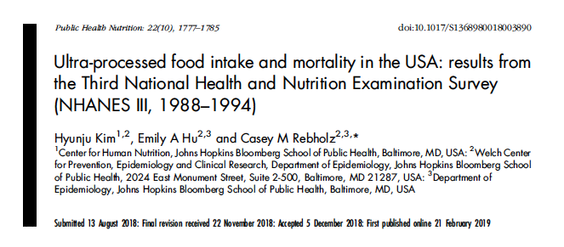
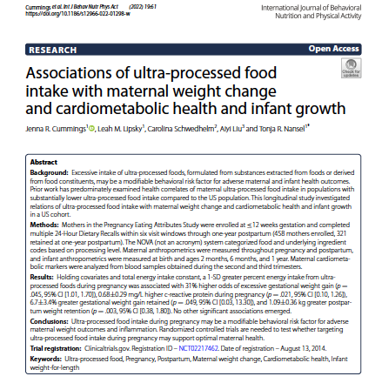
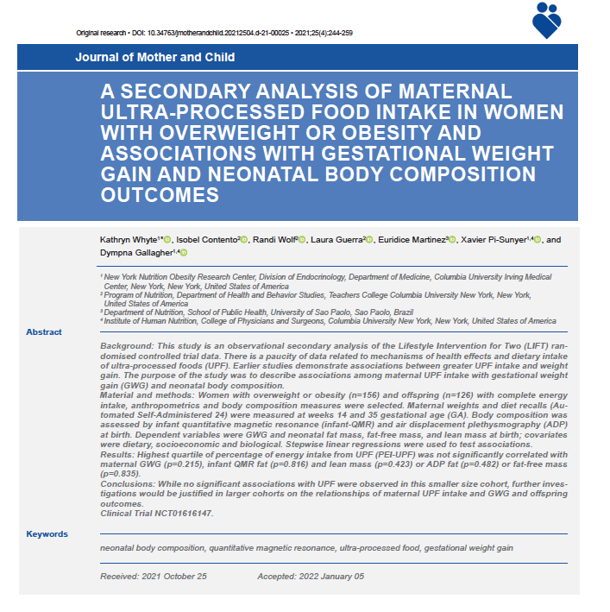
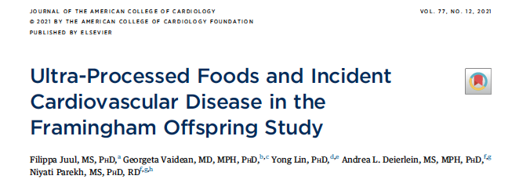

Slide 14
Current evidence heavily based on observational studies with a general lack of clinical and mechanistic studies
Primarily driven by cross sectional studies
Increasing number of longitudinal cohorts
Generally, this area lacks:
  Consistency in application of UPF and HPF definitions
  Consistency in approach
  Rigorous clinical trials
  Deeper mechanistic studies
Tendency has been to jump from observational studies to hypotheses that are not testable or fully actionable

Slide 15
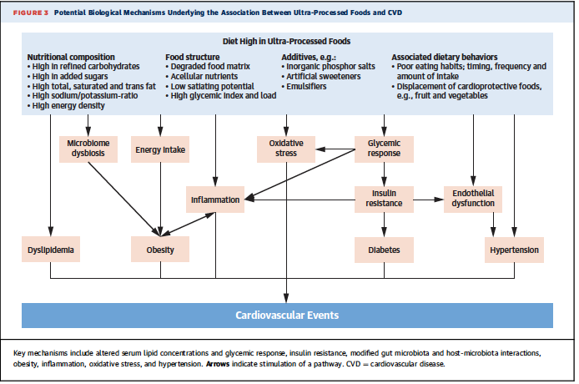
↑ Ultraprocessed food intake = ↑ Energy Intake = ↑ Obesity = ↓ Long Term Health
Juul et al. J American College of Cardiology. 77:12. 2021.

Slide 16
Is this still about nutrition?
Are we just recapturing what we already know about foods with poor nutrient density with UPF definitions?

Slide 17
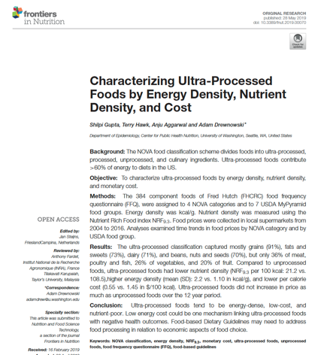
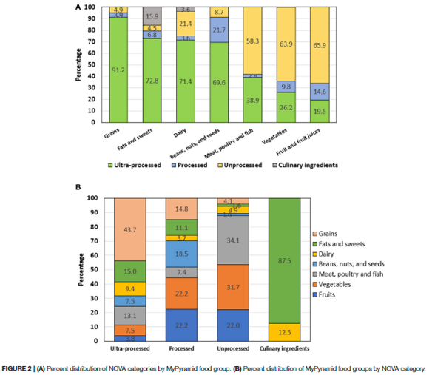
Characterizing ultra-processed foods by energy density, nutrient density, and cost
Gupta S, Hawk T, Aggarwal A, Drewnowski A.. Frontiers in nutrition. 2019:70.

Slide 18
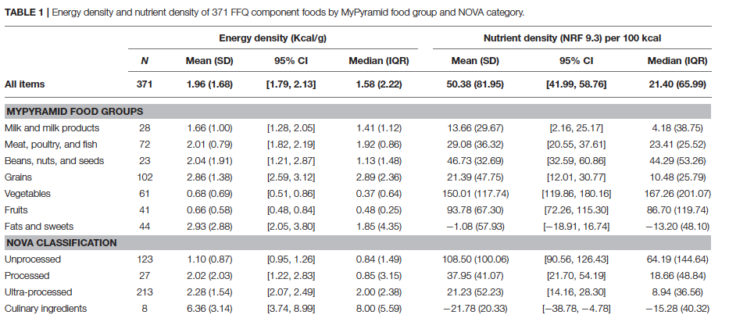
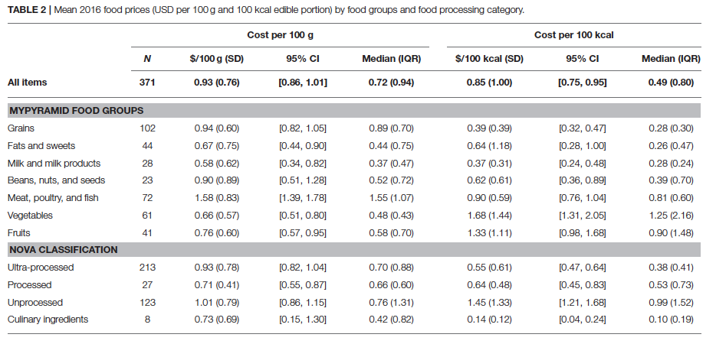
“It would appear that the ultra-processed NOVA designation is a new name for energy-dense grains, fats and sweets. These foods are energy dense, can be nutrient poor, and are distinguished by their low per calorie costs.”
“By contrast, the NOVA unprocessed category successfully captured some of the same food groups that multiple NRF schemes have previously recognized as nutrient-rich.”
“Food-based Dietary Guidelines focusing on dietary components or foods by degree of processing may be one strategy to make recommendations intuitive for the consumer; developing an overall processing index of the diet might be another.”
Gupta S, Hawk T, Aggarwal A, Drewnowski A.. Frontiers in nutrition. 2019:70.

Slide 19
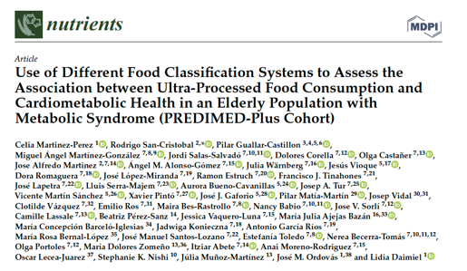
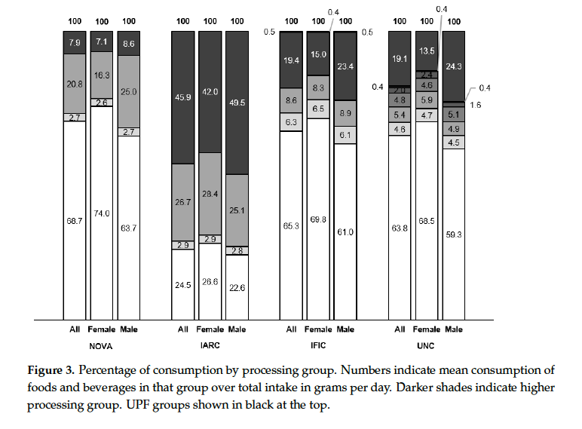
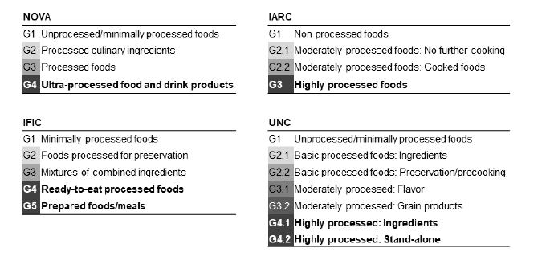
Challenge with classification systems is they can lead to different categorization within food groups and with overall diet
Martinez-Perez C et al. Nutrients. 2021 Jul 20;13(7):2471.

Slide 20
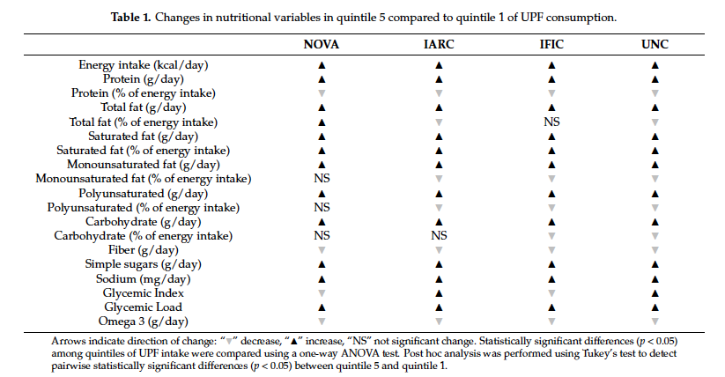
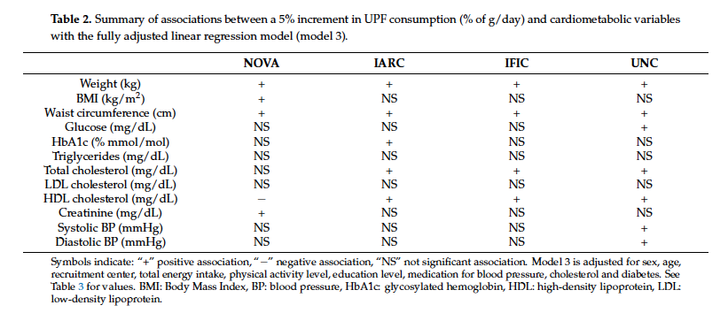
And these can lead to differences in associations with disease incidences and outcomes
“Food classification methodologies markedly influenced the association between UPF consumption and cardiometabolic risk markers.”
Martinez-Perez C et al. Nutrients. 2021 Jul 20;13(7):2471.

Slide 21
What have been some of the challenges in interpreting findings from the observational literature?
Application of food processing definitions is not standardized and often not fully disclosed
Even within Nova there appears to be a regular lack of detail in terms of how foods are properly categorized and by who
Result is high level of heterogeneity between studies in what is included in ultra processed foods category…

Slide 22
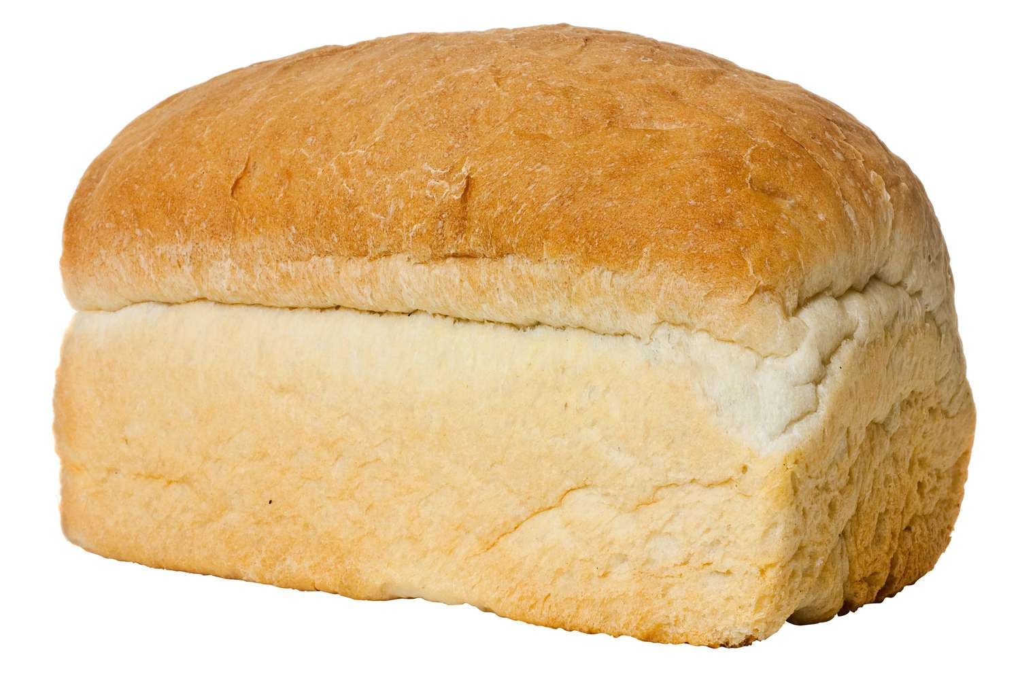
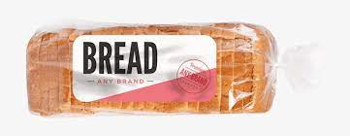
Does a product name or purchase point make a difference and how may that confuse classification approaches?
If made at home of local bakery
Not a UPF
Purchased from Grocery
or Industrial Scale
Totally a UPF?

Slide 23
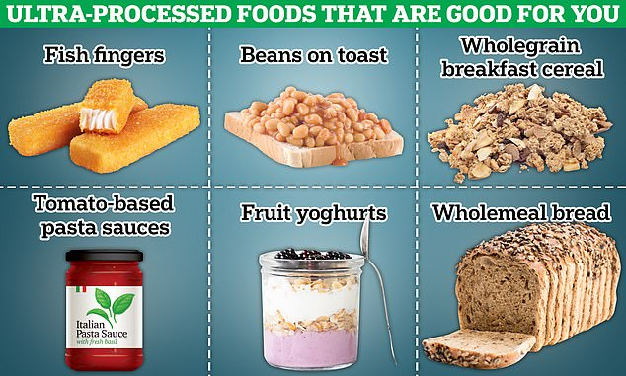
Do we have examples of highly/ultra-processed foods that are healthy?
Disclosure: I did not make this list
https://www.dailymail.co.uk/health/article-13135781/processed-foods-cigarettes-expert-cancer-heart-lung-disease.html

Slide 24
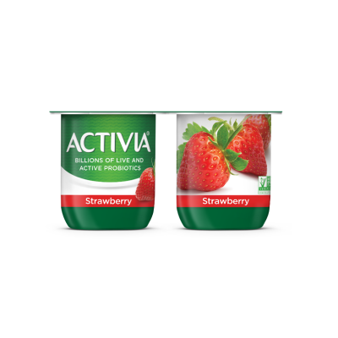
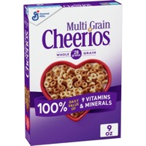
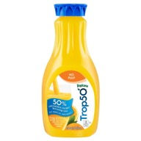
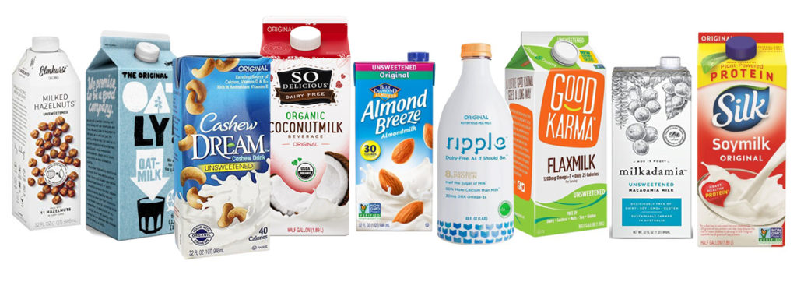
Blindly using NOVA can lead to some interesting categorizations that can be more confusing for consumers trying to make good choices
Nova Category 3 and 4

Slide 25
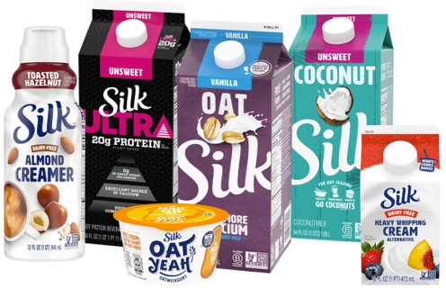
Challenges exist for specific product categories:
Plant-based dairy alternatives
Drewnowski A. Perspective: identifying ultra-processed plant-based milk alternatives in the USDA branded food products database. Advances in Nutrition. 2021 Dec 1;12(6):2068-75.
Key Finding. Most plant-based beverage met the NOVA criteria for ultra-processed foods
Why? Because they were formulated from industrial food ingredients/additives not used in normal cooking
Conclusion. Replacing milk and dairy products with plant-based alternatives will result in higher use of ultra-processed foods

Slide 26
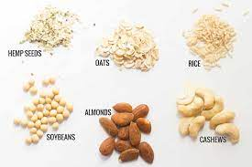
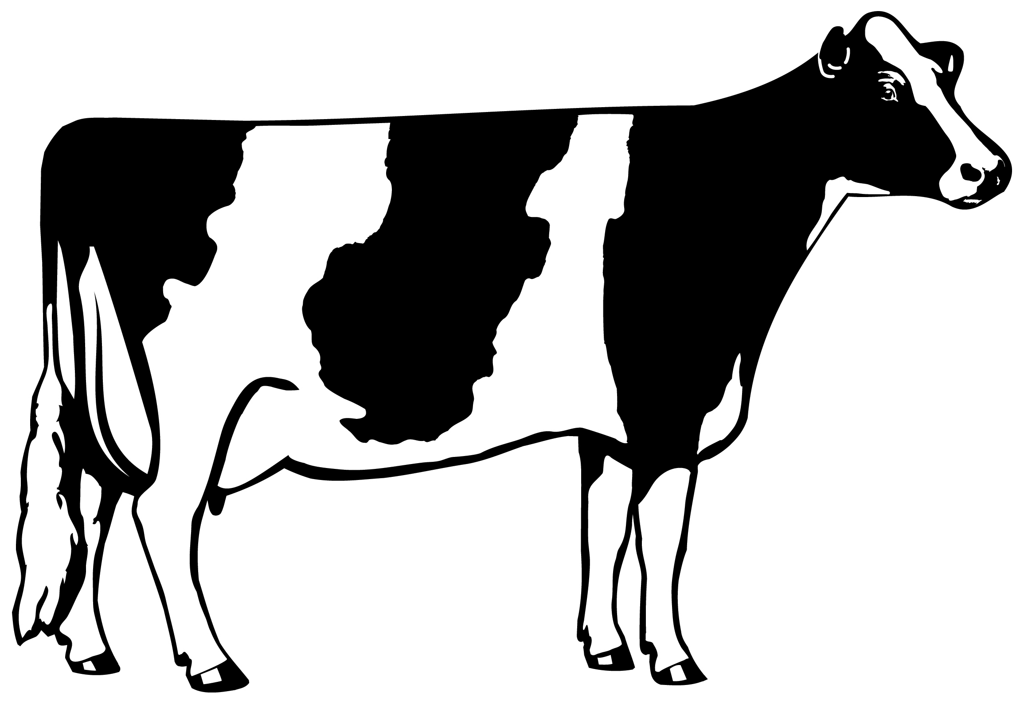
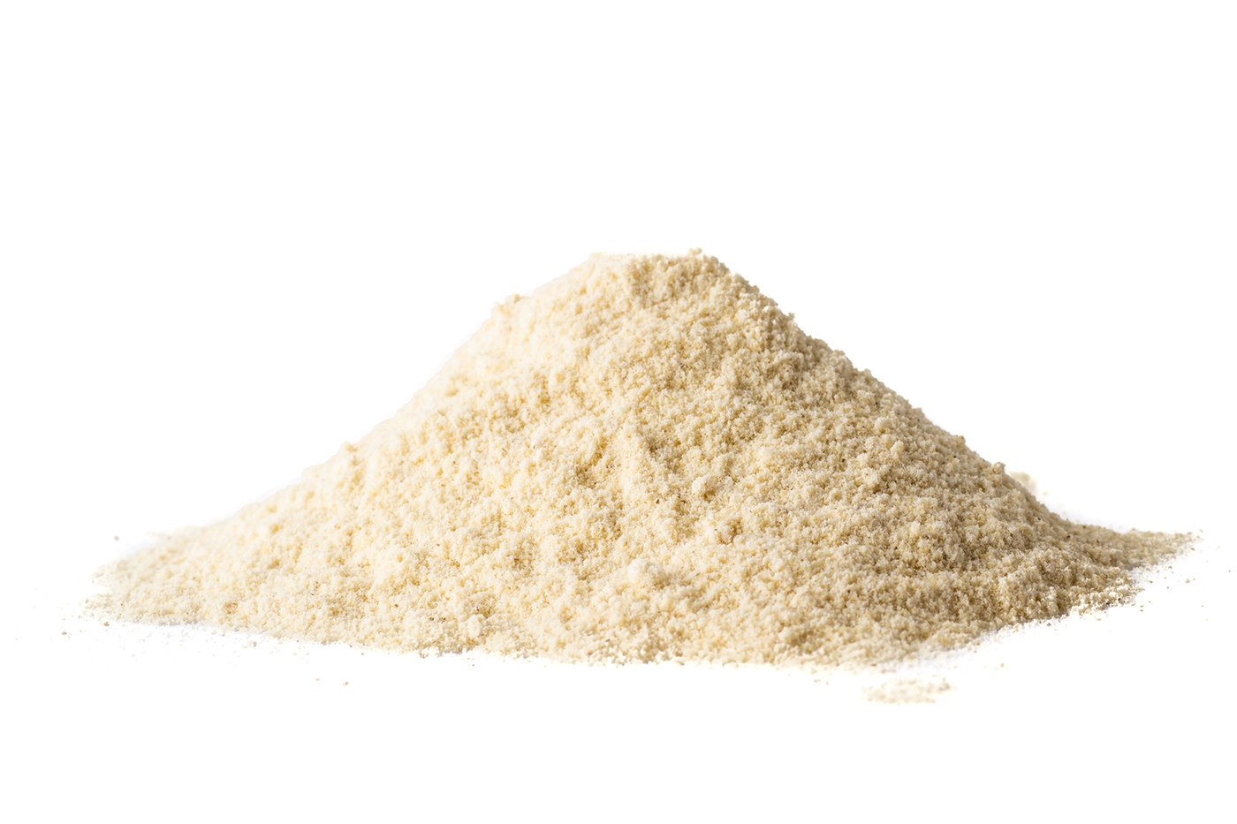
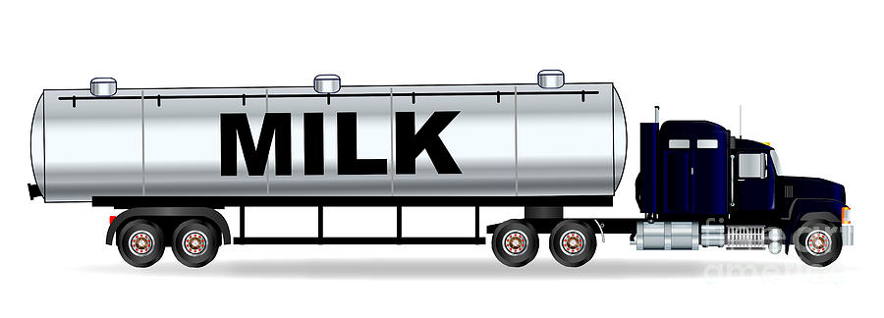
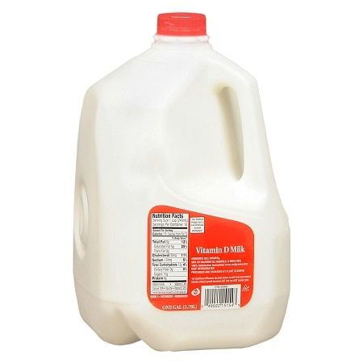
Yet both product undergo similar levels of processing…
Milling
Raw Milk Receiving Tank
Bleaching
agent
Water
Bleaching
Raw Milk
Collection
Filtration
Impurities
Enzyme
treatment
Wet Grinding
Quality Testing
Ultra/
Filtering
Product
Packaging
Cream
Skim Milk
Stabilizers
Fortificants
Color
Sweeteners
Flavor
Ingredient
Formulation
Product
Packaging
Fortification
Mix
Stabilizer
Emulsifier
Product Homogenization
Standardization
(Skim, 1%, 2%, Whole)
Product Homogenization
Thermal Treatment
Thermal Treatment
Preheat & Homogenization
Fortification
Formulation

Slide 27
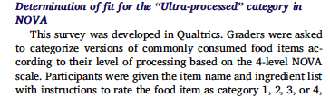
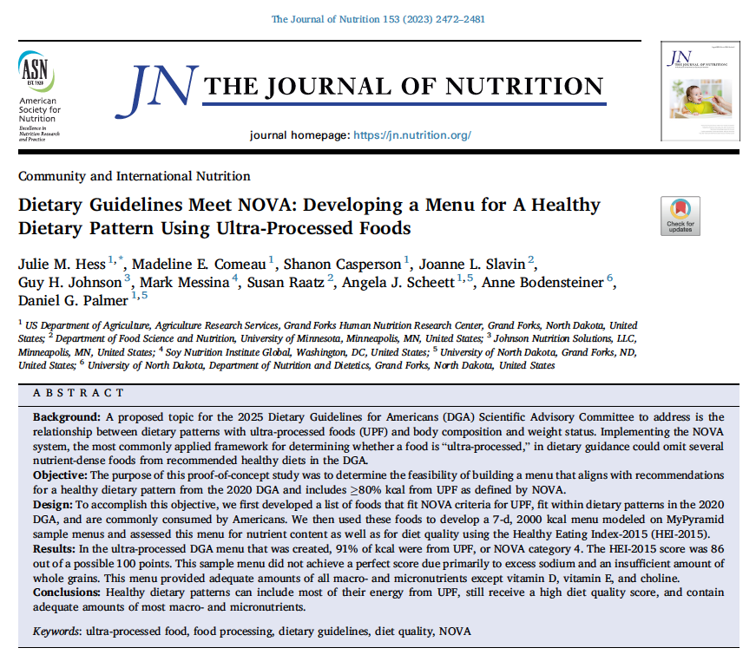
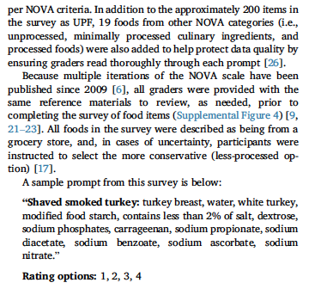
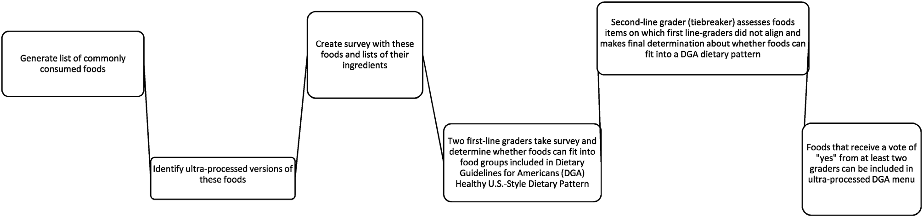
Processed and Ultra-processed foods can be incorporated into a healthy diet?
Study Schematic to determine which foods to include
“The top 10 most commonly consumed foods from each category and subcategory among adults 19 to 70 years old were identified from the FPM report... An ultraprocessed version of each of these commonly consumed food items was then identified by searching the websites of national retail grocery chains. This process generated a list of approximately 200 food items. Ingredient lists for these products determined which products were included in the surveys developed for our first- and second-line graders.”

Slide 28
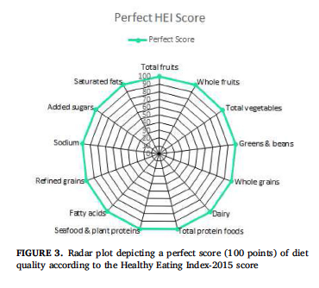
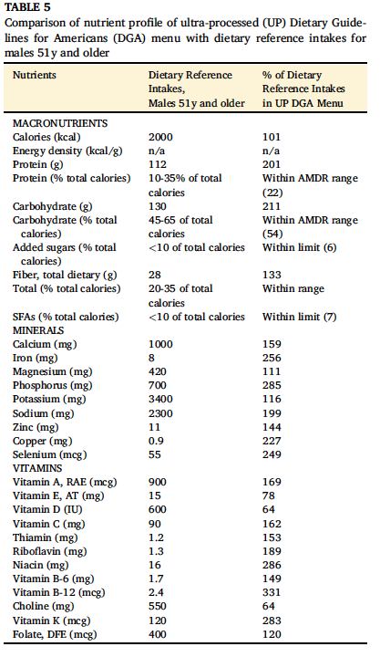
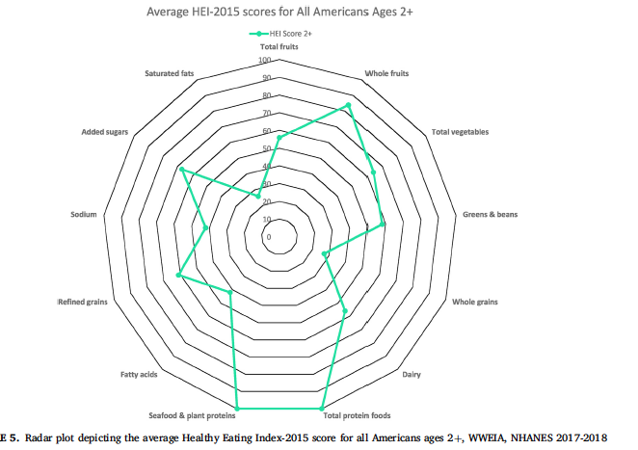
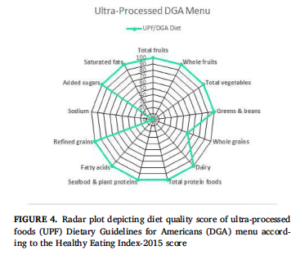
Hess study: Dietary Guidance meets NOVA

Slide 29
What does the clinical literature tell us?

Slide 30
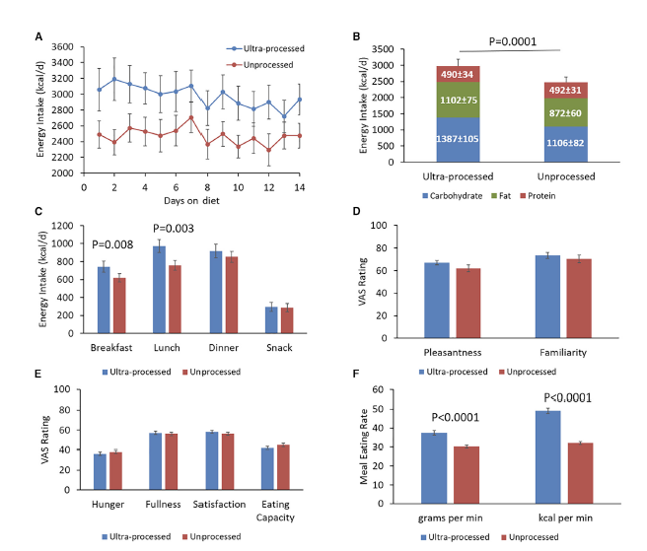
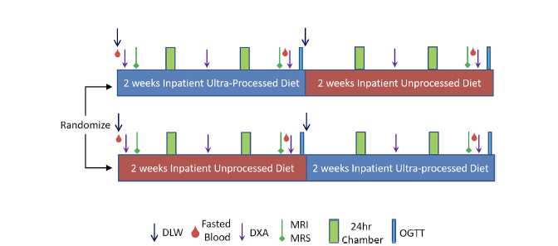
Still only limited clinical evidence to date… Hall et al. (2019)
Hall KD, Ayuketah A, Brychta R, Cai H, Cassimatis T, Chen KY, Chung ST, Costa E, Courville A, Darcey V, Fletcher LA. Ultra-processed diets cause excess calorie intake and weight gain: an inpatient randomized controlled trial of ad libitum food intake. Cell metabolism. 2019 Jul 2;30(1):67-77.

Slide 31
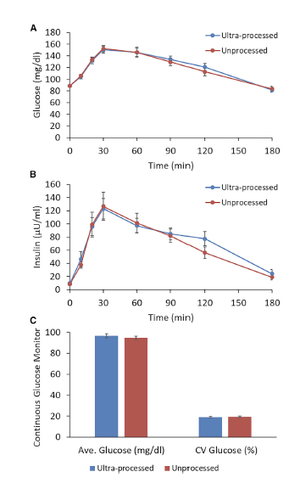
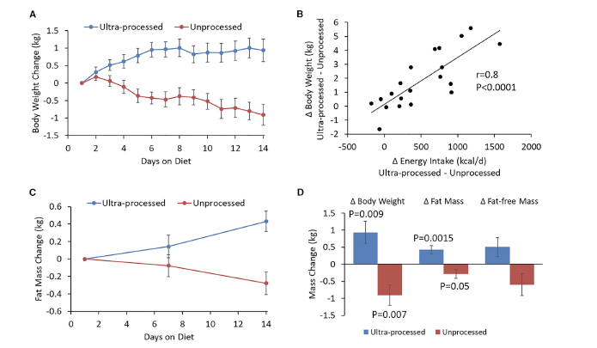
Hall study has driven discussion on mechanism and health
Hall KD, Ayuketah A, Brychta R, Cai H, Cassimatis T, Chen KY, Chung ST, Costa E, Courville A, Darcey V, Fletcher LA. Ultra-processed diets cause excess calorie intake and weight gain: an inpatient randomized controlled trial of ad libitum food intake. Cell metabolism. 2019 Jul 2;30(1):67-77.

Slide 32
What are the pertinent research questions we should focus on in the study of processed foods and health?

Slide 33
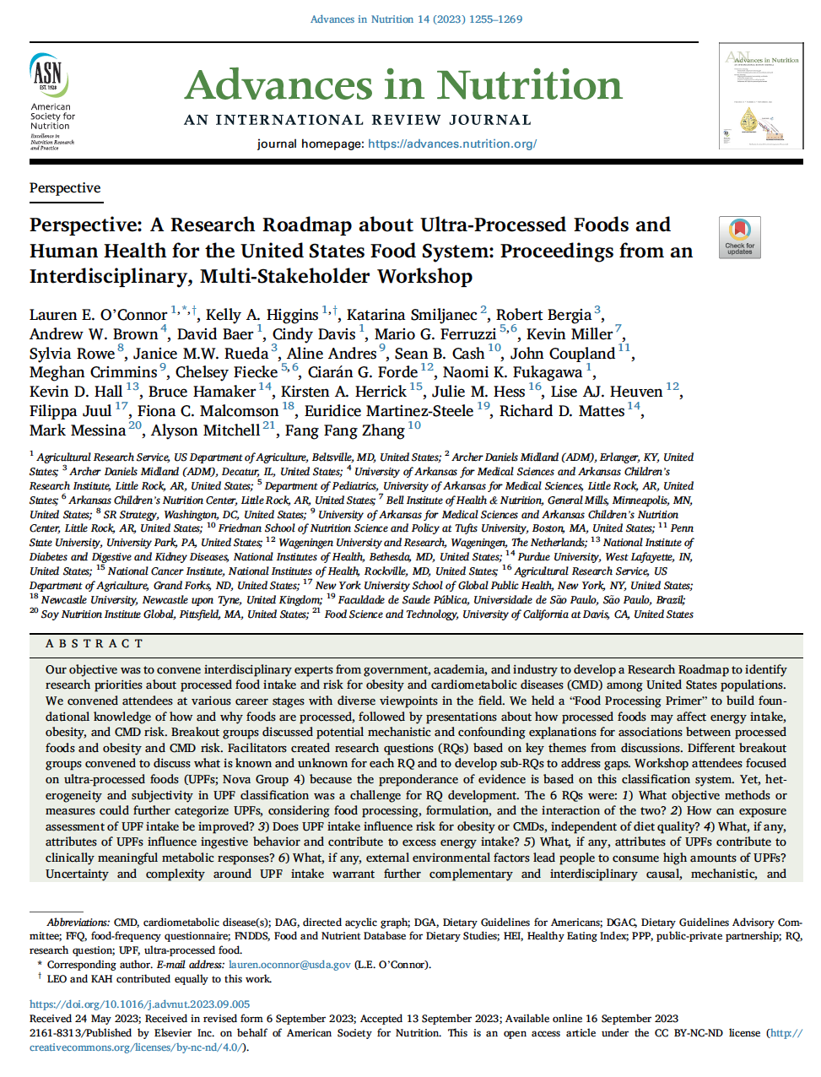
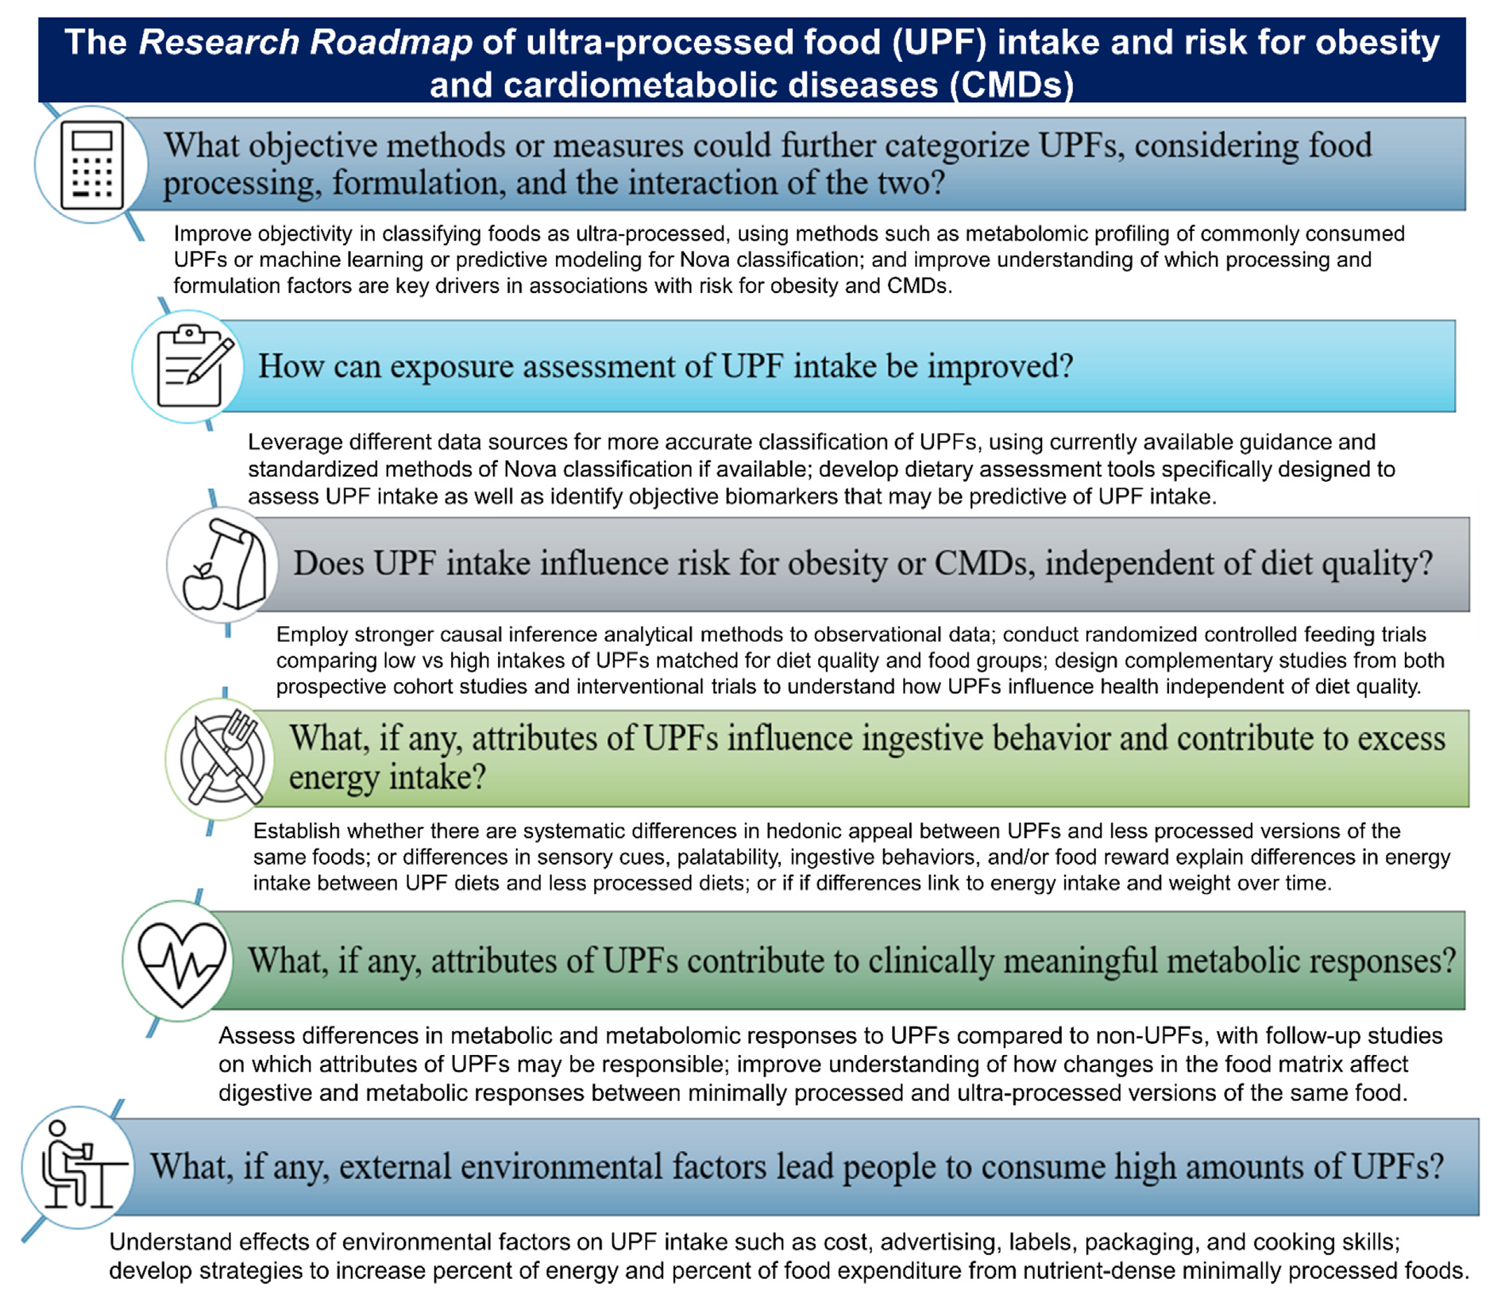
Proposing a Research Roadmap for Ultra-Processed Foods and Human Health for the United States Food System
O’Connor et al. Perspective: A Research Roadmap about Ultra-Processed Foods and Human Health for the United States Food System: Proceedings from an Interdisciplinary, Multi-Stakeholder Workshop. Advances in Nutrition 14 (2023) 1255–1269

Slide 34
Mechanistic hypotheses being advanced and studied regarding how ultra processed foods have driven energy intake and impact health
Food Properties:
Composition – Nutrition and non-nutrient profiles
Food additive safety – Emulsifiers, LC sweeteners, flavors, colors and
Food structure – modification of the “natural” structure of food
Food digestibility – Enhanced digestibility of ultra-processed foods
Direct toxic effect of additives

Slide 35
Mechanistic hypotheses being advanced and studied regarding how ultra processed foods have driven energy intake and impact health
Food-Consumer interactions:
Sensory – High palatability
Ultra-processed food properties modify both eating behavior and hedonic reward responses
Leads to altered hormonal responses and altered satiety cues
Packaging – “Hyper convenient”

Slide 36
Critical considerations for use of food classification systems in research
Should we have guiding principles on how food classification systems are applied, and this is disclosed in research?
  Should help drive consistency, reliability and trust in observational research
  Allow science to capture the conversation
Continue to drive advances in assessment of food and nutrient intake
  Capture qualitative and quantitative intake of processed foods
  Leveraging advances in social and emerging “omics”
Real need for clinical and mechanistic studies to move the science forward… and ultimately develop guidance for consumers

Slide 37




