Slide 1

Novel Foods, New Frontiers: Exploring the Landscape
of Alternative Protein Sources
Jay Alappat, Ph. D
Regional Technical Director, Chemistry
Merieux Nutrisciences, USA
Food and Agricultural Organization of the United Nations, Rome, 2023

Slide 2
Global Classification of Novel Foods
Microorganism based
Mod. Chem Structure
NOVEL FOODS
New Production Process
Plant or plant parts
Animals or parts
GMO
Cell or tissue culture derived from animals or plants
“If intended to replace another food, it must not differ in a way that the consumption of the novel food would be nutritionally disadvantages to the customer”

Slide 3



Drivers for the Development of Novel Foods
Sustainability: Lower land use & less carbon emission than animal-based foods.
ROI on beef 1% (100 calories for every 1 calorie return)
Plant based burger: 87% less water; 96% less land; 99% less GHG
Behavioral Changes: “Flexitarian” trend (Upto 30% of consumers are keen to transition to diet with less or no meat)
Economics: Global Alternative meat and dairy valued at $31 bn in 2022; growing at CAGR 20% to reach $105 bn in 2030 (Bloomberg and Euromonitor)
$15 billion investments from 2010-2023
$11.7 billion since 2020
Notes:
if you eat an alternative protein burger over a traditional meat burger, is equivalent to driving 18 less miles when thinking about carbon dioxide/greenhouse emissions/etc.
ROI in terms of resources is much lower for traditional - using a lot of resources such as water, heat, etc to produce
economics: projected to be at $140b in retail sales in next decade making up 10% of the meat industry

Slide 4
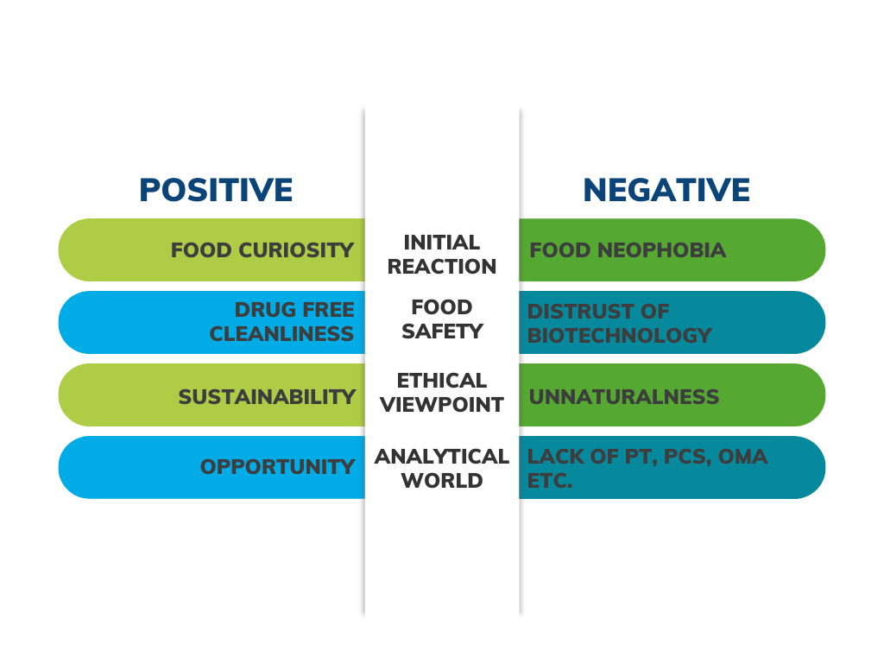
Drivers for the Development of Novel Foods

Slide 5
Novel Foods Regulations: Global Landscape
Purpose of the Novel Food Regulation: Ensure a high level of protection in food safety | critical to advance this sector | maximise its potential
Few standardised best practices or technical recommendations have been established
Current frameworks lag behind consumer demand for novel foods.
Inputs in early steps of Production Process: Quantify the substances precisely before proceeding with a safety assessment.
Inputs used in later steps of the production process (e.g. growth factors): Understand the safe levels of such residues (maximum residue limits).

Slide 6
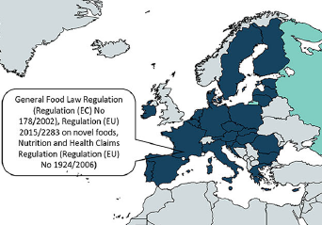
European Union Novel Food Framework
Safety Requirement
(EU) 178/2002
Definition
(EU) 2015/2283
Procedure
(EU) 2018/456
Scientific Requirement
(EU) 2017/2469
List of Novel Foods
(EU) 2017/2470
Foods from third countries requirement
(EU) 2017/2468
Frontiers in Nutrition 9, 2022

Slide 7
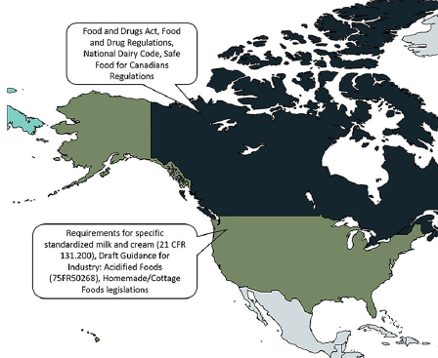
US and Canada Novel Foods Framework
United States
FDA and USDA
Regulation:
21 CFR Chapter 9
Canada
Health Canada, Food Directorate; Canadian Food Inspection Agency (CFIA); Environment and Climate Change Canada
Regulations:
Food and Drugs Act (FDA)
Food and Drug Regulations (FDR) (Section B.28.001 of the FDR defines “novel food”; Premarket notification According to B.28.002)
Safe Food for Canadians Act (SFCA)
Safe Food for Canadians Regulations (SFCR).
Frontiers in Nutrition 9, 2022

Slide 8
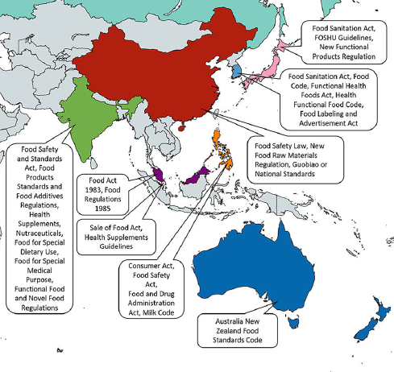
Middle East, Asia Pacific Novel Foods Regulatory Framework
Japan
Australia: Food Standards Australia New Zealand (FSANZ)
Food Standards Code 1.5.1
Safety assessment:1.1.1-13(4)
A food, a substance derived from food, or the source from which it is derived, that does not have a history of human consumption in Australia or New Zealand
Two-prong test – it must be considered non-traditional and must also require an assessment of the public health and safety
South Korea
Philippines
Frontiers in Nutrition 9, 2022

Slide 9
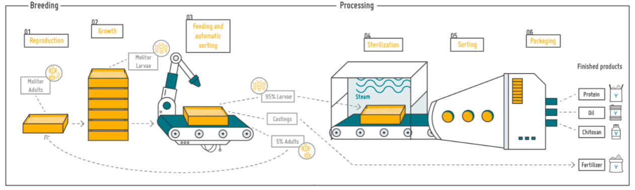
Production Process: Insect-based
Selection
Cultivation
Processing/ Formulation/ Storage
Distribution
Source:Yinsect

Slide 10
Production Process: Plant-based
Textured Vegetable Protein (TVP): Dry or Wet
Produced by extrusion technology
Hydration/ Marination
(Incorporation of fats, flavors and functional additives)
Coating
(Incorporation of additional flavor and texture)
Extended Shelf Life Processes (ESLP)
(heat-pasteurization, high-pressure processing, UV, and addition of antimicrobials)
Cooling
(Refrigeration/ freezing)
Cooking
(Frying, baking, boiling and/or steaming)
Packaging and Storing
GFI, November 27, 2019

Slide 11
Production Process: Fermentation-based
Fermentation
(Fermentation in carbon source medium)
Selection of organism
Protein Recovery
Extended Shelf Life Processes (ESLP)
(heat-pasteurization, high-pressure processing, UV, and addition of antimicrobials)
Cooling
(Refrigeration/ freezing)
Processing
Packaging and Storing
GFI, November 27, 2019

Slide 12
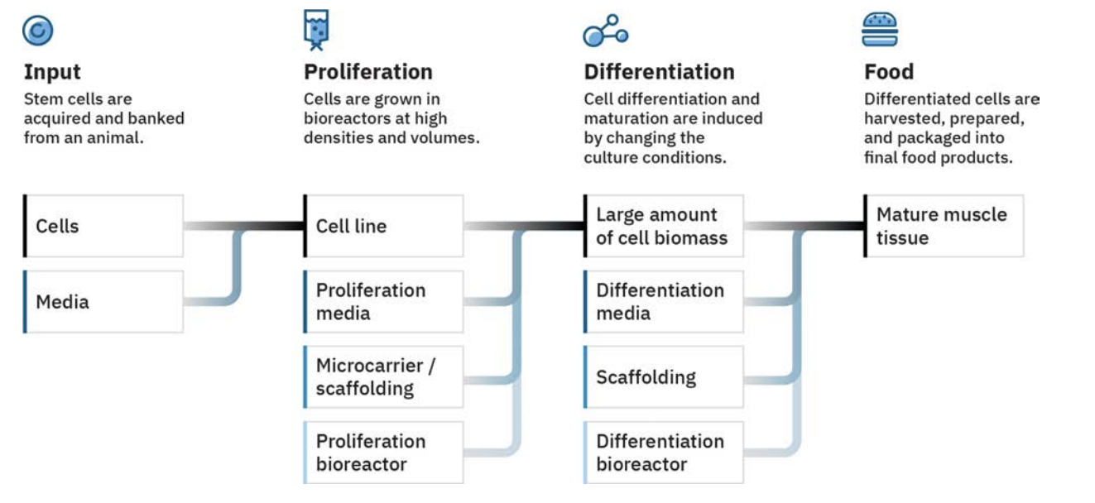
Production Process: Cell-based
https://gfi.org/resource/plant-based-and-cultivated-meat-online-course/

Slide 13
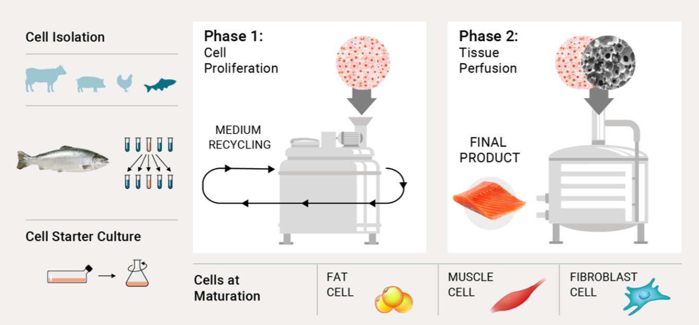
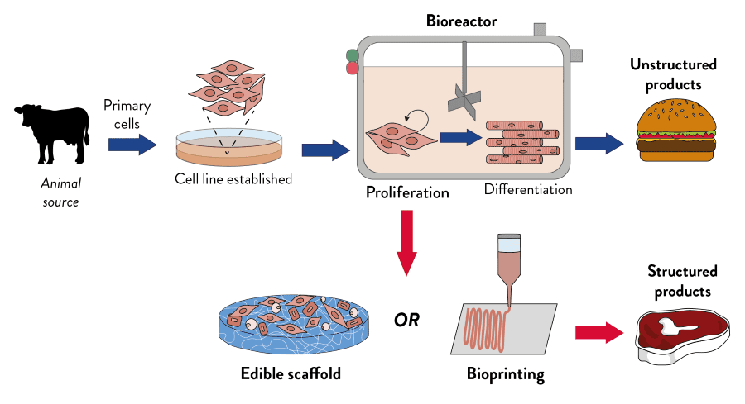
Production Process: Cell-based
https://gfi.org/resource/plant-based-and-cultivated-meat-online-course/
https://www.amsbio.com/cultured-meat/

Slide 14
Novel Foods Safety testing: Contaminants and Residues
Arsenic
Cadmium
Lead
Mercury
Nickel, Cobalt
Emerging risks
Dioxins
PCBs
PAHs
PBDE
Mycotoxins
Afla B1, B2, G1, G2
Fumonisin B1, B2, B3
Zeavalenone
Ochratoxin
Beauvericin
Sterigmatocystin
Alternaria toxins
Nitrates
Perchlorates
Chlorates
Pesticides
Antibiotics
Allergens
(contamination to other products), Allergens from substrate (gluten, soy, peanuts?)
Process contaminants:
Acrylamide
3-MCPD & glycidyl ester
Sovent residues
Processing enzymes
Mineral Oils (MOH)
PFAS
Bisphenols
Phthalates
Nanoparticles
Undesirable substances:
Melamine
Cyanuric acid
Nitrosamine
Residues
Packaging
Environmental
Biosynthetized toxins
Contaminants & others
“As food safety is everyone's responsibility, collaboration among different stakeholders including companies, regulatory agencies, scientists, and researchers is useful for sharing the results of food safety assurance approaches and methodologies”, Stakeholder Roundtable, Tel Aviv, 2022

Slide 15
Novel Foods: Quality & Nutritional analysis
Moisture
Ash
Lipids
Fat
Fatty Acid Profiles
Omega 3:6 fatty acids
Cholesterol (insect herbivores produce cholesterol by metabolizing phytosterols)
Carbohydrates
Total Dietary Fibre
Soluble/insoluble fiber
Starch
Total Sugar and Sugar profiles (basic & expanded)
Polysaccharides (FOS, GOS, Beta-glucans)
Proteins
Protein content
Non-protein nitrogen
Amino acids profile
Protein digestibility (PDCAAS)
Macroelements
Calcium, Sodium,Potassium, Magnesium, Phosphorus
Microelements
Iron, Copper, Manganese, Zinc
Other minerals:
Selenium
Iodine
Others:
Choline
Lutein
Carnitine
Inositol
Vitamin A (retinol)
B Vitamins
Thiamine (B1), Riboflavin (B2), Niacin (B3), Pantothenic Acid, Pyridoxine (B6), Biotin (B7), Cobalamin (B12), Folic Acid (B9), Cobalamin (B12)
Vitamin C
Vitamin D3 (cholecalciferol)
Vitamin E (Alpha tocophérol)
Vitamin K
Vitamins
Minerals and Others
Proximates & Macro Nutrients
Proximates & Macro Nutrients

Slide 16
Quantification of Protein: Challenges & Gaps Posed
Common methods: Kjeldahl, Dumas, colorimetric methods…
Challenges of nitrogen “proxy” methods:
- Wide range of protein factors: 5.18 (almonds) to 6.38 (milk)
- Interference from non-protein nitrogen (nitrates from media, lipids, chitin, nucleic acids..)
- Interference from free amino acids (asparagine…)
- Insects: species to species, developmental stage, feed, gut content.. (Agri. Food. Sci. 29, 2020, 1-5)
Protein factors for new protein sources
- Cell-based; Fermentation based; algae based; Insect based
Protein factors for combination on proteins
No standard methods or reference materials.
“….Macroalgal amino-acid profile has shown to be different in different stages of the life cycle of the macroalgae” CEN/TC454

Slide 17
Importance & Impact
Quality is one of the defining parameters for Novel Proteins
Protein Quality: the power of protein source to cover the requirements of nitrogen and amino acids for the organism
- Protein Digestibility Corrected Amino Acid Score (PDCASS); since 1980 (Codex Committee on
Vegetable Proteins, CCVP, 1980)
- PDCASS replaced measurement of Protein Efficiency Ratio (PER, since 1919)
* Discrepancies due to the validity of reference protein
* Effects of processing on the protein quality
* Presence of anti-nutritional factors in the protein matrix
(Natural anti-nutrient factors or anti-nutritional factors formed during the processing
would overestimate PDCASS)
- Digestible Indispensable Amino Acid Score (DIAAS), Since FAO expert consultation in 2011

Slide 18
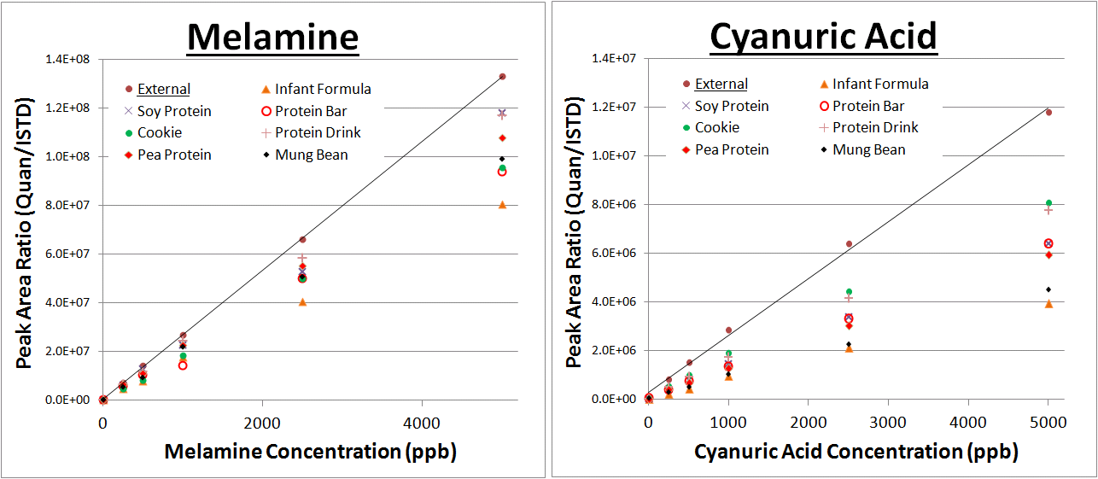
Standard Curves - No Internal Standard

Slide 19
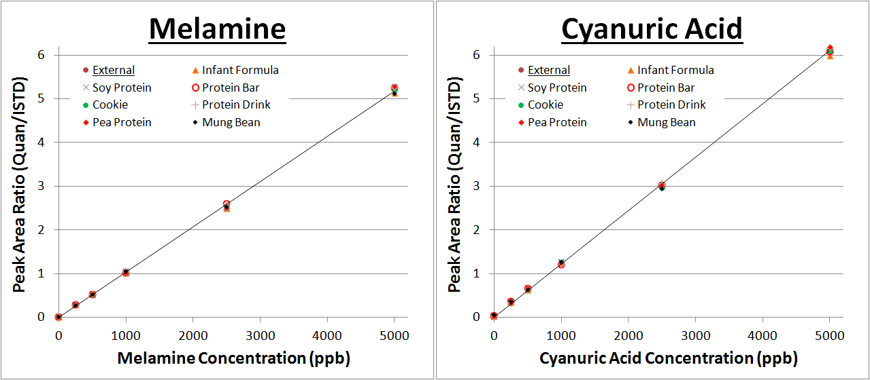
Standard Curves - Internal Standard

Slide 20
Sample: Freeze dried protein (Shiru, Inc) produced via heterologous expression/fermentation in a bacterial host
 | LIB 4421 | Mérieux Method
Sample | 4 g (2.0 g x 2) | 40 mg (20.0 mg x 2)
PCS (Spiked) | 4 g (2.0 g x 2) | 40 mg (20.0 mg x 2)
Standard Curve | 12g (2.0 g x 6) Matrix Matched | External
Internal Standard | N/A | 20 µL
Extraction Volume | 14 mL | 0.4 mL
LC-MS/MS Injection | 10 µL | 10 µL
Total Sample | 20 g | 80 mg

Slide 21
Novel foods acceptability testing
Peroxide value
Anisidine value
Aldehydes profile
Free Fatty Acids (=acidity)
TBA (Thiobarbituric acid)
Phospholipids profile
Organic volatiles: Hexanal, 3-cis hexanal(grassy, beany flavors); octenone, octenal (mushroom smell
Enzymes: Lipoxygenases, peroxidases, lipases and proteases
Biogenic amines
Histamine
(Indicators of microbial
spoilage)
Organoleptics
Short Chain amino acids
Hydrophobic amino acids
Shelf life analysis; Freeze-thaw shelf life analysis
Texture measurements; Viscosity Measurements; Physical: pH. viscosity, color, texture
Qualitative
Protein degradation
Oxidation parameters
Organoleptics & Sensory

Slide 22
Novel Foods Testing Challenges
Testing of pesticides, mycotoxins, allergens, antibiotics…
Identification of flavors, off flavors and taste
Amount of material required for testing
Correlation of molecules to Sensory and Organoleptic attributes
- Lipids (bitter after-taste); Peptides and Proteins; Saponins
Lack of PTs, RM, OMA and SMPR

