Slide 1
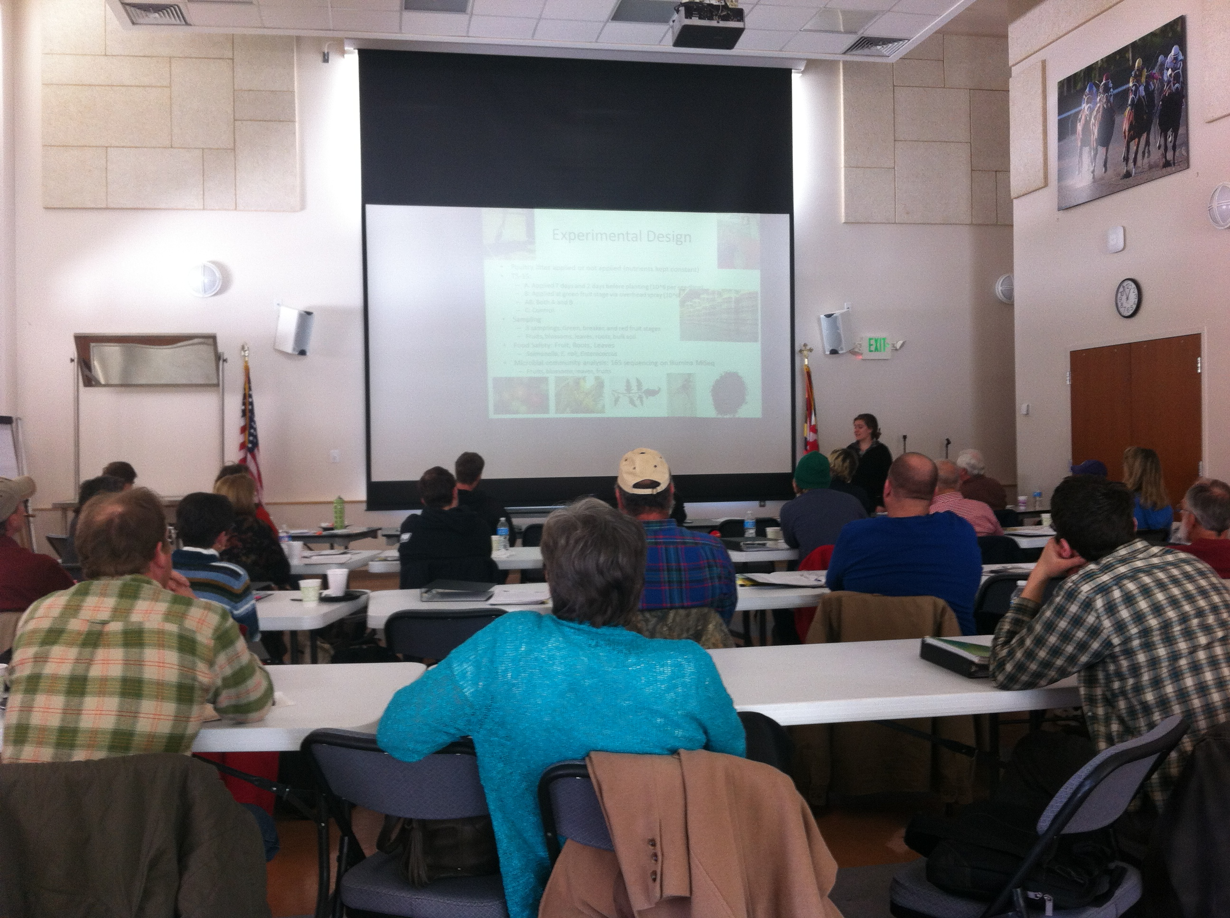


Evaluating the Effectiveness of Food Safety Trainings by Determining Factors that Influence Grower Adoption of Food Safety Certification Practices
Donna M. Pahl¹*, Tarik Chfadi², Clare Narrod², Christopher S. Walsh¹, David Martin³, Shirley Micallef^{1,4}
*Presenting author, ¹University of Maryland, Plant Science and Landscape Architecture, ²Joint Institute for Food Safety and Applied Nutrition,
³University of Maryland Extension, ⁴Center for Food Safety and Security Systems
Introduction
Results
Fresh produce growers are under increased pressure to abide by federal food safety guidelines and obtain third-party Good Agricultural Practices (GAPs) certifications. Food safety trainings have been offered in Maryland for several years, although only about one quarter of attendees implement food safety plans and receive GAP certification.
This study aimed to use surveys and factual tests to define the factors influencing grower’s opinions of food safety practices and their reluctance to obtain GAP certification. These factors can be addressed in future trainings to increase the number of participants implementing recommended practices.
Pre-training Questionnaire: Over 128 participants (one representative per farm) completed the questionnaires and factual tests in 2014 and 2015. Participants in the beginner trainings were involved in markets ranging from retail to wholesale, and 73% (74 out of 102 respondents) had never attended a previous GAP training. Participants’ reasons for attending the beginner trainings are listed in Figure 1. Figure 2 demonstrates the participants self-evaluation regarding the increase in knowledge of GAPs after attending the beginner training. After the trainings, 87% (73 out of 84 expressed answers) of participants planned on implementing GAPs and receiving a certification. Figure 3 lists several potential difficulties that participants may have in becoming GAP certified – note that the majority estimate no potential difficulties.
Factual Tests: Responses to the ten-question multiple choice factual test improved after attending the beginner training. Only 9.6% (9 out of 94) of the participants scored 75% or greater in the pretest, in contrast to the 62.2% of participants scored 75% or greater in the posttest. Depending on the training, participants increased their scores on the factual test by 20-30% (2-3 answers out of 10) after attending the training.
Advanced Training: A high percentage of the participants attending the advanced training wholesale to grocery stores (17 out of 45 replies), as compared to selling at farmer’s markets (9 out of 45), restaurants (6 out of 45), and other marketing avenues. 85% of growers at the advanced training had attended previous food safety trainings (13 out of 26 respondents had attended 3 or more trainings, 9 out of 26 respondents had attended 1-2 trainings). The motivation for attending the advanced training were for continuing education (15 out of 25) and/or to prepare for upcoming food safety regulations (14 out of 25).
Figure 1.
Primary Reason for Participants to Attend Beginner Training | Number of Responses*
Obtaining a training certificate | 58
Learning about food safety practices | 76
Understanding proposed regulations | 61
Becoming aware of programs and audit certifications | 60
Understanding paperwork involved | 44
Methodology
* Participants were asked to select any choices that applied.
Figure 2.
Figure 3.
University of Maryland offered full-day trainings to teach growers the produce safety practices and documentation associated with third party audits and upcoming federal regulations. Five beginner trainings and one advanced training were offered per year in 2014 and 2015.
Each beginner training consisted of a morning session of presentations covering the microbiological concepts behind food safety and GAPs. The remainder of the training is spent writing risk assessments and Standard Operating Procedures, which are then written into a food safety plan. The advanced trainings were open to growers with a food safety plan and contained demonstrations on water sanitizers, guest talks from industry leaders, and discussions of relevant food safety issues.
To define the factors influencing grower’s opinions of food safety, trainees were administered several questionnaires and factual tests before and immediately after the training, and nine months post-training. The flow chart below explains the questionnaires.
Participants’ Self-Ranking of Knowledge on GAPs, Before and After Beginner Training
Participants’ Estimate of Potential Difficulties to Receiving Food Safety Certification
Before training:
Pre-training questionnaire to capture perceptions of regulations and trainees’ abilities to implement practices
+
Multiple-choice factual test to test baseline knowledge
Conclusion
Despite the fact that 87% of participants at the beginner trainings planned on becoming GAPs certified, only 8% (5 farms out of 62) of the farms in attendance at the 2014 trainings received a third-party GAPs certification that year. This number is surprising, since most growers were optimistic and predicted no difficulties in becoming certified. Since certification can be a multi-year process, it is possible that training attendees will be attempting certification the following year. The next steps in this study will be administering follow-up surveys to determine why many growers failed to become certified. Once the reasons are understood, trainings and outreach can be adapted to better accommodate growers’ needs.
One key difference between the beginner and advanced trainings is the motivation for attending. Advanced participants are more familiar with basic GAPs practices – they often want continuing education on concepts that arise during third-party audits: equipment sanitation and water mitigation.
A difficult aspect of using factual tests to determine grower comprehension of the training material is many of the concepts taught cannot be assessed with multiple-choice questions. Skills such as performing risk assessments and Standard Operating Procedures, required for a farm to become certified, cannot easily be tested.
Directly after training:
Post-training questionnaire to self-assess skill level, training satisfaction, and estimated barriers to certification
+
Multiple-choice factual test to quantify learning
Nine months post-training:
Follow-up questionnaire to measure implementation of food safety practices on farm
Acknowledgements
This material is based upon work that is supported by the National Institute of Food and Agriculture, U.S. Department of Agriculture, under award number 2014-68003-21588.

