Slide 1

Message Dissemination: Social Media and Beyond
Dominique Brossard, Professor and Chair
Department of Life Sciences Communication
College of Agricultural and Life Sciences
University of Wisconsin-Madison
@brossardd
Communicating Food Risk in an Era of Social Media
2016 Symposium of the Joint Institute For Food Safety and Applied Nutrition

Slide 2
This Talk: an Overview
Setting the stage
Who uses social media and why?
Specificity of the online context
Take home messages

Slide 3
A case study: GE crops and food
Notes:
The 1950s and 1960s: discovery of double helix of DNA; genetic code deciphered
The 1970s:
Development of rDNA technologies
Elucidation of the mechanism used by Agrobacterium to transfer its own DNA into plant cells to grow tumors
Mid 1980s: first USDA APHIS approvals for release of GE crops into the environment in the United States
Mid 1990s: first USDA-deregulated GE crop grown for commercial sale, a GE tomato with delayed ripening

Slide 6
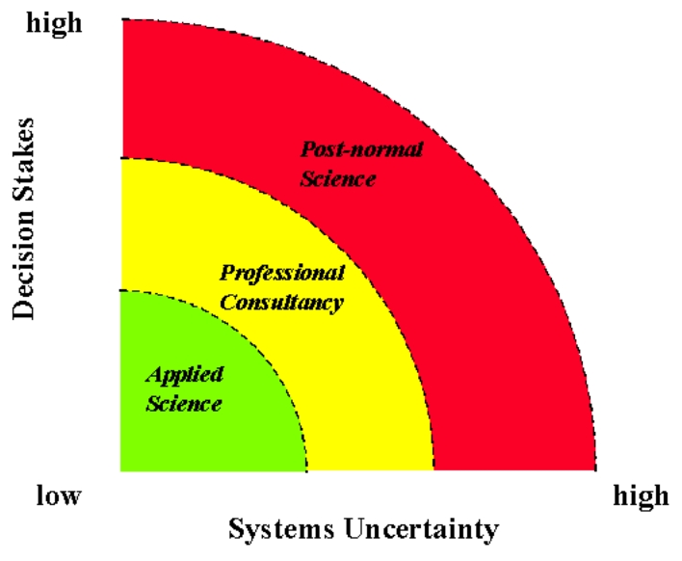
GE Food: a “Controversial,” or “Post-Normal” Science/Technology Bases Issue
Issues that have technical, social, legal, ethical dimensions
Shared features:
  Ideological components (political,
  religious, etc.)
  Competing interests/agenda
  Likely to be intensively debated in the public sphere
  Linked to the socio-cultural and political climate
  => Potential for polarization
Funtowicz, S. O. & J. R. Ravetz, J. R. (1992). Three types of risk assessment and the emergence of post-normal science. In Krimsky, S., and D. Golding, ed., Social Theories of Risk. p. 251–274. Westport, CT: Praeger.

Slide 7
Awareness of GM food in the U.S.

Slide 8
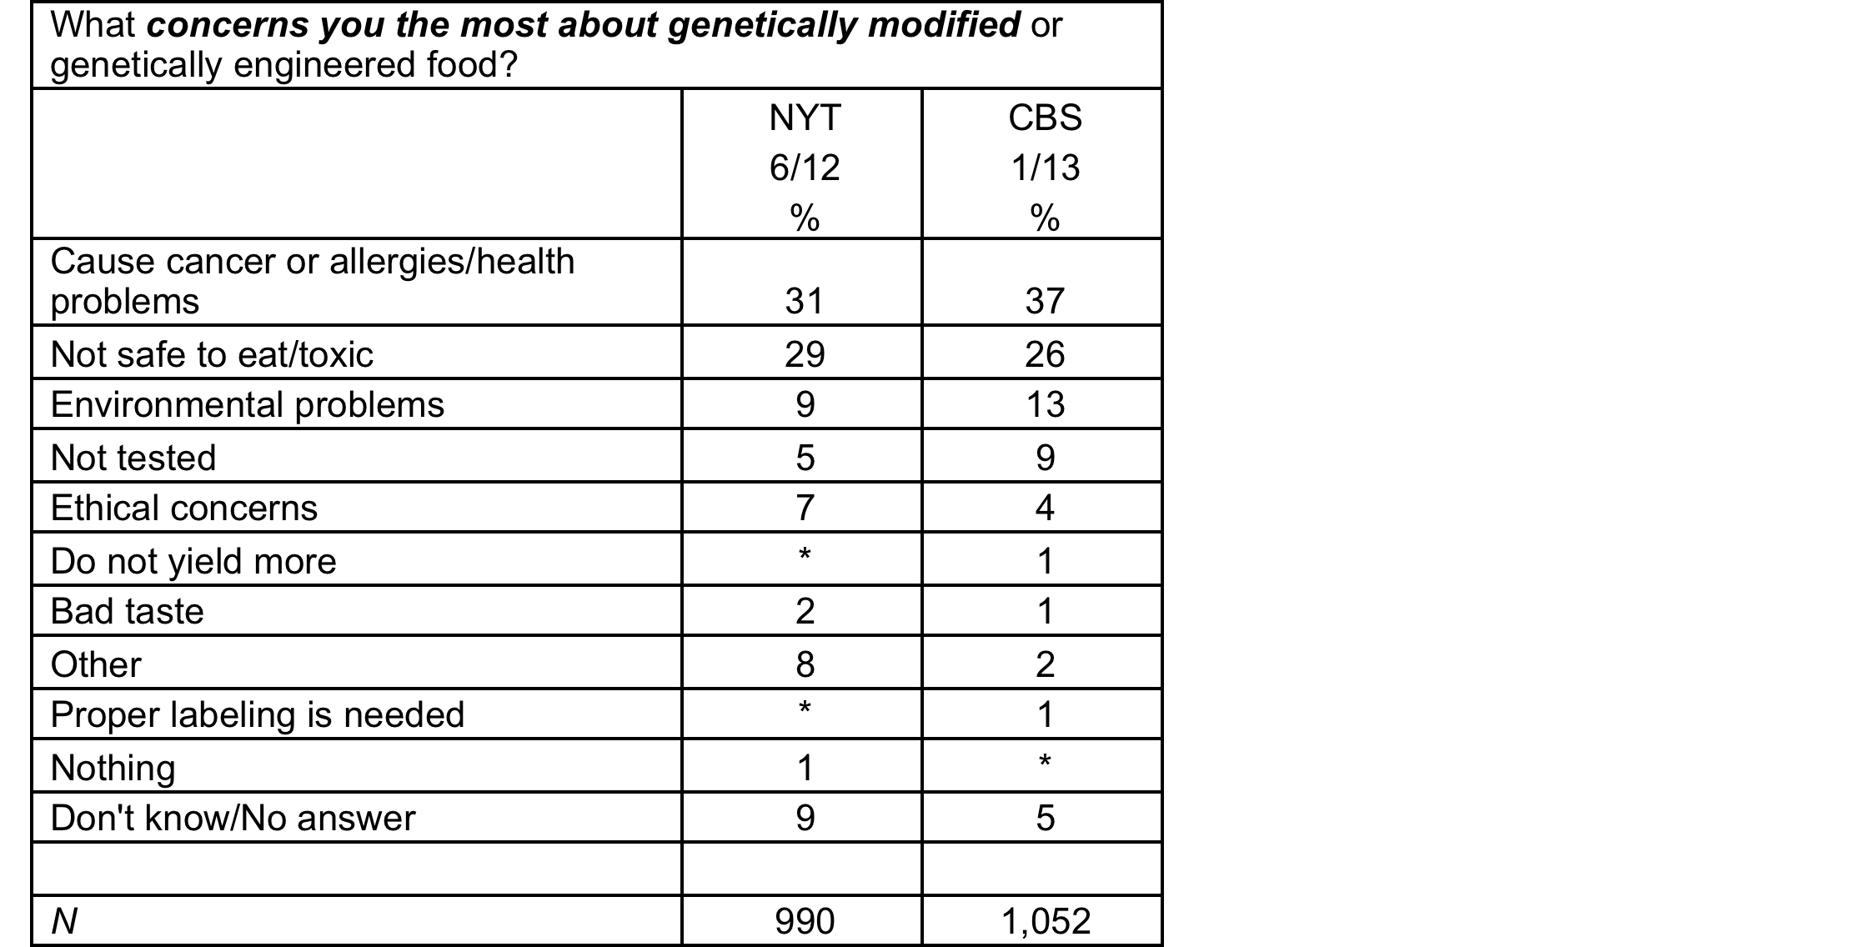
Public opinion in the U.S.

Slide 9

What research tell us:
The myth of more information and knowledge
Knowledge only accounts for a small amount of when explaining variance in attitudes toward GE in plants and food (and other technologies)
heuristics and mental shortcuts play a more important role
Notes:
Knowledge Deficit: For the general low information public…..
Knowledge is important, but small, and not the only variable that predicts positive attitude toward science and technology.
(Einsiedel, Jelsøe, & Breck, 2001; Hempel, Pfenning, & Peters, 2000; Gaskell, Allum, & Stares, 2003; Priest, 1995, 2001),
though knowledge appears to still play a limited role in promoting more positive views of the technology
(Brossard & Shanahan, 2003; Hallman, Hebden, Aquino, Cuite, & Lang, 2003; Priest, 2001).

Slide 10
What shapes public attitudes toward
“risky issues” such as GMOs?
Religion and Worldviews
Institutional Context
Socio-Economic Context
Socio-Political
and Cultural Context
Information Climate
Individual Level
Characteristics

Slide 11
What shapes public attitudes toward technological innovations in food (and other risky issues?)
Socio-Political
and Cultural Context
Media Coverage
Marketing Messages
Science Fiction Films
…
Information Climate
Individual Level
Characteristics

Slide 12

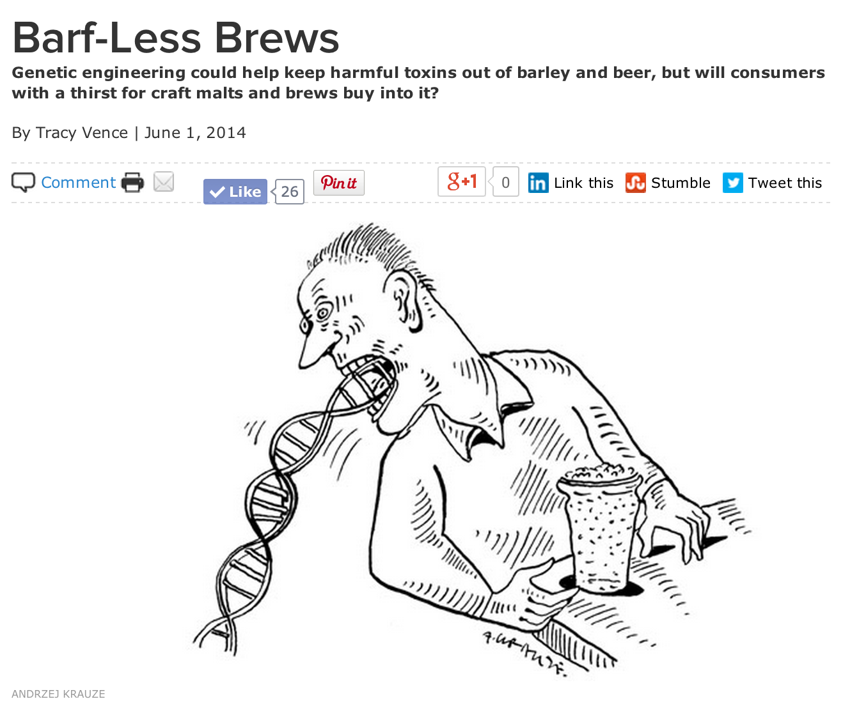
FRAMES AND
NARRATIVES
Common elements of frames: Headlines, visuals, metaphors, sources …

Slide 13

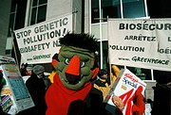
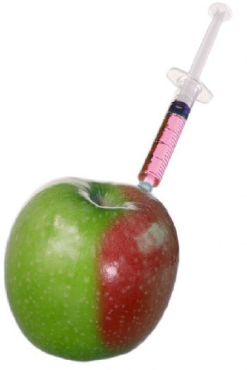
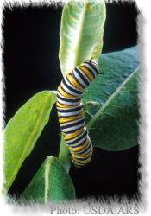
Media frames can be powerful
Any given frame may mean different things
to different people.

Slide 14
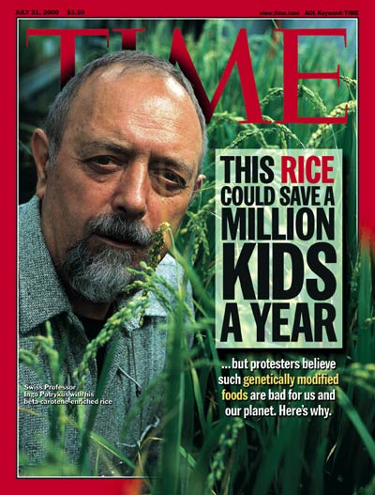
Framing as information processing tool
Tewksbury, D., & Scheufele, D. A. (2009). News framing theory and research. In J. Bryant & M. B. Oliver (Eds.),
Media effects: Advances in theory and research (3rd ed., pp. 17-33). Hillsdale, NJ: Erlbaum.
Frames help us
  determine why an issue is important or exciting
  efficiently process complex information by connecting it existing mental schemas …

Slide 17
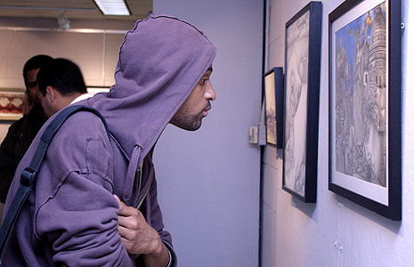
… “Media frames” do not operate in a vacuum
Audiences process frames and information through their own perceptual filters, including
  religious beliefs
  moral schema
  political ideology
  deference to scientific authority
  social norms
  etc
As a result: Any given frame may mean different things to different people.

Slide 18

In a nutshell, “low-information publics”make sense of information through different filters
How much information do I need to decide?
How do the media around me interpret and define this?
How do those interpretations fit with my beliefs and other values?
Notes:
People are 1) cognitive misers (Fiske & Taylor, 1991) who 2) look for shortcuts in decision making (Popkin, 1991), and will 3) take a convenience sample of media nearby, and 3) check information against value predispositions, like political ideology and religiosity,

Slide 19
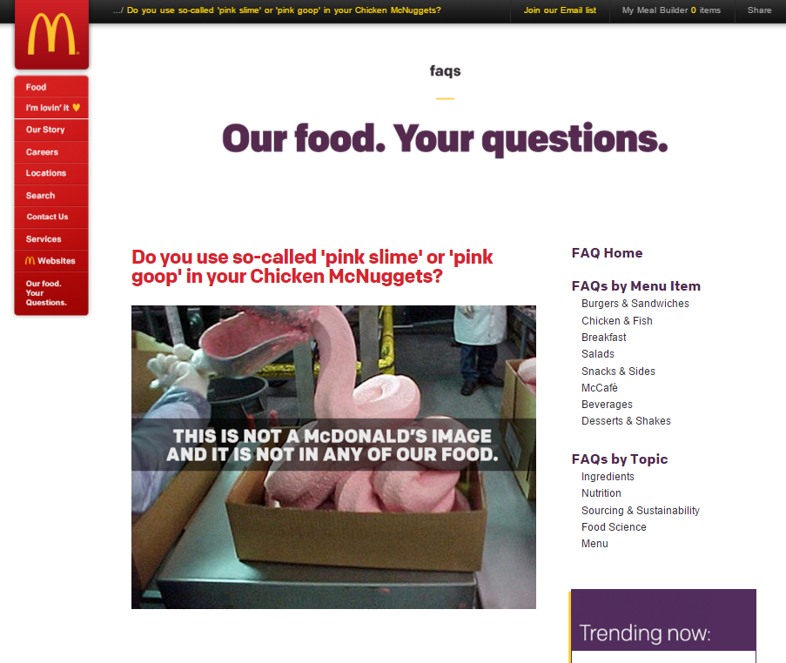
The power of the pictures in our heads
should not be ignored

Slide 20
What shapes public attitudes toward
risk and food?
Socio-Political
and Cultural Context
Information Climate
Individual Level
Characteristics

Slide 21
Religion
Institutional Context
Socio-Economic Context
Media Coverage
Marketing Messages
Science Fiction Films
Educational Messages
Individual
Characteristics
Attitudes toward technology/science/environment
political ideology
Deference to scientific authority
Moral considerations
Media use
Knowledge about the issue
Trust in information providers
Perceptions of risks/benefits
Interpersonal exchanges

Slide 22
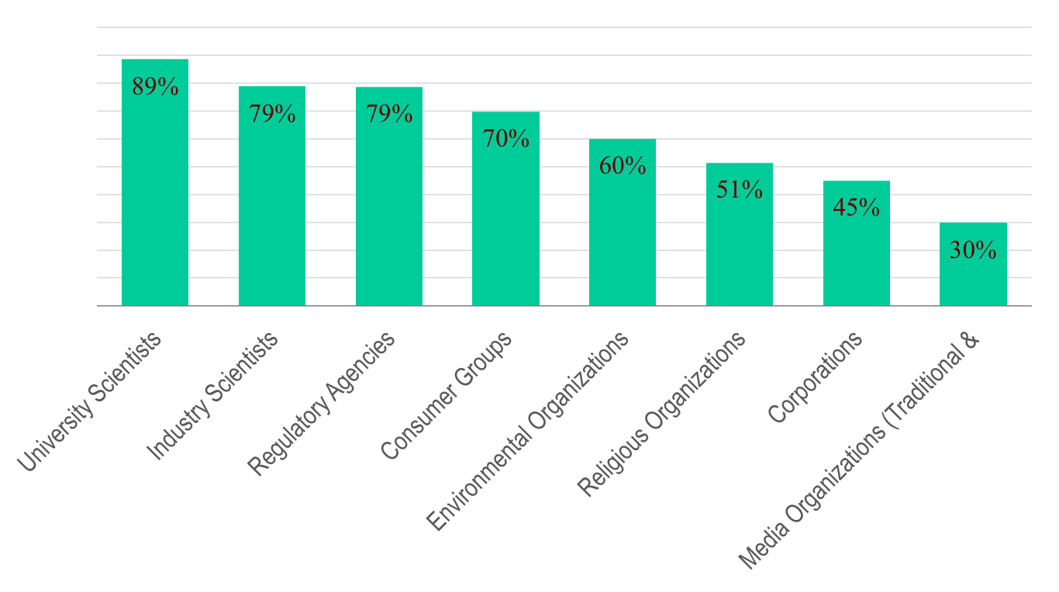
“Who do you trust on food issues?”
(WI residents, N=939, Summer 2015)
Notes:
% of sample that indicated at least some level of trust (somewhat, quite a bit, a great deal)

Slide 23
“How much trust do you have in the following groups to keep food safe?”
*Figures based on percentage of respondents that indicated “quite a bit” or “a great deal”
of trust in these groups to keep food safe.
Notes:
% of sample that indicated higher levels of trust (“quite a bit,” “a great deal”)

Slide 24
What about social media?
Notes:
The 1950s and 1960s: discovery of double helix of DNA; genetic code deciphered
The 1970s:
Development of rDNA technologies
Elucidation of the mechanism used by Agrobacterium to transfer its own DNA into plant cells to grow tumors
Mid 1980s: first USDA APHIS approvals for release of GE crops into the environment in the United States
Mid 1990s: first USDA-deregulated GE crop grown for commercial sale, a GE tomato with delayed ripening

Slide 25
The new realities of risk communication: top channels for “science and technology information”
(Data based on: Associated press/NORC/API Media Insight Project Poll, Jan. 2015)

Slide 26
How about information on “food and cooking”?”
(Data based on: Associated press/NORC/API Media Insight Project Poll, Jan. 2015)

Slide 27
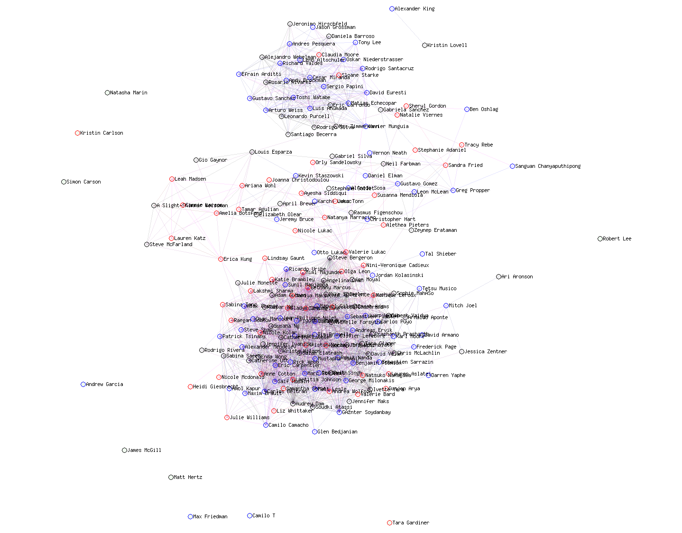
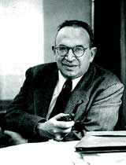
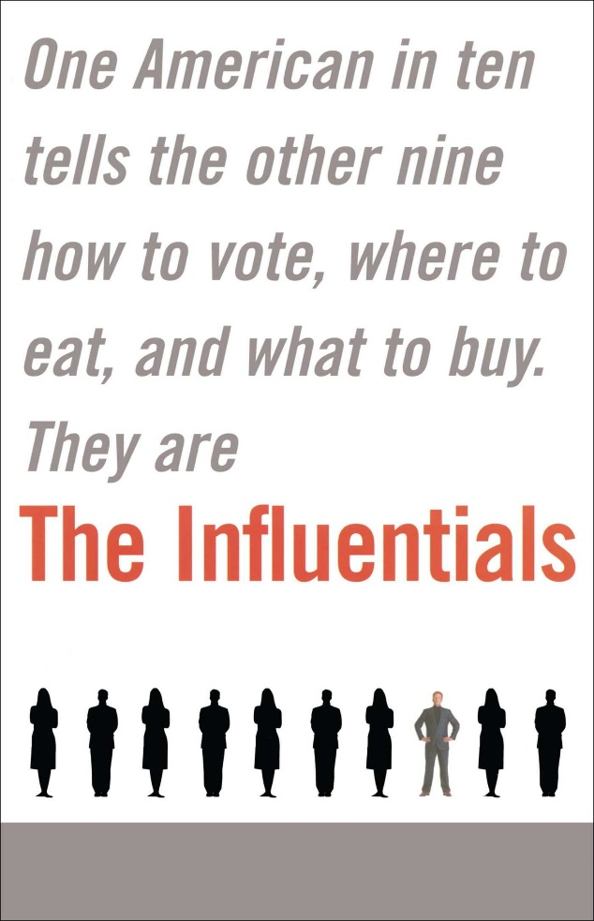
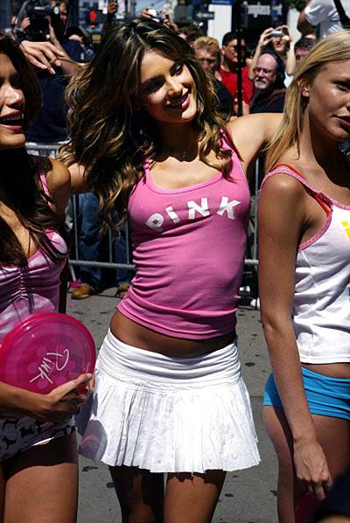
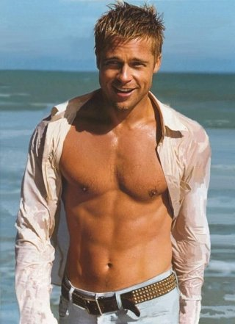
Social media: Opportunities for (almost) direct communication

Slide 28


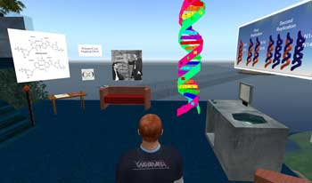











Slide 29
(Online) Americans are using these platforms

Slide 30
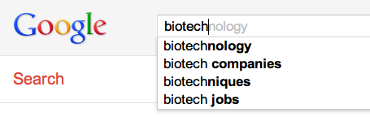
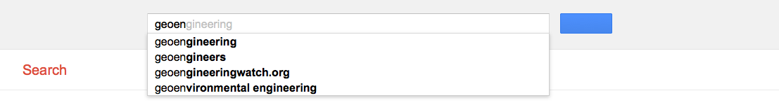
What are consumers likely to encounter online when they search?
We can get insights from “big data” approaches
  For nanotechnology, discrepancy between
    Searches:
      what people look for (tracked by Nielsen online)
    Results:
      what search terms are suggested to them (Google suggest data)
      what they find (content analysis of top ranked search results in Google)
Ladwig, P., Anderson, A. A., Brossard, D., Scheufele, D. A., & Shaw, B. (2010). Narrowing the nano discourse? Materials Today, 13(5), 52-54. doi: 10.1016/s1369-7021(10)70084-5

Slide 31
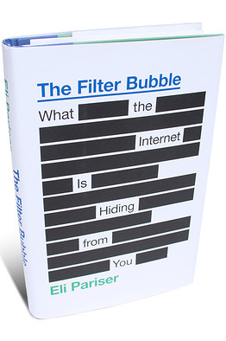
What this means for science-informed audiences
  Potential of “self-reinforcing informational spirals”
Searches
Traffic
Page ranks
Google Suggestions
  Are opinions formed based on how Google presents results rather than on what individuals are searching?
Li et al. 2011; Brossard & Scheufele 2013

Slide 32


Novel “big data” content analysis tool based on intelligent algorithms can provide insightful data
  “Supervised machine learning methods”
    Commercial tools (e.g., Crimson Hexagon ForSight)
Supervised sentiment classifier
Documents
Coding
categories
Large volumes of documents
Coding
categories
Training set
Unlabeled documents

Slide 33
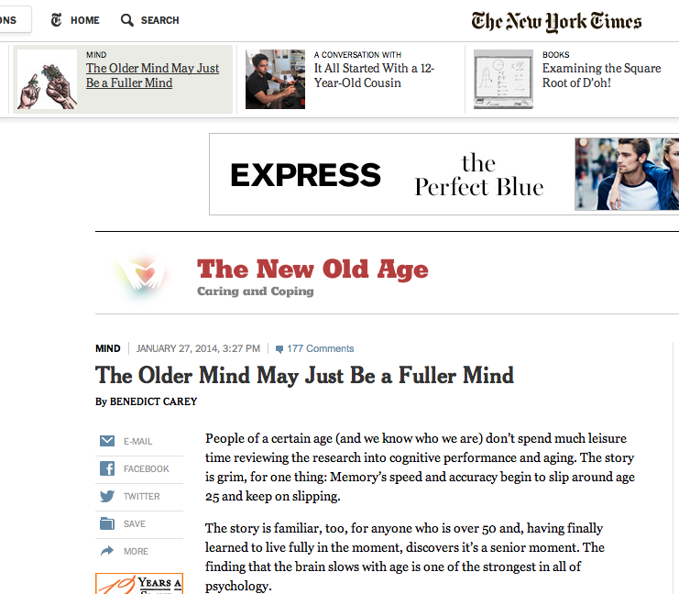
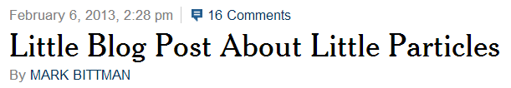
Online users are encountering contextual information
19

Slide 34
The “nasty effect:”
Tone in online comments polarizes readers
People who read uncivil comments
(which only differ on the tone)
end up walking away from an online story
with a much more polarized understanding of the actual risks of the technology

Slide 35
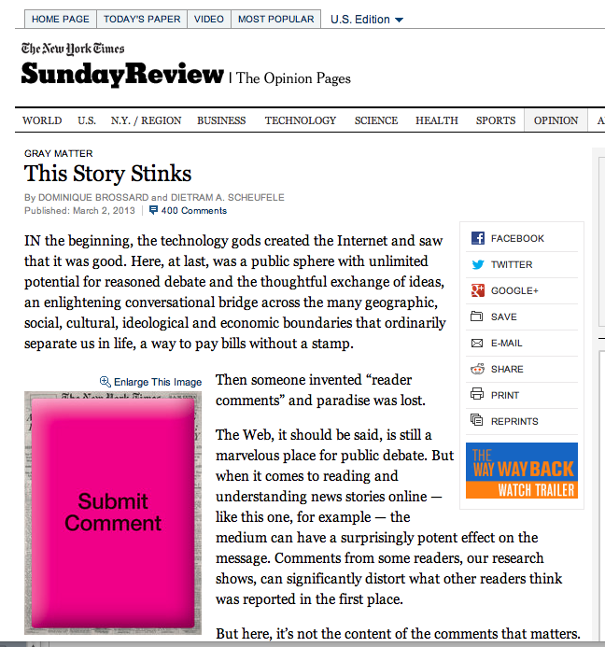

Slide 36
And platforms such as YouTube the normative importance of an issue
Spartz, J.T., Su, Leona Y.F., Dunwoody, S., Griffin, R., Brossard, D. (2015). Social Norms, new media, and climate change. Environmental Communication: A Journal of Nature and Culture, Vol. 9. DOI:10.1080/17524032.2015.1047887
Notes:
Personal Positive High

Slide 37
Let’s go back to the “pink slime” issue..

Slide 38
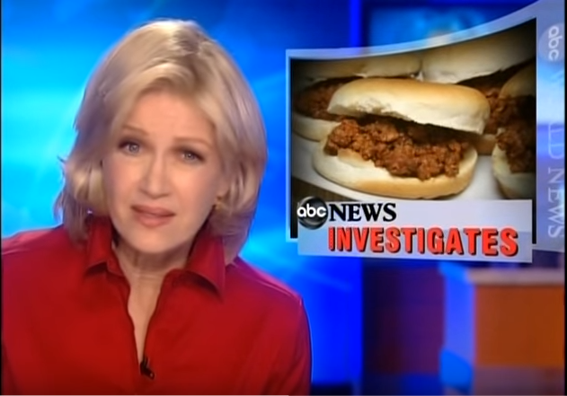

Slide 39

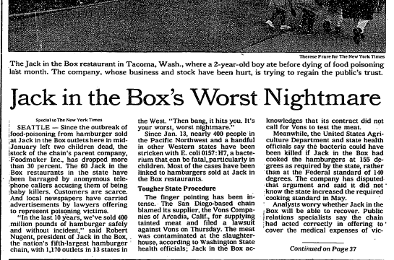
1993 USDA approves BPI’s heated centrifuge process to separate lean beef from boneless, fatty trimmings
2001 FDA & USDA approve use of ammonium hydroxide to eliminate pathogens in lean beef

Slide 40
1993 USDA approves BPI’s heated centrifuge process to separate lean beef from boneless, fatty trimmings
2001 FDA & USDA approve use of ammonium hydroxide to eliminate pathogens in lean beef
2007 USDA officials say ammonium hydroxide treatment reduces E. coli to undetectable levels

Slide 41
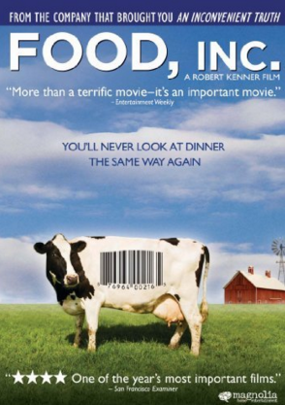
2008 Food Inc. contains segment on BPI and LFTB

Slide 42
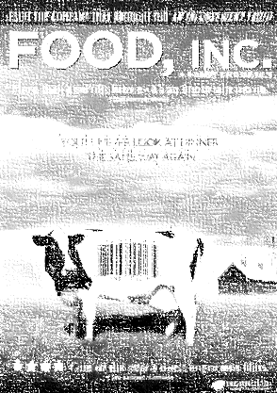

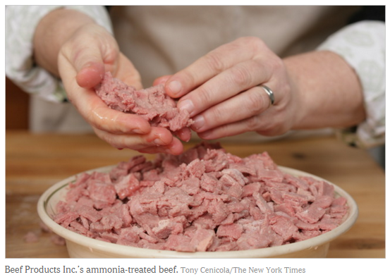
2008 Food Inc. contains segment on BPI and LFTB
2009 New York Times Pulitzer Prize for Explanatory Reporting for piece on risks related to LFTB

Slide 43

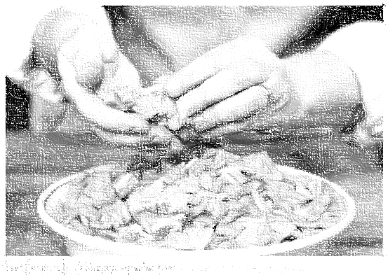
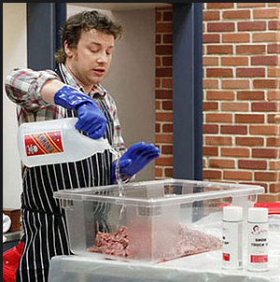
2008 Food Inc. contains segment on BPI and LFTB
2009 New York Times Pulitzer Prize for Explanatory Reporting for piece on risks related to LFTB
2011 ABC’s Food Revolution season premiere

Slide 44

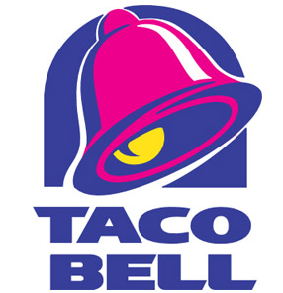
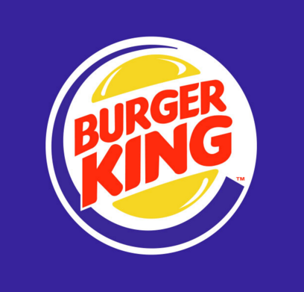
2012
31 January McDonald’s, Taco Bell, and Burger King announce they will no longer use ground beef containing LFTB in their recipes

Slide 45
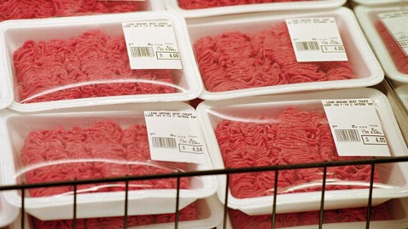
5 March David Knowles, NY Daily reports USDA purchased 7 million pounds of LFTB-containing beef for use in school lunches

Slide 46
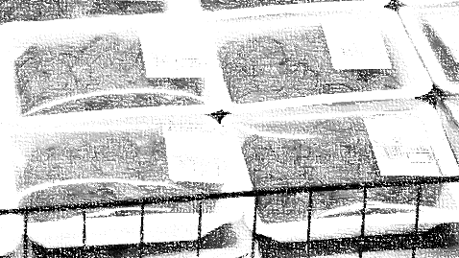
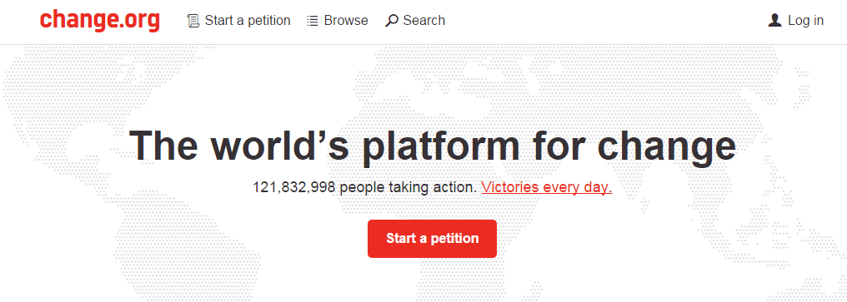
5 March David Knowles, NY Daily reports USDA purchased 7 million pounds of LFTB-containing beef for use in school lunches
6 March Bettina Elias Siegel launches petition on Change.org

Slide 47
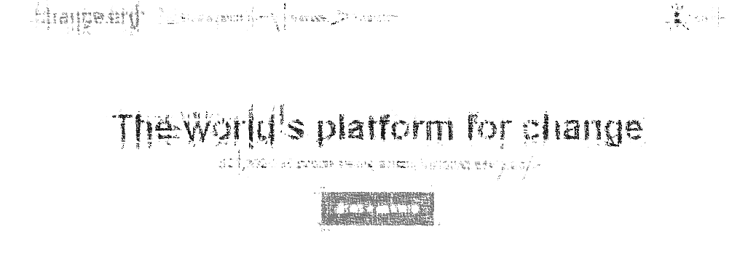
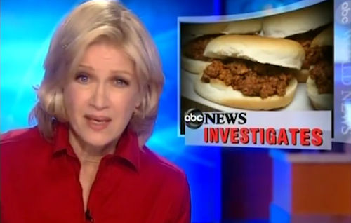
5 March David Knowles, NY Daily reports USDA purchased 7 million pounds of LFTB-containing beef for use in school lunches
6 March Bettina Elias Siegel launches petition on Change.org
7 March ABC News runs first of several reports on LFTB, claiming up to 70% of ground beef in supermarkets contains LFTB

Slide 48

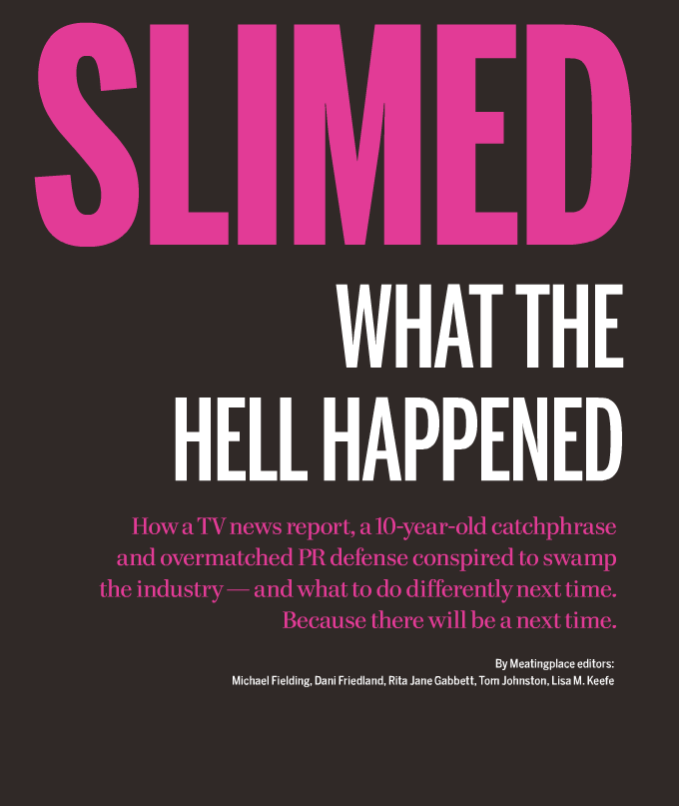
“a social media frenzy”
“You had a perfect storm of sort-of-facts. You have this product no one knows anything about, and … it gets tagged with the ‘Pink Slime’ name.”
“What the bloggers did with the story … was pure infocide”

Slide 49
Our recent study
Runge, K., Brossard, D. & Scheufele, D.(2015). Pink Slimed: A Time Series Analysis of Broadcast Coverage and Twitter Discourse During the 2012 'Lean Textured Beef' Controversy. Paper presented at the 2015 APLS Conference
From 1 January – 31 December 2012:
336,240 LFTB tweets on Twitter
200,000 signatures on Change.org petition (9 days)
LexisNexis
  37 ABC News
  728 reports on other television stations or networks
  360 newspaper articles
  10 industry responses

Slide 50
N=37 ABC News reports; N=728 broadcast/other television coverage reports; N=360 newspaper reports;

Slide 51
Media
LFTB keyword tweets
N=37 ABC News reports; N=728 broadcast/other television coverage reports; N=360 newspaper reports;
N=336,240 LFTB keyword tweets

Slide 52
Results of a “time serie analysis”: Business responses were inadequate in tone and volume to influence the voice of a contingent of interested citizens with active social media accounts
Recent experiment in Wisconsin: consumers see more risk in “ground meat with pink slime” than in “ground meat with LFTB”

Slide 53
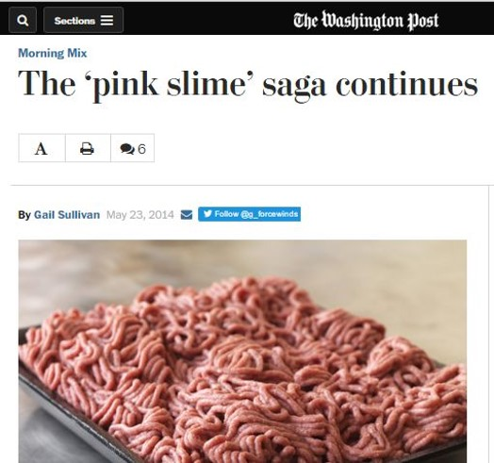
In the social media age, it now matters even more
how we talk about science early on…
Tewksbury, D., & Scheufele, D. A. (2009). News framing theory and research. In J. Bryant & M. B. Oliver (Eds.),
Media effects: Advances in theory and research (3rd ed., pp. 17-33). Hillsdale, NJ: Erlbaum.
  Once a frame is established in public discourse, it’s virtually impossible to change
  And there is no such thing as unframed information …

Slide 54
Care & Attention?
Consumers with little knowledge of food production transfer trust to….
    Actors in food supply chain
    Government regulatory agencies
    Trusted leaders (on social media)
    …
Once destroyed, trust is very hard to rebuild
Competence & Knowledge?
Honest & Open?
Notes:
Stop O-S-O-R review and highlight role of trust
Summarized from deJonge et al. 2007…..
Consumers with little knowledge of food production transfer trust to actors (i.e. farmers, manufacturers and retailers) in the food supply chain as well as regulatory agencies responsible for managing hazards related to the cultivation, production and processing of food.
Children are perceived to be more vulnerable to food safety risks than adults though there is no conclusive evidence that parents of children have greater risk perceptions.

Slide 55


A few do’s of sound
science and risk communication
Be proactive rather than reactive, i.e., when there’s controversy, it’s probably too late.
Think about how you talk about science as much as the science itself; scientific facts alone will not win public debates.
Go beyond “just the science;” take into account values, emotions, prior beliefs etc. that your audiences bring to the table.
Use new and social media as much as possible; it pays off and it will be more and more important.
Rely on on sound social science.

Slide 56
Concluding Thoughts
Audiences are online and using social media
Online profile of companies and regulatory agencies crucial
Empirical research can help! Research can help
  Identify the sentiment of online discourses
  Disentangle the effects of “contextual factors” on risk perceptions
  Understand viral processes
  etc
More and more scientists are embracing direct communication with lay publics -- they can play an important role

Slide 57
Take home messages for practitioners
Specificities on online media have to be taken into account
  Information is contextualized (“likes,” MT, etc)
  Information is shared
  Information is commented on
  => Unique characteristics of each social media platform needs to be leveraged
Crisis need to be anticipated and adequate social media plans launched as needed

Slide 58

Thank you
dbrossard@wisc.edu
scimep.wisc.edu
@brossardd

