Slide 1

Leadership: Where Food Risk Communication Begins and Ends
April 5, 2016

Slide 2
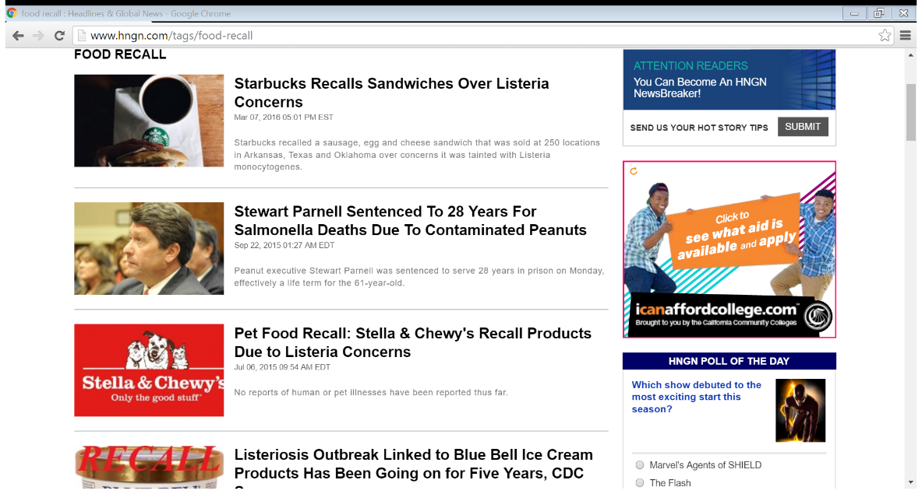
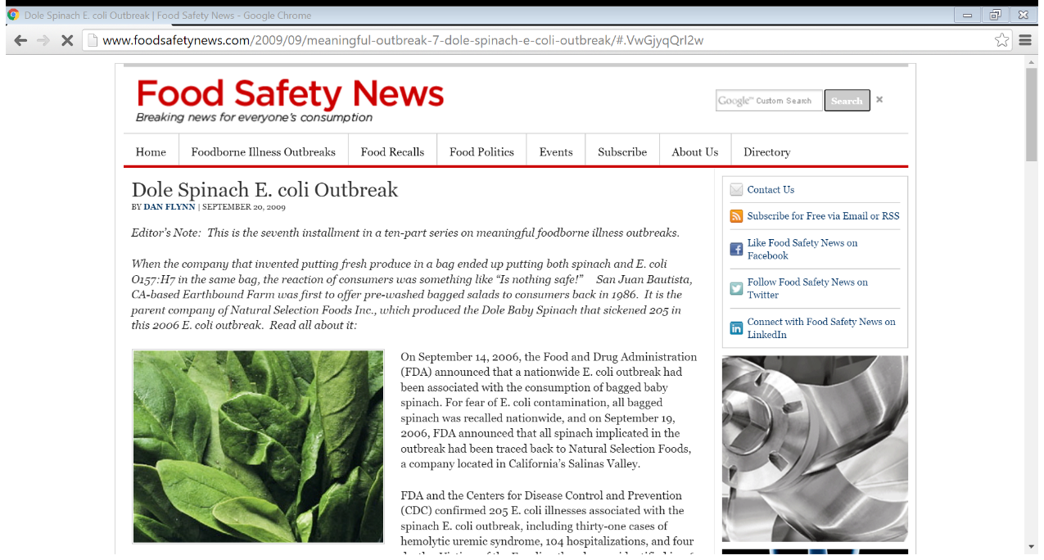
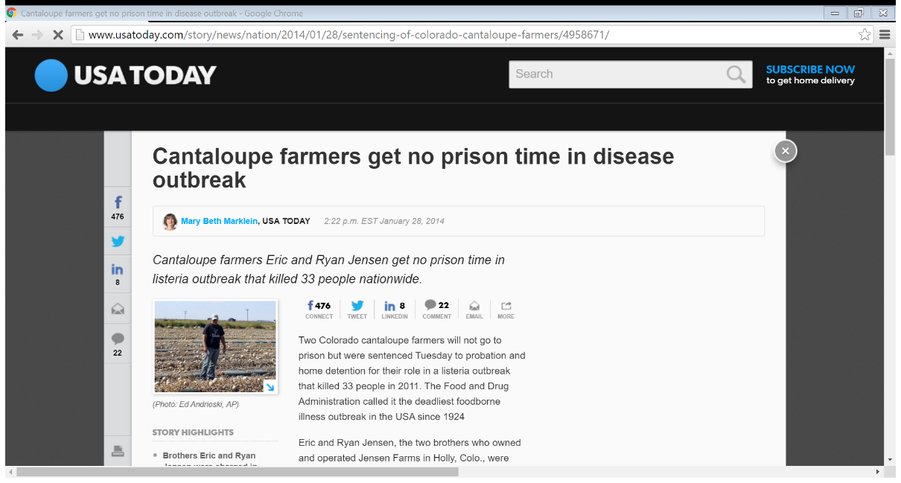
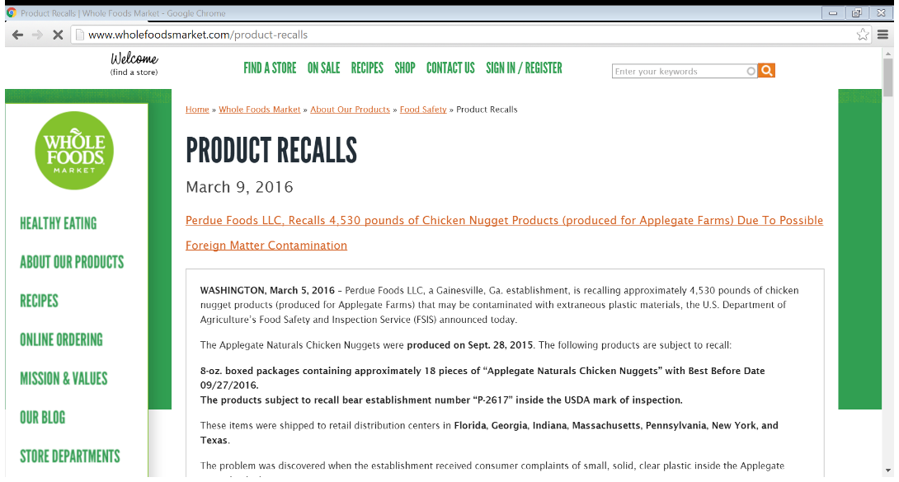
Risks are abundant!
Notes:
Risks are abundant. Quite an understatement. With the evolution of packaged products, more and more fresh foods are processed and prepared in a way that the consumer does not have a kill step at home.
Packaging has provided better traceability and product identity in the wake of illness and detection methods have gotten much more refined, detecting organism at much lower levels than ever before.
Packaging also provides a avenue for consumer risk communication but it’s a slippery slope. How to communicate risk without scaring away business is a huge challenge.
Who would have thought that prison would be the result of risks and that listeria would be such a driver for recalls today. In 2006, who would have thought that fresh spinach would be a problem…I didn’t and I was working at a fresh cut salad plant.
Story of outbreak and weekend meeting with Sr Leadership….didn’t understand the risk

Slide 3
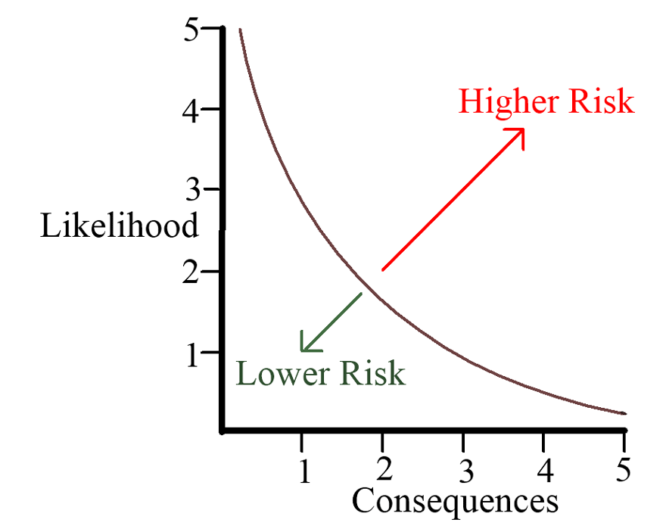
Key Elements to Risk Communication
Build a strong risk assessment tool and process
      tool
team
process
    frequency
Take every opportunity to educate leadership team
timing
process
demonstrate an understanding of the business implications
Communicate risk appropriately
timing
prepare
provide economics
consumer facing messaging!
Notes:
In the coming months and years I learned the need to be at the top of the game in communication, especially around risk.
I never wanted to be caught in the same situation as I was at the meeting on Sept 16, 2006.
I realized I needed to bolster our program.
Our risk assessment needed to be enhanced. We built a huge tool, bringing in all studies possible, building off of recalls and outbreaks, incorporating new information and asking all parties involved for their input.
We met as often as needed to assess risk; any new product, process, equipment or flow needed assessing.
I took more opportunities to educate on the risks. Teaching executives biology is not always an easy deal but when we can leverage the discussion with facts and real people, it becomes more compelling.
Educating often is very important.
Timing is always important. You don’t want to bring up the risk at the end of a new product launch, for example. You need to talk about this right out of the gate when the idea is presented.
Consumer facing messaging needed to change! Best if used by…. Changed to use on or before. More info at website.

Slide 4
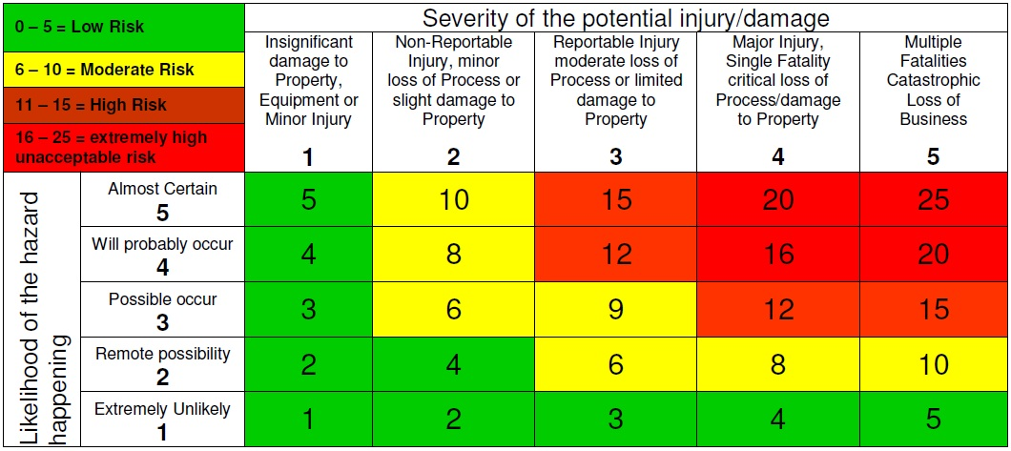
Create your process
Pick a tool
Assemble a team
Define risk
Use information available
Understand process or object being assessed
Determine trigger to assessments
Notes:
AS I mentioned we spent a lot of time building our tool.
We started with the basics like using the matrix here and built from there.
We had a really smart food scientist who loved the risk assessment side of things and she would build in all this complexity. Identifying risk in growing areas, regions, commodities, and ingredients through a constant vigilance on new information. What product is recalled, from where, who were the suppliers involved, etc.
Building a team is very important and include all the stakeholders. This also provided an opportunity to educate the members of the team and they will become your advocate. If you have convinced the floor managers that something carries risk and requires intervention, it will be much easier to convince their boss and your boss.
Risk may be a little different for everyone. Some people will take more risks. Know what and where your limit is and be sure that its not crossed. Know what you’ll do if it ever happens.
Know when you will perform a risk assessment. Pre-determine what will convene the team.
The assessment team is typically not your executive team so be sure to have a mechanism to update the exec team of new findings.

Slide 5
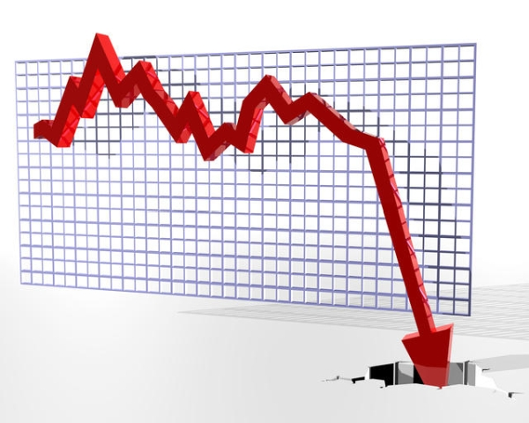
Types of Risk
Brand integrity
Consumer Safety
Consumer Perception
Employee Safety
Productivity
Financial
Notes:
Risks should not only focus on food safety. There are many additional risks that could affect the brand and drive the company out of business.
Keep in mind that not only do you need to protect your consumer but you also need to focus on the employee, the company’s reputation, and the ability for the company to manufacture efficiently in order to protect the financial well being. If, for example, you are assessing a new product and it can be safe while jeopardizing an employees safety, it should be considered as part of the assessment.
Some of these risks may not fall into the food safety/qa arena so be sure to include those people who are most knowledgeable in your assessment.
A strong understanding of what drives the business from a financial aspect is critical to gaining buy in from your peers and actionable results from the assessments.

Slide 6
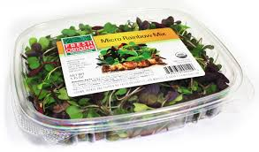
Identify Risks
Assess it all!
Look at product use and consumer perception
Notes:
What needs to be assessed? I think by now you are getting the picture that everything needs to be assessed.
Be sure to understand intended and unintended use of whatever you are assessing.
Tell story of microgreens

Slide 7
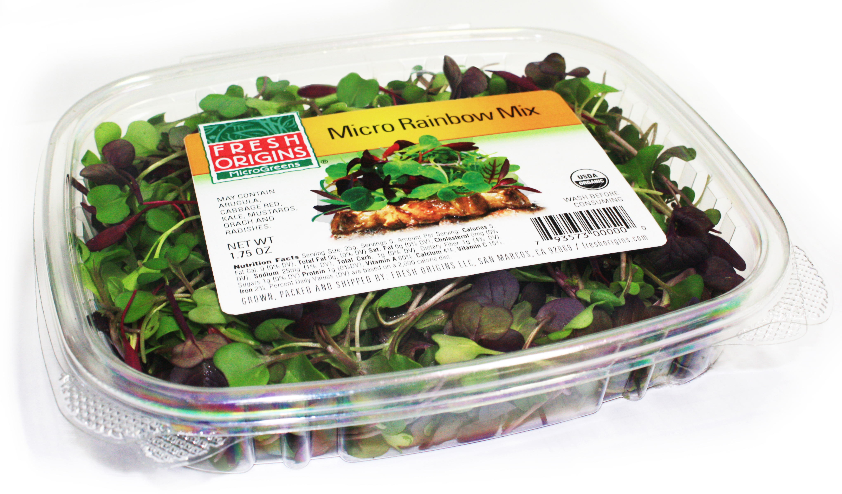
Notes:
Micro greens story continued
Consumer facing risk communication is important but can’t be too extreme as to scare off business.
EBF product testing…..should we communicate that……airlines industry

Slide 8

Prepare your leadership team
Take time to educate on general risks of products
Educate on the process used to assess risk
Take opportunities to insert education
Keep team informed of new developments/learnings
Know your team
Notes:
Don’t be a doomsday reporter but identify key moments to insert education.
Bring in financial implications of decisions and always try and bring in the human factors of decision.
Be honest in the assessment; not everything leads to serious injury or death (although you can almost always assess your way to this conclusion).
As new information presents itself, be sure to forward on to team. Especially if it is easily relatable to your product or products. Being concerned about risks that don’t impact your product can jeopardize the entire process. You must maintain your credibility.
Speak to their level of understanding. Don’t talk down to anyone. Reinforce their knowledge with acknowledgment and take time to correct folks when or if their message is off point.
Knwoing the team is very important. Who will require more time and attention? Who needs less? Do you need to keep talking points for the team on certain aspects of the plan.
Gaining buy in is everything. If you have a plan and people are talking negatively about it in the hallway, you lose credibility.

Slide 9


Communication of Risk
Never in a crisis!
Timing and Frequency
              New products/process
      New information
Determine what level is appropriate to communicate internally and externally
Consumer level
Package
Website
Social Media
Notes:
Your team should be well prepared for what could become a crisis. If you are educating during the crisis, you have not done your job.
Gain buy in from your leadership that what you are doing is important and make sure that you are given the time to properly educate everyone.
Be sure that your executive leadership is properly educated but also be sure that you are educating the entire staff at the appropriate level.
Consumer level communication is a huge challenge. Deliver mitigation strategies to the risk associated with the product. Package, website and social media.

Slide 10



Nothing is static – always be prepared for new challenges…..
Notes:
Much different paradigm this time around.
Executive leadership is different
Copacked product..
Social media only accelerates the process and your executive team’s readiness is that much more important.

Slide 11


Thank you!
Will Daniels
wdaniels@wtrmlnwtr.com
831-236-8090

