Slide 1
Food Risk Communication Plans, Planning, and Social Media
Tools for today’s
food risk communication plan
Amy Philpott and Donna Rosenbaum
Notes:
1 min
Segue from Tim’s “crisis communication overview” presentation

Slide 2
How Social Media is Changing Communication Plans
WHO
Communication Teams Need Flexibility
Moving People and Resources
WHAT
Keep Up with New and Changing Information
Constantly Modify Strategy, Policies, Guidelines
WHEN
Increasing Pace of Media Cycle
Decreasing Time for Decision-Making
WHERE
Wherever Can Have Conversations with Audience
Choices Seem Overwhelming
WHY
Modernize Because Communication Has Evolved
Goal is Building Relationships
Convinced? Let’s Look at Crisis Statistics...

Slide 3
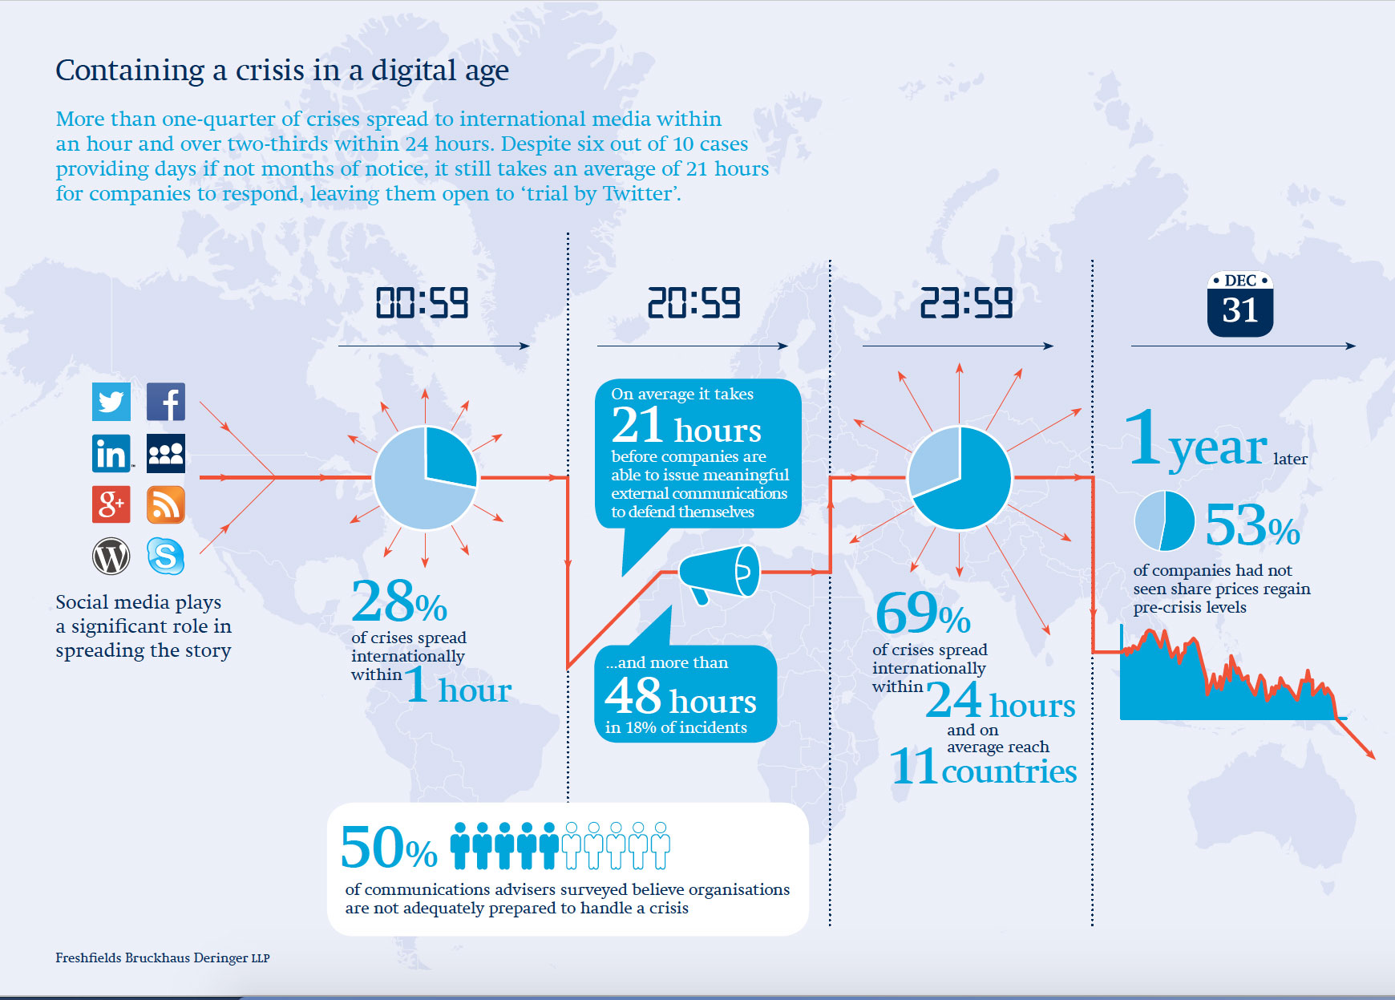
Notes:
Study released 3/2106 by a UK firm - Based on survey of 102 senior crisis professionals in 12 countries (including US) who handled 2,000 crises of large organizations over the course of a year.

Slide 4
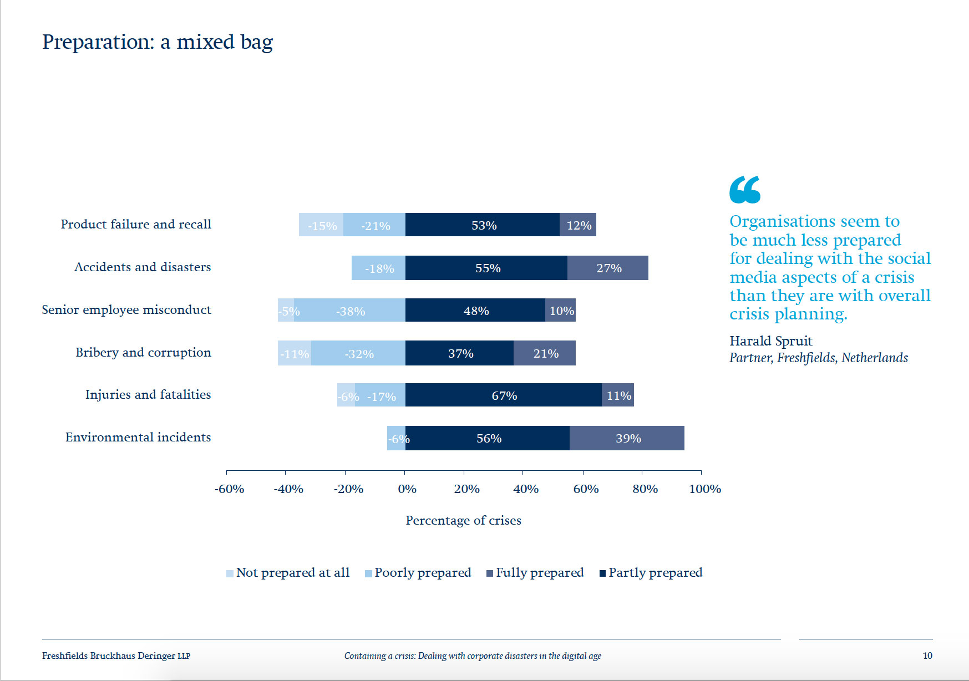
Notes:
Important to note these are large firms which usually indicates more resources to devote to crisis planning.
In the Product failure and recall sector, only 12% large firms fully prepared!

Slide 5
Food Risk Communication Planning is Very Challenging
Fact: Food risk differs from other risk issues because of the many emotional and cultural issues involved
And, vulnerable populations...children, the elderly, pregnant women, pets...intensify these emotions
Fact: Most organizations are not as well prepared for a crisis as they should be
And, A Crisis is a Perpetual Reality
Fact: Social media not only ramps up response time but also amps up response volume
And, What happens in social media stays on Google FOREVER!
It’s easy to feel paralyzed and not know where to start
Notes:
Why food risk differs somewhat from other risk issues and has more emotional components to it
...food risks are not perceived in the same manner as other risks due to the more intimate personal and cultural relationship we have with food and its nurturing component- every consumer has a unique relationship and attitude towards food and food safety based on their personal life history.
....also secondary issues with vulnerable populations...children, elderly, immune compromised, pets....these populations often don’t shop or prepare their own meals, so dependent on others to make good choices + consequences of bad choices, ie., foodborne illness, much more severe and complicated in these populations.....so perfect storm for heightened emotions....and we know that emotion and visceral reactions can cloud rationality and ability to communicate

Slide 6
There is a Silver Lining: The Social Cloud
What if...
All of a sudden, your business or organization were offered a tool that allowed you to listen and respond to the casual conversations of current, potential, and past customers and audiences?
Wouldn’t that be too incredible to pass up?
Well, it’s actually here and sitting right in front of you every day.
Social media used intelligently as part of food risk communication planning offers companies and organizations of every size an incredible opportunity to gain business insight through social interaction.
Notes:
Keep in mind that as networks and applications expand and change, communication today, both social and traditional is always evolving, and so should communication planning....this is all a work in progress to be revisited.
Social media used to be an afterthought- throw out there and see what works.
Food safety news that used to take an entire day to transmit (I remember sitting at a fax machine for hours with press releases) is now shared instantly.
Food news is global news and impacts wide and diverse populations and supply chains.

Slide 7
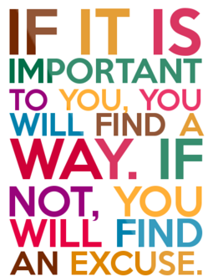
Need More Convincing?
What has caused the tremendous surge in the local or locavore food movement?
The locavore movement is popular because consumers want to have conversations with those that produce their food.
“Unselling”, the new trend in marketing, is based on relationship building in order to develop trust and social capital.
It’s hard to build relationships without conversations and audience interaction
Social media platforms make this possible
For both B2B and B2C
Excuses abound for not starting social media activity.
No control – BUT you never really had control!
People always complained - BUT now everyone hears it
No time or ROI – BUT what financial risk do you face by
not participating?
Will you to able to communicate effectively during a crisis?
If people are talking about you, your brand, your organization,
...You NEED to be part of the conversation!
Notes:
ck so loud and clear before. Now, with social media you get to hear the positive feedback as well, and get the opportunity to turn those negatives into positives - or at least neutrals.
participating?taking the time for social media and making this investment in your business?

Slide 8
Two Features Drive Social Media Success
Invest in Social Listening
The insight gained in social media conversations can fuel the success of your entire Food Communication (FRC) Plan and add value to your organization
A modern FRC Plan means deploying staff time so that you allot as much budget to listening and talking to your audience as you do in creating content....social media is just that, SOCIAL, so get out there
Social listening is part science and part art and it is evolving quickly, so invest in training
2. Focus on Your Website as a Hub for Activity
The goal of social media is not to push content and hope that someone will find it
It’s to pull your audience to you to quickly find the content they need, and come back again
Ensure your website is user-friendly and interactive- can your audience ask questions and have them answered in a timely fashion?
Start small and ramp up your social media program as you gain experience
Start a Blog on your website (even once a month is okay)- have staff respond to posts
Experiment with different social media platforms and link to and from your website
REMINDER: GOAL IS NOT TO PUSH & PRAY, BUT TO PULL & STAY!
Notes:
Starting small can mean starting with your website-

Slide 9
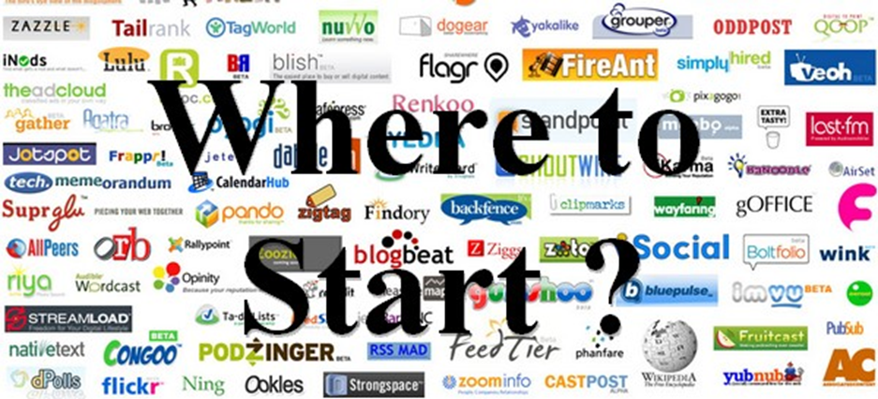
Jumpstart Success
Understand the primary goal of brand-centered communication plans (selling) differs from that of issues and crisis communication plans (building trust and social capital)
Doing well with social media communication takes a different skillset and a different attitude than traditional media communication.
To succeed, carefully choose the right people to engage your audience and have them doing the right thing at the right time.

Slide 10
Start by Looking at Evolution of Media Communication
This was Then - Before Internet & Social Media
Life was simple
The universe was your brand
Create and push content
Broadcast(radio & TV) and print
Issues & Crises were handled by satellite teams pulled in on as need basis
Marketing Communication Plan for Brand
Notes:
Let’s explore a model for understanding how media communication has evolved.....

Slide 11
This is recent past + Internet & + Social Media
Marketing Communication Plan
Issue & Crisis Communication
Plan
Social Media Team:
Tactic, Audience
Notes:
Addition of the internet brings website development and beginning of social marketing
Traditional relationships between marketing, social media and issue/crisis communication changing
Goals of marketing, or branding, vs. food safety risk communication are different and impact effectiveness, such as in when following an emerging trend with a food product, either being used incorrectly used or in a recall situation, there needs to be a juncture to decide if FS related so emphasis changes from product based and company based, and from keeping consumers as customers to something more basic- i.e., keeping people safe! (i.e. The plan doesn’t begin with a response; it begins with understanding the situation and potential impact on various audiences. Gather information and assess the situation before acting and you’ll be more effective!) Staff your response team carefully….when you are having individual conversations via twitter or even showing up in email, approach, tone, goal is different.
SM new- throw it out there & hope it sticks!......process of changing the push to pull…used same tactics, something missing

Slide 12
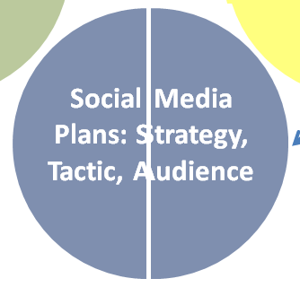
This is recent
Marketing Communication Plan
Issue & Crisis Communication Plan
Social Media Plans: Strategy, Tactic, Audience

Slide 13
This is now!
Marketing Communication Plan
Issue & Crisis Communication Plan
Social Media Teams: Strategy, Tactic, Audience
Social Media Teams: Strategy, Tactic, Audience
Notes:
Ultimately the, communication plans come down to the people you have in place to make your system work , and it doesn’t matter how big or small you company or organization is.....you need the right people at the right time making the right decisions and saying the right things at the right times. These might need to be different people on the SM team if goal is issue & crisis management instead of marketing.
So, let’s start at the very beginning, with the planning necessary in order to put the right people in place.
May need to re-examine your planning chart and think about hierarchies differently when put together issue teams.

Slide 14
Of Teamwork & Avatars
Social Media Team Core Functions:
Community Manager - spends time online with customers, fans, perspective audiences, your industry/issue influencers
Strategist – decides on targets, audiences, what platforms to use and how often to post
Analyst- tracks what competitors doing, best practices and opportunities, tactics and creates measurements/reports
Content Creator-messaging specific to context, audience, platform
Consider Using Avatars:
Coax out your issues by doing specialized audience research and role-playing
Avatar character description write-ups
Avatar role-playing
Bonus - Avatars can help find more similar customers/audience for marketing
Notes:
Start by doing active listening to gain insight with audience, but to be fully functional in social media with your organization comfortably in the drivers’ seat......need to be strategic...can ramp up or ramp down by having core responsibilities handled by 1 or more people, depending on budget and size/complexity, BUT need to have core components handled effectively AND DIFFERENTLY if you are brand marketing vs. handling sensitive crisis or issues management…choose different people, or if same people, have them put on different hat; change the goals in your plan!.
In my opinion, this is part of what went wrong in the communication department with the recent Chipotle outbreak….social media a buzz with language….dude, what a bummer, can’t get my burrito…..what’s a little e. coli compared to a day without a burrito……a little more serious corporate messaging needed…..stop selling and put health first….this is what is needed to maintain respect, trust, and ultimately protect brand.
1. Success is issue dependent for team, tone and objectives....some folks recommend coaxing out your issue audiences by using avatars.....research to get very specific ....married, gender, # of kids, education, travel, hobbies...how spend weekend & what types of movies!!!!!....find better ways to relate and reach out
2. 60% of Americans are on FaceBook.....Then find out geographics or national ....use FB Ads Manager to estimate size. If too small to handle, modify & change to reach, if too large, then break up into subissues
3. Ask customers what sm sites the use? Podcasts? blogs?
4. Research online behavior...Pew Research Center...also can find globally other platforms & country info
5. Find your customer/audience (by issue!)
In FB can find a “lookalike” Audience to match your avatar & go
Or ads.Twitter can lead to geographic, gender, keywords, interests, and influencer searches
Talk a minute about personas/ avatars- really good tool to summarize research about a target audience ad help s.m. and regular marketers see your organizations world from a single target person’s perspective.....Imp to note that you may be engaging different personas/avatars for pre-crisis, during crisis and post crisis period , but compilation of those avatars will help you reach and msg

Slide 15
Benefits of Social Media
Makes decision-making easier
Develops marketplace insight
Increases exposure & traffic
Develops trust and loyal fans
Increases search rankings
Establishes thought leadership in an issues space
It takes people and organizational resources to be effective.
Outsource your weaknesses and things your organization doesn’t like or isn’t good at, but do not outsource relationship building.
A modern communication plan based on developed social media skills will better prepare you for whatever issue or crisis comes your way.
Notes:
Special note- issue here with some companies strictly forbidding even internal discourse on “problems” – no case study even within teams of that company- just bury it and forget it....no lessons learned.....archaic way of conducting business and esp. problematic in the s.m. era- cuz bad enough if happens once- but IF happens again in same manner----or keeps on happening= very difficult to recuperate and may even harm you with prompting litigation.

Slide 16
Social Media Triage Response Plan

Slide 17
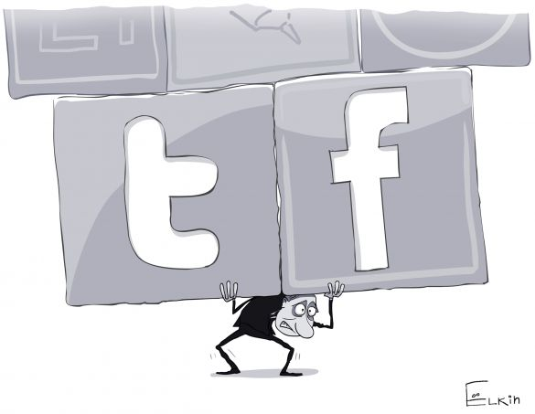
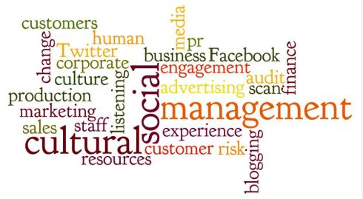
Social Media Triage Response Plan
Integrated into issue and crisis communication plan
Include a SM Community Manager AND an alternate on the crisis communication team
Be realistic about the corporate (SM) culture
But push those barriers as far as you can. Work to bring them down.
One size doesn’t fit all
Notes:
Lawrence stated that 79 percent of companies believe they are only 12 months from a crisis, and 50 percent of those companies believe it will happen in the digital space - See more at: http://
Dallas Lawrence (@dallaslawrence) 12/13/2013
SM is the ultimate corporate culture truth serum

Slide 18
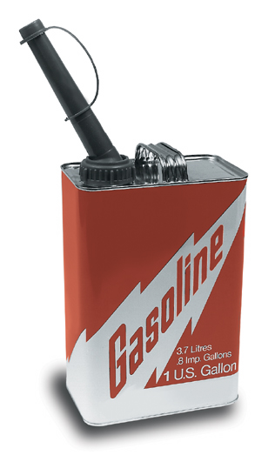
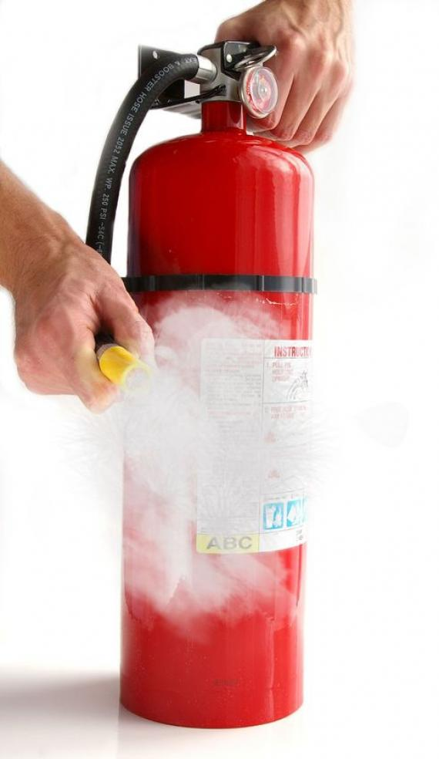
Social Media Triage Response Plan
Identify the role of SM and how it may impact your response:
To instigate
To accelerate
To extinguish
Notes:
The next role is that of accelerant. A similar crisis may have happened 20 years ago, but it would not have metastasized so quickly without social media. So Lawrence stresses we must be prepared to act immediately instead of waiting and seeing.
The third and most important role social media plays is extinguisher. We can use social media effectively before, during, and after a crisis to mitigate the damage, and in some cases actually eliminate the crisis. - See more at: http://www.burrellesluce.com/freshideas/2013/12/14-tips-for-building-your-social-media-crisis-communications-plan/#sthash.tYi8I4un.dpufwww.burrellesluce.com/freshideas/2013/12/14-tips-for-building-your-social-media-crisis-communications-plan/#sthash.tYi8I4un.dpuf
Dallas Lawrence (@dallaslawrence) 12/13/2013

Slide 19
Which is it?
The Need for Speed
Notes:
Adapt communication response process to social media timeframe
Operate in quickly to avoid an information vacuum, but don’t act before you know what to say
Need a feedback loop on steroids

Slide 20
When is it too late?
Notes:
When is it too late to plan?
When is it too late to respond? Planning will help prevent this.
If you don’t already have a list of all the company’s SM accounts in the regular SM plan, then make one!

Slide 21
Social Media Triage Response Plan
Identify activities and assign responsibility
Have a process for monitoring, approving platform-appropriate messages, replying and providing feedback
Messages should be consistent with rest of crisis communication
Identify resources (human, financial, technical) in advance
Notes:
When and how will you:
Monitor
Engage
Not engage
Identify – more frequency? Additional search terms for specific crises or issues?
Does the normal SM policy take into consideration extra ordinary circumstances?
HOW: Use a social media management system (SMMS)

Slide 22
Social Media Triage Response Plan
Guidelines for using people, not logos, as the face of your social media accounts during a crisis
Identify roles your various communities may play in a crisis
Make a list of everywhere your brand appears on SM.

Slide 23
Planning without practicing is not a complete waste of time…just mostly.

Slide 24
Tell me and I’ll forget;
Show me and I may remember;
Involve me and I’ll understand
-- Chinese Proverb

Slide 25
Suggested Tools & Templates in the SM Triage Plan
Social Media (Digital)Policy
Social media triage response diagram
List of social media handles (usernames) with administrative information (passcodes)
List of issue-specific search terms to be monitored
Notes:
Have clear employee rules and training for social media engagement in general, and specifically for engagement during a crisis

Slide 26
Suggested Tools & Templates in the SM Triage Plan
List of social media audiences and their potential roles (influencers in your space, bloggers, x-reference w/ non-social media communication list)
Notes:
Have clear employee rules and training for social media engagement in general, and specifically for engagement during a crisis

Slide 27
SM as an Audience or a Tactic?
Audience | Primary Responsibility | Communication Options | Concerns

Slide 28
Remember…
Stay grounded in crisis communication principles
Use resources and decision-making structures to adapt to changing circumstances
Be a regular social media community member
Get support from throughout the company – and especially from top management
Update the triage plan - at least annually
Practice the triage plan in order to remain ready
Notes:
5 min
Final tips regarding plans, planning and social media:
Stay grounded in the principles that Bill talked about, but…
What works today, may not work tomorrow, so use your resources and decision-making structure to adapt.
Social media is constantly changing so must stay on top of it in order to be able to use it when needed
Plans and planning require full support throughout the company – and especially from top management
No plan is perfect. Use every opportunity to improve: include practices and postmortem in the plan
Plans must be periodically tested in order to keep them current with company practices and in order to maintain a state of readiness
How a company tests its plan does matter

Slide 29
Social Media Reality
Notes:
Social Media has shaken up more than the response time ...also amplifies response by creating “Buzz’ or going “Viral

Slide 30
Resources*
Material Specific to Food Risk Communication:
A Handbook on Risk Communication Applied to Food Safety, WHO/FAO, 2015 http://www.auv-ks.net/repository/docs/2016_01_28_141028_Final_version_Handbook_28-11-2014.pdf
Food Safety: A Communicator’ s Guide to Improving Understanding, IFIC, 2015 http://www.foodinsight.org/foodsafetyguide
Best Practices for Crisis Communicators: How to communicate after food or feed safety incidents, EFSA, 2016 http://www.efsa.europa.eu/sites/default/files/crisis_manual_160315.pdf
Social Media & Marketing Advice & Tools- articles, white papers, toolkits, podcasts, videos, webinars:
MarketingProfs.com
SimplyMeasured.com
SocialMediaExaminer.com
Particularly useful: 2016 Social Marketing Planning Guide, Simply Measured http://get.simplymeasured.com/2016-social-planning.html#sm.000117lgf61byte2trzc9tg52xwmg
Toolbox for Social Media Marketing
http://www.marketingprofs.com/smarttools/tool/18
Caveat 1- This is a membership site ($)- need to join to access the tools
Caveat 2- They do not differentiate between social media brand management and social media issues management. That being said, the tools are very helpful and easy to use; numerous forms for tracking detail work

Slide 31
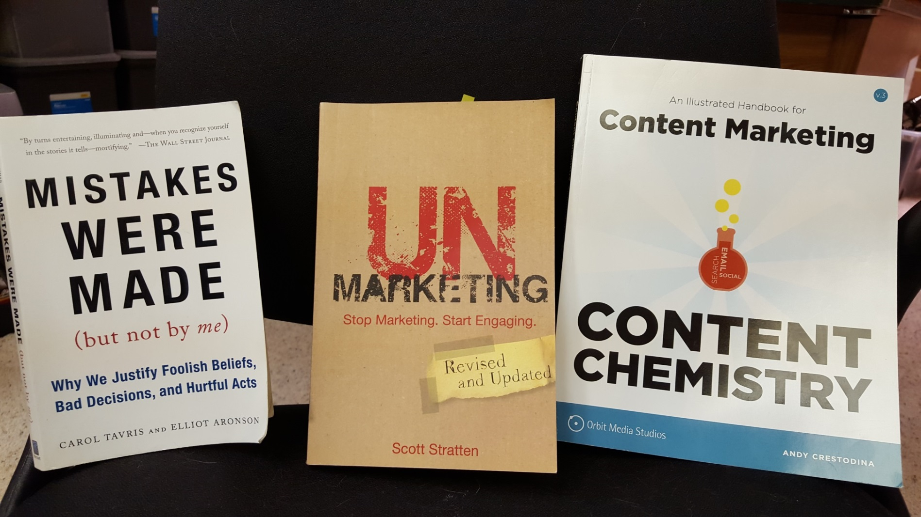
Resources
Carol Tavris & Elliot Aronson (2007) Scott Stratten (2012) Andy Crestodina (2015)

Slide 32
Resources*
Social media triage response diagrams
http://cksyme.com/how-to-put-together-a-social-media-triage-response-plan/
http://www.socialfish.org/2010/11/social-media-response-triage/
Social media policy
http://blog.hirerabbit.com/5-great-corporate-social-media-policy-examples/
https://www.americanexpress.com/us/small-business/openforum/articles/employee-social-media-policy/
Case Studies in Food Protection: Why Utilizing Social Media as a Risk Mitigation Tool is a “Must Do”
http://www.foodsafetymagazine.com/magazine-archive1/februarymarch-2014/why-utilizing-social-media-as-a-risk-mitigation-tool-is-a-e2809cmust-doe2809d/
*These resources are provided as references only. Neither Food Safety Partners nor Watson Green endorse or work with or for any of the resources provided.

Slide 33
Thank you
Amy Philpott
Watson Green LLC
Washington, DC
O: 202-384-1840
C: 703-472-6615
aphilpott@watsongreenllc.com
Donna Rosenbaum, M.S.
Food Safety Partners, Ltd.
Northbrook, IL
O: 847-715-9589
C: 847-757-5377
donna.foodsafety@gmail.com
Notes:
1 min

Slide 34
Questions
Notes:
9 min

