Slide 1
A Public-Private Partnership for Data Sharing on the Impact of Food Safety Capacity Building
Clare Narrod* and Andrea Stumpf**
*
**Structured Partnerships

Slide 2
Main points
Given changing regulatory requirements and the joint need to understand impact of past efforts
  This is the ideal time to have discussions and build a platform to share existing data to measure the impact of food safety capacity building efforts well as a partnership to collect additional agreed upon data not currently being collected.
Paper
  Proposes an approach to measure the impact of food safety capacity building efforts
  Provides a rationale for forming a PPP to share data
  Presents a skeletal framework for a PPP.
Though the proposed PPP is focused initially on the impact to U.S. consumers, it has global dimensions from the start and is envisioned to develop a global focus over time.

Slide 3
Rationale for Measuring Impact of Food Safety Capacity Building Efforts
Measuring the impact of training and capacity building efforts on food safety can:
  document and examine past efforts;
  justify and galvanize future efforts;
  identify new focus/improvements for future efforts
Such efforts benefit everyone: consumers, producers, distributors, and regulators;
Improvement in food safety can result from collective attention to capacity building efforts by public and private sectors globally

Slide 4
Why care?
Serves as a linchpin for investments to improve public health.
Helps private sector show corporate responsibility.
Helps public sector collect trusted, quality-controlled data.
Takes FSMA to the next level.
Creates a global public-private good.
Food Safety Capacity Building Data

Slide 5
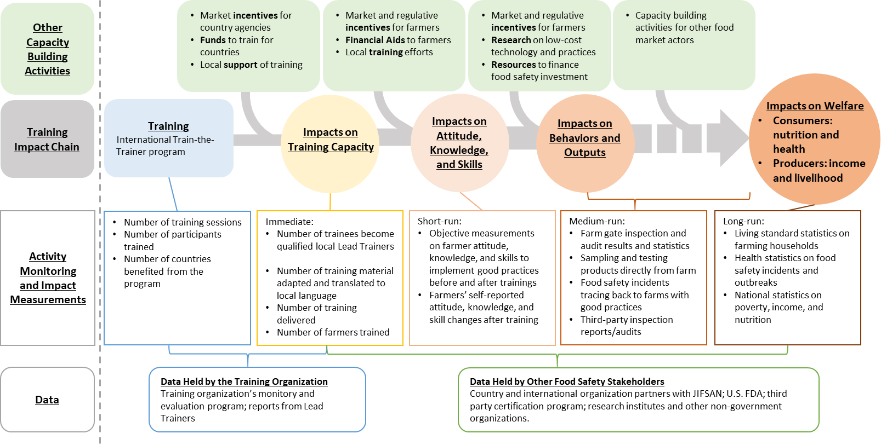
Chain of Food Safety Capacity Building Impacts

Slide 6
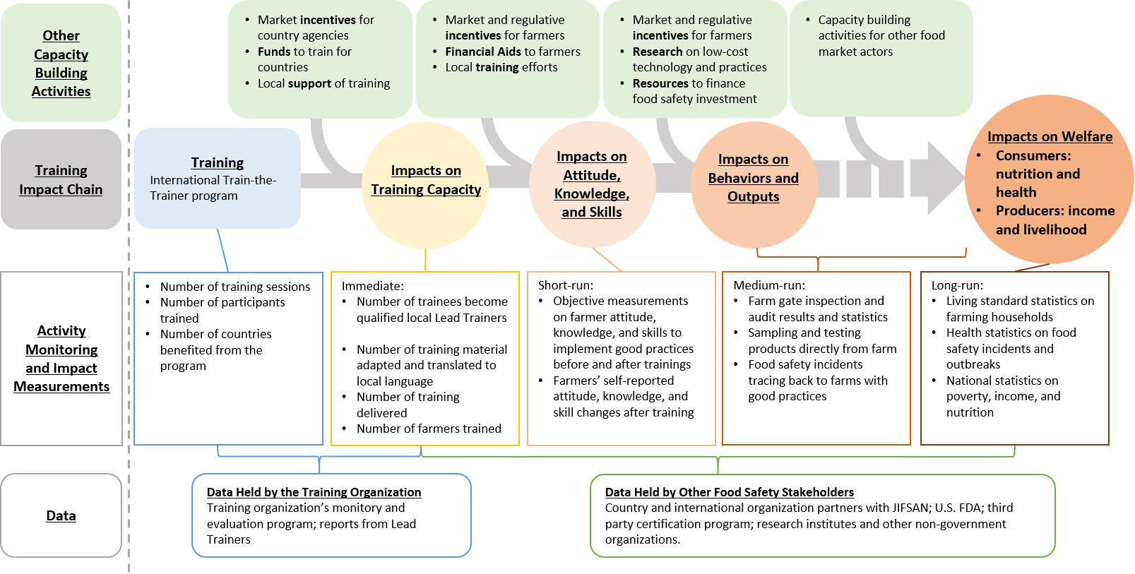
Chain of Food Safety Capacity Building Impacts

Slide 7
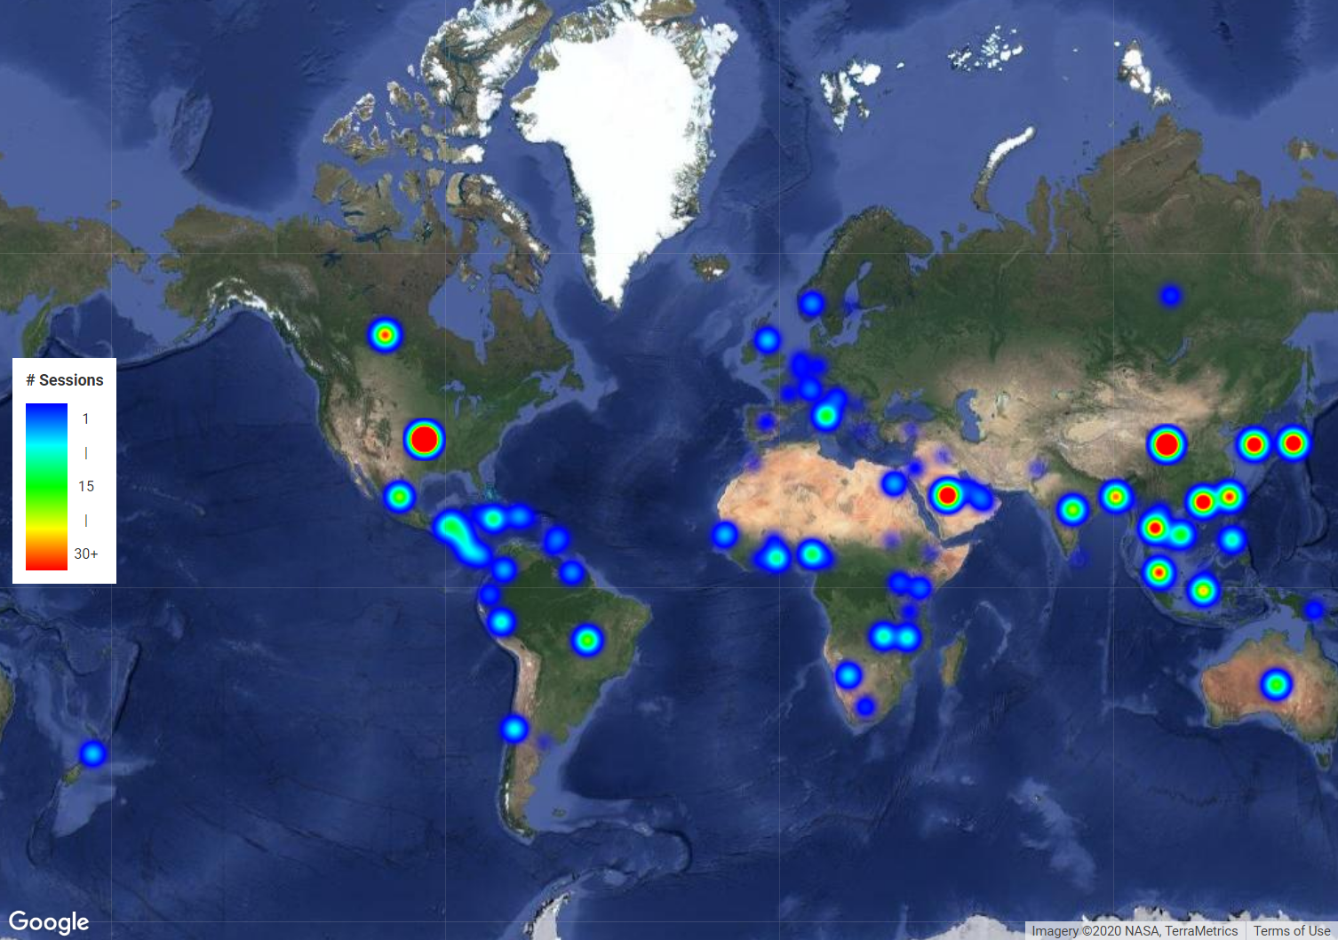

Slide 8
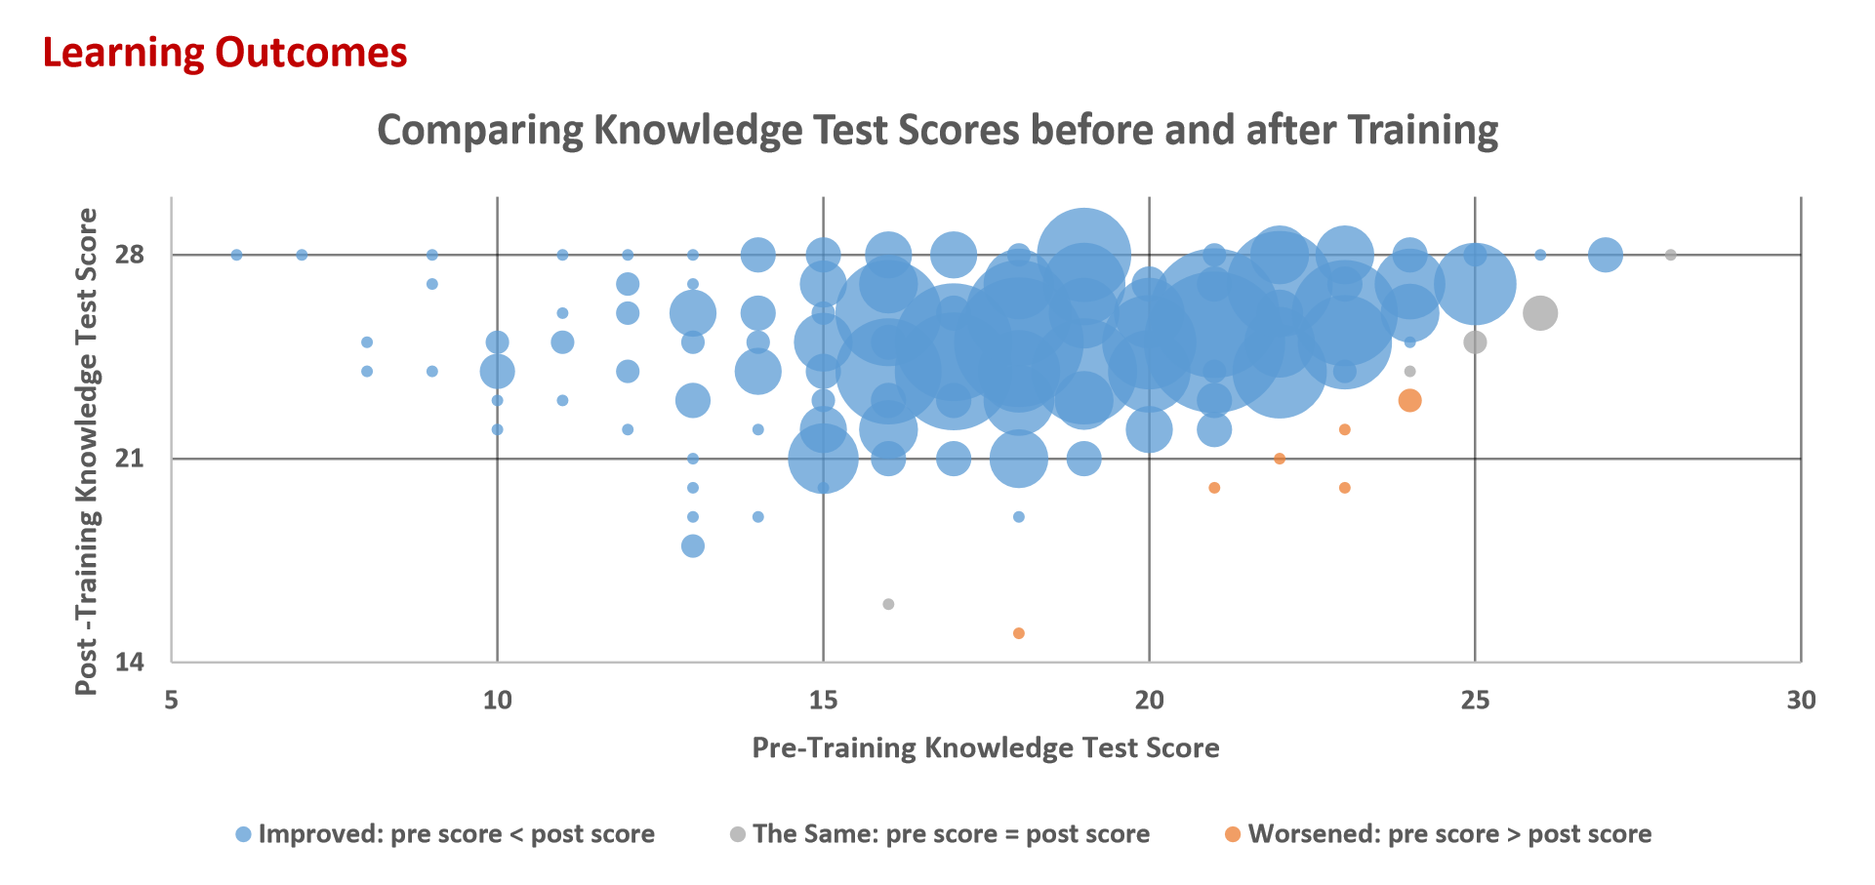

Slide 9
Chain of Food Safety Capacity Building Impacts
3rd party audit/
inspection reports

Slide 10
Potentially Useful Data Sets by Public Sector
Sector | Category | Possible Measures
Trainers | Training | Number of training sessions, number of participants trained, number of countries benefiting from training programs
 | Impacts of capacity building | Number of trainees becoming qualified lead trainers Number of training material adapted and translate to local languages Number of trainings delivered Number of farmers or processors trained Number of producer producers getting PSA or FSPCA certification
 | Impacts on knowledge, attitude skills | Surveys on producer’s/processors knowledge, attitude and skills to implement good practices before and after trainings
Regulators | Monitoring for problems/ progress of efforts | Rejection, Inspections, Compliance, Actions, Recalls, Summary, Import data Food safety incidents traced back to farms/processors Data on FBDs outbreaks Data on capacity building progress Data on food safety informatics program progress
 | Monitoring of welfare impacts | Living standard statistics Health statistics of FBDs National statistics on poverty, income, nutrition
Notes:
If used these slides would just be flashed

Slide 11
Potentially Useful Data Sets by Private Sector
Category | Possible Measures
Monitoring measurements of production outcomes, As well as impacts on behavior | Farm gate and manufacturer inspections, third party audit reports Product sampling and testing of products along the value chain, trackbacks Number of products going through the “first pass” quality check without having to be reworked or diverted to a lesser value stream, Number of products on hold, Number of marketplace actions taken based on customer complaints or recalls, Ability to attract new customers and enter new markets that could be good measures of impact of capacity building efforts.
Internal control measures for a company | Development of facility internal control measures, Increased number of analytical test results within acceptable values, Improved audit scores through internal or 3rd party audits, Improved “risk” score amongst those companies who create risk scores for their plant and/or suppliers, External certification of the facility/operation, Decreases in frequency of required audits, Reductions in regulatory violations
Monitoring measurements of production outcomes, As well as impacts on behavior | Farm gate and manufacturer inspections, audit reports Product sampling and testing of products along the value chain, trackbacks Number of products going through the “first pass” quality check without having to be reworked or diverted to a lesser value stream, Number of products on hold, Number of marketplace actions taken based on customer complaints or recalls, Ability to attract new customers and enter new markets that could be good measures of impact of capacity building efforts.
Notes:
If used these slides would just be flashed

Slide 12
Data Sharing Challenges
Data belongs to different organizations or groups.
  Need to be justifications to share data
Secondary data is collected for specific purposes and not directly for measuring the impact of food safety capacity building.
  Often not in a form that facilitate attributing changes to a specific food safety capacity building effort
Private sector data likely already being collected, however:
  Belongs to individual companies and often considered proprietary, sensitive business information.
  To share data need justification and motivations for these companies

Slide 13

FDA Commissioned Report
Released Jan 15, 2020

Slide 14
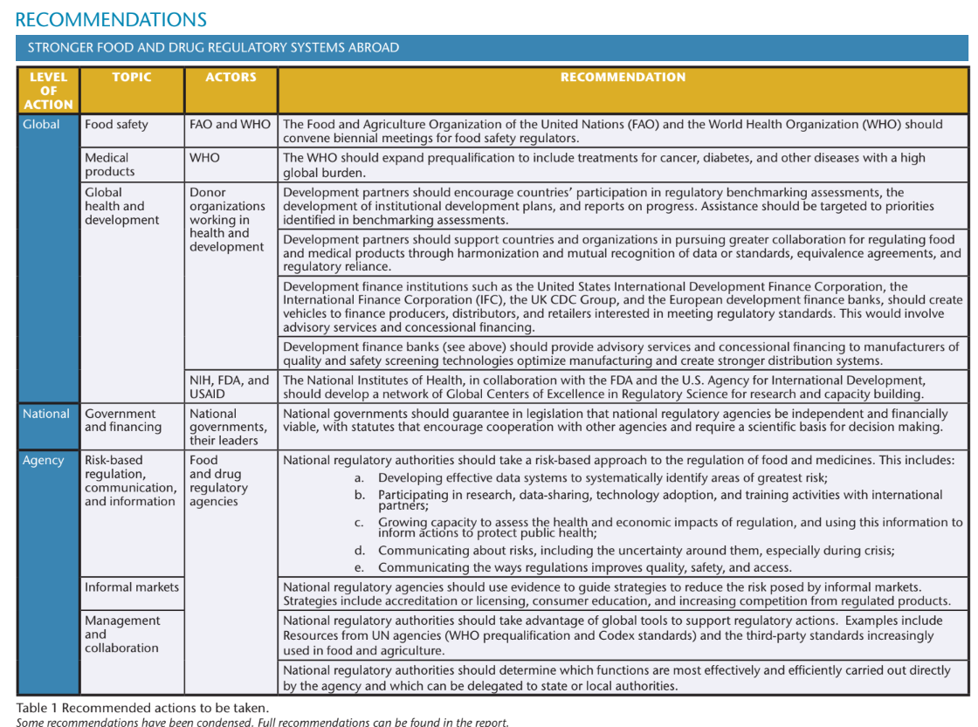

Slide 15
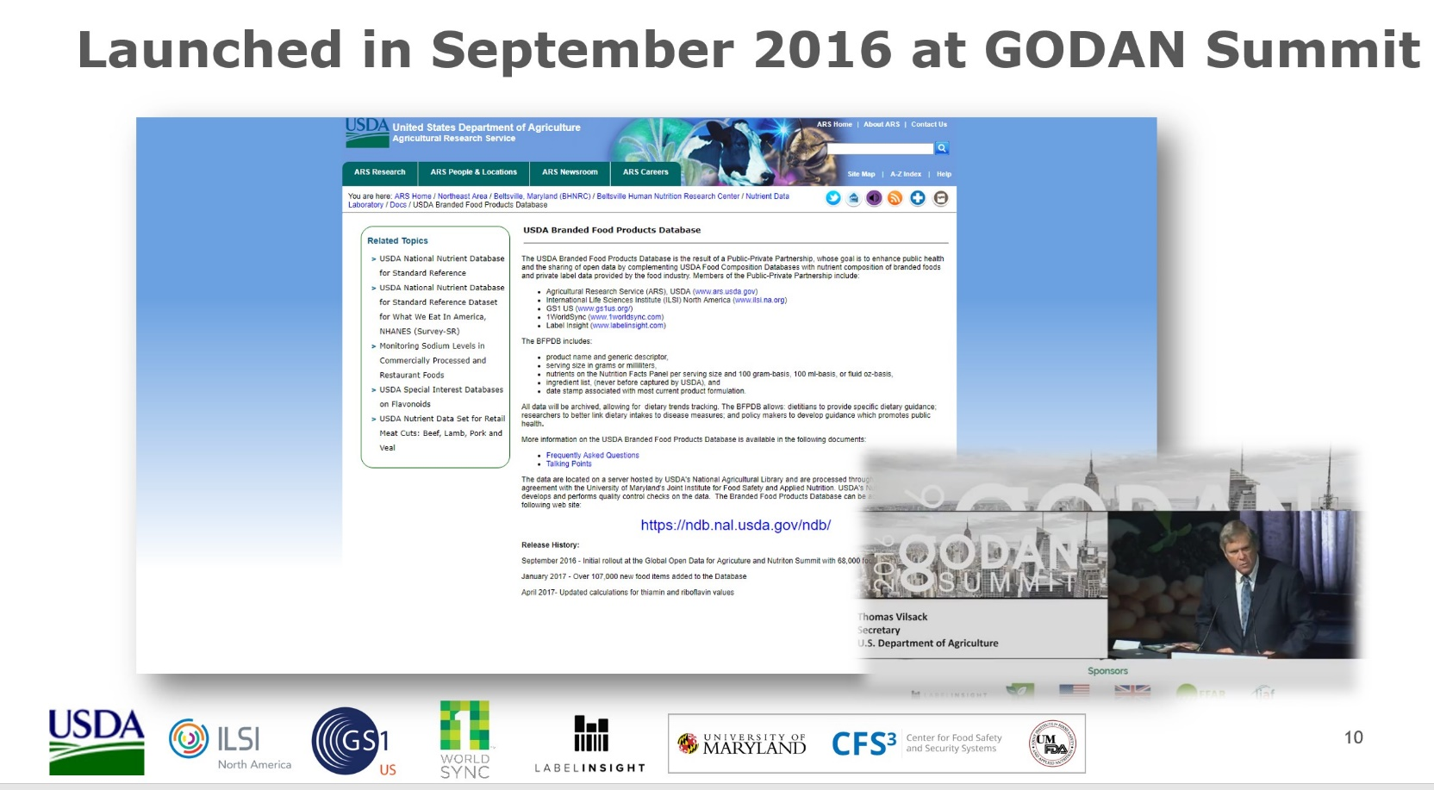
PPP formed in 2013 with the goal of enhancing public health and the sharing of open data by complementing the existing USDA Food Composition Databases with nutrient composition of branded foods and private label data;
Data Sharing Example: The Global
Branded Food Products Database
Today #1 most used application interface offered by the U.S. Gov with over 1.2 million users
Notes:
Global Open Data for Agriculture and Nutrition—Secretary Tom Vilsak had the honor.

Slide 16
What facilitated the success of the Global Branded Food Products Database PPP ?
A transparent, actionable framework to create the PPP;
A clearly defined and achievable goal to benefit the public;
A clear statement of work, rules, and partner roles, responsibilities, and accountability to build trust, transparency, and mutual respect;
Acknowledging upfront if there were “deal breakers” for the PPP; and
Clearly defined objectives that met public and private needs as a baseline to monitor progress and measure success.

Slide 17
It takes structure and design to get from A to B.
partnering
with
structure
and
design
A
B
CHALLENGE
VISION
RESULTS
IMPACT
Lots of options – topic, participants, level of formality, duration, politics, resources, etc.
Lots of business decisions – informed views, clear vision, agreed terms, etc.
Lots of room for good choices or poor choices and missed opportunities
Key words: Fit-for-purpose, sustainable, efficient, impactful.
There’s no one answer – it’s all contextual.

Slide 18

It’s about looking for synergies in the sweet spot.
symbiosis and synergies = from the Greek, living / working together
aligned and balanced mutualism,
mutually beneficial, mutually reinforcing

Slide 19

Motivations Incentives Benefits
Specific Interests Shared Interests Realized Interests
safe food
no spill-overs
strong market
private sector
Increase sales
public sector
Ensure safe food
Manage reputational risk
Improve brand
Avoid market failure
Benefits > costs
high compliance
verification
standards
efficient application
harmonization
prevention
training
Find the sweet spot
as partners.

Slide 20


Slide 21
FSMA is a market-driven regulatory framework – the public-private dialectic is already built in.
Food safety is not optional; either the market steps up or regs get stepped up.
Food safety is not about competition; everyone is interested in a preventive approach – fewer lives lost.
Sharing is essential for training, environmental monitoring, managing false positives, compliance, and best practices.
Food safety capacity building sharing is a
GLOBAL PUBLIC-PRIVATE GOOD.

Slide 22

If mandatory rules correct market failures,
can voluntary tools create market advantages?
Enter the PPP for sharing data to measure food safety capacity building impacts:
The Zero Version
TURNING REQUIREMENTS INTO OPPORTUNITIES

Slide 23
Zone of vulnerability
Last mile is always the hardest
Safe zone for sharing
Transparency without exposure
Strategic alignment around standards
Incentives for sustained sharing
Regulatory framework
Data sharing
Industry training
PPP
Data review
THE GREAT FEEDBACK LOOP
Safe
Food
FSMA Phase 3 M&E
The Sweet Spot
TURNING RISKS
INTO REWARDS

Slide 24
Next Steps
Widely circulate white paper “A Public-Private Partnership for Data Sharing on the Impact of Food Safety Capacity Building”
Publish shorter version for academia and FDA with proposed budget
Present idea to stakeholders at upcoming GFSI meetings
Hold listening sessions with interested stakeholders in DC side lines of ILSI-NA meeting, mid/west-west, and abroad
Develop plan forward with various subgroups
Incremental Approach: Start with focus on data sharing and database to avoid diluting efforts; keep open to adding related elements over time, including training and capacity building support.

Slide 25
Main messaging at GFSI
  There is a need to measure the impact of capacity building efforts
  Measuring the impact of training and capacity building efforts on food safety can:
    document and examine past efforts;
    Justify and galvanize future efforts;
    identify new focus/improvements for future efforts
Such efforts benefit everyone: consumers, producers, distributors, and regulators;
Improvement in food safety can result from collective attention to capacity building efforts by public and private sectors globally

Slide 26
Main messaging at GFSI (cont.)
Partnership is needed to measure the impact with existing data and to identify additional data needs
Public sector can work with public sector providers and inspectors; but the pictures is incomplete
Public sector can fund additional studies, but that costs tax payer money
Private sector already is collecting valuable data and duplicate efforts and funds to collect additional data is costly

Slide 27
Main messaging at GFSI (cont.)
Proposed partnership will begin by
Holding listening sessions with stakeholders to identify concerns and opportunities
Forming subgroups with specialist in public and private sector will be formed to develop solutions to concerns so as to facilitate data sharing

Slide 28
Main messaging at GFSI (cont.)
4. Data sharing principles
Data sharing will be voluntary;
Data will be open sourced
Data will be used in analysis to inform and refine future capacity building efforts (and possible regulatory requirements)

